Slide 1
Broadening Indigenous participation across the disciplines:
ATSIHEAC Indigenous Business Roundtable
Friday 12 June 2015
Professor Jill Milroy
Executive Member
Aboriginal and Torres Strait Islander
Higher Education Advisory Council
Notes:
Welcome
I would like to acknowledge the Traditional Owners of the land on which we meet today, and to pay my respects to its Elders, past and present, and to other Aboriginal and Torres Strait Islander people here today.
I would like to thank you all for taking the time to join us today for this important conversation.
And I would like to introduce… who will offer their Welcome to Country

Slide 2
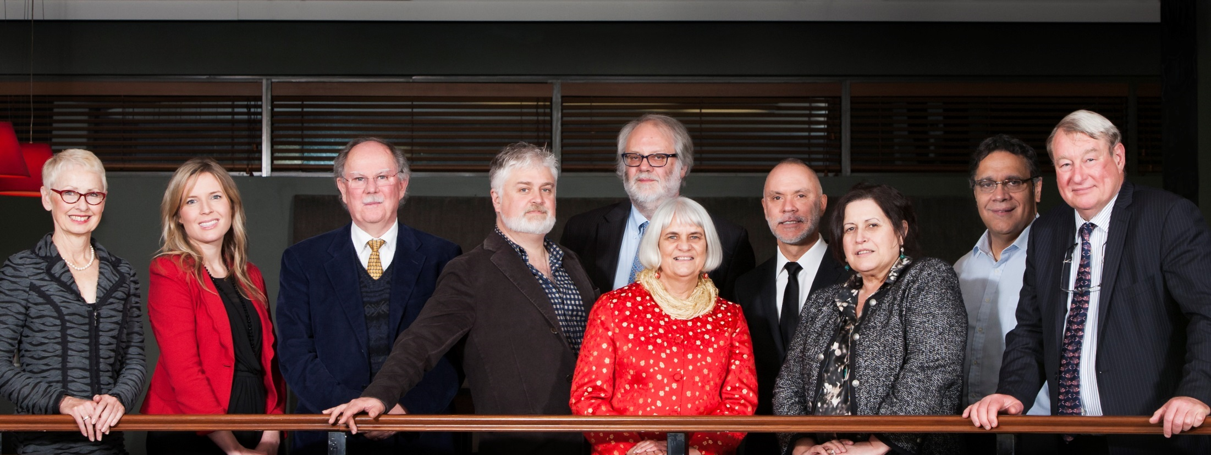
Aboriginal and Torres Strait Islander Higher Education Advisory Council
Notes:
About ATSIHEAC
The Council was established in 2012, following the Behrendt Review of Indigenous higher education
Membership comprises Indigenous academics, and individuals selected for their expertise in business, governance and university leadership
Universities Australia and the National Aboriginal and Torres Strait Islander Higher Education Consortium also send observers.
Current members
Professor Ian Anderson, University of Melbourne, Co-Chair and Executive Member
Professor Jill Milroy, University of Western Australia, Executive Member
Ms Rosie Southwood, Wesfarmers Limited, Executive Member
Professor Toni Downes, Charles Sturt University
Professor Sandra Eades, The University of Sydney
Professor Shane Houston, The University of Sydney
Professor Steven Larkin, Charles Darwin University
Professor Michael McDaniel, University of Technology, Sydney
Professor Michael McManus, The University of Queensland
Professor Andrew Wells, University of Tasmania
Professor Greg Hill, University of the Sunshine Coast
Ms Jillian Miller, University of South Australia
Mr Russell Taylor, Australian Institute of Aboriginal and Torres Strait Islander Studies [Observer]
Professor Peter Buckskin, Chair, NATSIHEC [Observer]

Slide 3
ATSIHEAC policy development framework
Broadening access across the disciplines
Whole of University Strategy
Academic Workforce
Sustainable financing
System level performance monitoring
Notes:
ATSIHEAC’s reform agenda
ATSIHEAC envisages a higher education sector where:
Indigenous people succeed across a broad range of disciplines. A simple focus on participation is not sufficient.
Indigenous knowledges and perspectives are valued and embedded across university business.
Indigenous people are represented at all levels of the academy, including in academic and decision-making roles.
Finance is sustainable and optimally configured to maximise outcomes.
Progress is monitored and reported at institutional and sectoral levels.

Slide 4
Why business?
11% of Indigenous people are employed in professional occupations, compared to 20% of non-Indigenous people
Most common occupation group for employed people:
For Indigenous people - Labourer (24%)
For non-Indigenous people - Professional (20%)
Participation clustered in three fields of study
Drawn from Census data 2006 and 2011
Notes:
The Behrendt Review
Higher education plays a significant part in Indigenous social and economic development and should be conceptualised as part of broader human capital strategy.
The Behrendt Review found that the clustering of Indigenous student participation within a narrow range of disciplines was working against access to professional careers.
It also reduces the capacity of non-Indigenous professionals to understand and incorporate Indigenous knowledges and perspectives.
According to the Census, Labourer is the most common occupation reported by Indigenous people, and only 11% of Indigenous people report being employed as professionals.
The Behrendt Review highlighted the role of faculties in students’ professional preparation.
It recommended faculties work with professional bodies, employers and communities to drive growth in the number and breadth of Indigenous professionals.
ATSIHEAC has identified business and the STEM disciplines as priorities for action.
[Source for figures on slide: Anderson, I, 2011. Indigenous Pathways into the Professions, University of Melbourne]

Slide 5
Undergraduate enrolments by Indigenous status, 2010–13
 | 2010 | 2011 | 2012 | 2013
Indigenous
M&C enrolments | 884 | 1,066 | 1,042 | 1,123
All enrolments | 8,273 | 8,879 | 9,461 | 10,342
Percentage of all enrolments that were in M&C | 10.7 | 12.0 | 11.0 | 10.9
Non-Indigenous
M&C enrolments | 121,501 | 121,805 | 125,631 | 129,870
All enrolments | 616,570 | 639,604 | 676,000 | 713,350
Percentage of all enrolments that were in M&C | 19.7 | 19.0 | 18.6 | 18.2
Source: Australian Government Department of Education, Higher Education Statistics Collection
Notes:
Business-Related Studies and Indigenous Australian Students
The Centre for Aboriginal Economic Policy Research (CAEPR) was commissioned to provide analyse of key data relating to Indigenous participation and success in business higher education and employment outcomes.
Their research included consultation with business schools and Indigenous programs at a sample of 15 universities, regarding current practice relating to recruiting and supporting Indigenous students.
The following tables and charts are taken from CAEPR’s report and a seminar on their findings held on 27 May.
Undergraduate enrolments by Indigenous status, 2010–13
There has been strong growth in the number of Indigenous enrolments in Management and Commerce in recent years – from 884 in 2010 to 1123 in 2013.
But the share of all enrolments in that broad field by Indigenous students has remained fairly stable at around 11%, compared to more than 18% for non-Indigenous students.

Slide 6
Indigenous award completions by level, 2001–13
Level of course | 2001 | 2006 | 2010 | 2012 | 2013
Doctorate | 8 | 18 | 30 | 28 | 32
Masters | 96 | 118 | 165 | 198 | 232
Graduate diploma | 136 | 161 | 219 | 253 | 276
Bachelor degree | 600 | 869 | 921 | 985 | 1,189
Associate degree | 19 | 57 | 61 | 57 | 73
Diploma/other | 186 | 137 | 41 | 106 | 57
All Indigenous award completions | 1,045 | 1,360 | 1,437 | 1,627 | 1,859
Source: Australian Government Department of Education, Higher Education Statistics Collection
Notes:
Indigenous award completions by level, 2001–13
There has been a significant increase in the number of Indigenous completions in Management and Commerce – from a total of 1045 completions at all levels in 2001 to 1859 in 2013.
The growth has been strongest at the Bachelor level, which doubled over that period.

Slide 7
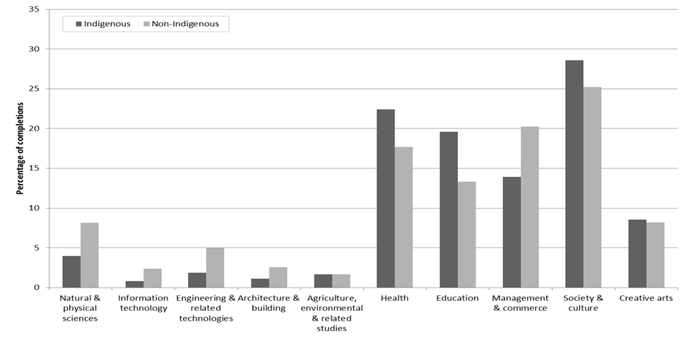
Award completions by field of study by Indigenous status, 2010–12
Notes:
Award completions by field of study by Indigenous status, 2010–12
However, Indigenous students are still significantly under-represented in award completions in Management and Commerce compared to non-Indigenous students – a gap of around 6 percentage points for the period 2010-2012.

Slide 8
Enrolments in enabling courses for Management and Commerce & other fields of study, 2010–13
Type of enabling course | 2010 | 2011 | 2012 | 2013
Indigenous
Management & commerce | <5 | <5 | 0 | <5
All fields | 1,008 | 962 | 1,137 | 1,236
Non-Indigenous
Management & commerce | 61 | 73 | 81 | 99
All fields | 14,750 | 15,973 | 17,627 | 19,700
Source: Australian Government Department of Education, Higher Education Statistics Collection
Notes:
Enrolments in enabling courses for Management and Commerce & other fields of study, 2010–13
The CAEPR analysis found that there was a very low participation rate by both Indigenous and non-Indigenous students in enabling courses for Management and Commerce.
This might reflect the fact that most enabling courses focus on general skills, such as literacy.
The need for discipline-specific enabling courses may be an area for further consideration by business faculties and Indigenous program areas.
There is strong demand generally from Indigenous students for enabling courses run by universities.

Slide 9
Award completions by detailed field of study, 2010–12
 | Indigenous |  | Non-Indigenous
 | Post-graduate | Undergraduate | Postgraduate | Undergraduate
Percentage
General M&C | 2.4 | 7.9 | 4.3 | 16.7
Accounting | 4.9 | 24.0 | 9.6 | 10.9
Business & management | 82.0 | 47.6 | 68.1 | 51.1
Sales & marketing | 5.8 | 4.3 | 6.1 | 7.3
Tourism | np | np | np | np
Office studies | np | np | np | np
Banking, finance & related fields | np | np | 7.4 | 4.1
Other M&C | 2.9 | 15.0 | 4.7 | 11.0
Total M&C | 100.0 | 100.0 | 100.0 | 100.0
Number
Total M&C | 206 | 466 | 41,447 | 72,430
Economics & econometrics | <5 | 5 | 952 | 4,797
Source: Australian Government Department of Education, Higher Education Statistics Collection
Notes:
Award completions by detailed field of study, 2010–12
Award completions by Indigenous and non-Indigenous students at the undergraduate level were particularly concentrated in the narrow field of Business and Management, Accounting and Other Management and Commerce.
The proportion of Indigenous completions in Accounting for the period 2010-2013 was more than twice that for non-Indigenous students.

Slide 10
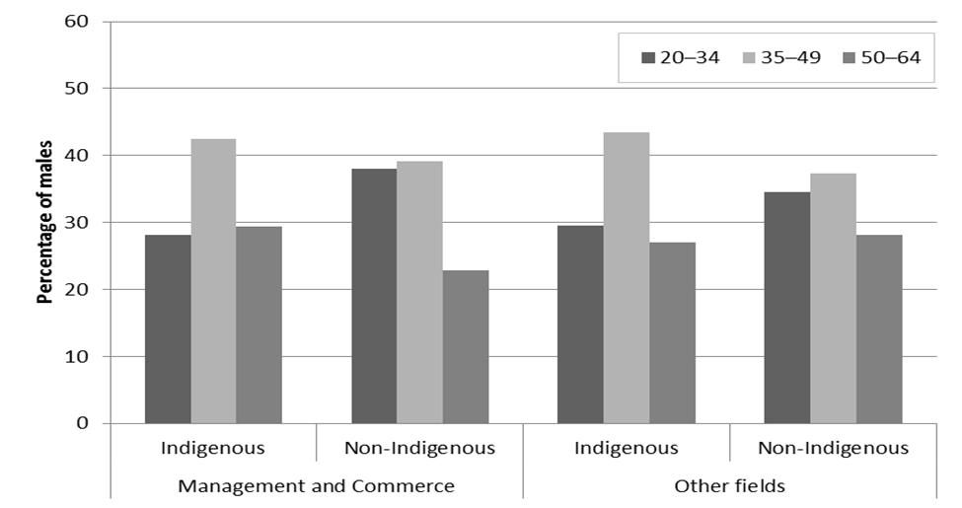
Males with bachelor or above by age & field of study, 2011
Source: 2011 Census accessed using Tablebuilder
Notes:
Males with bachelor or above by age, field of study & Indigenous status, 2011
Indigenous students tend to enrol in higher education at a later age than their non-Indigenous counterparts.
The age structure tends to be similar for Management and Commerce and other fields…

Slide 11
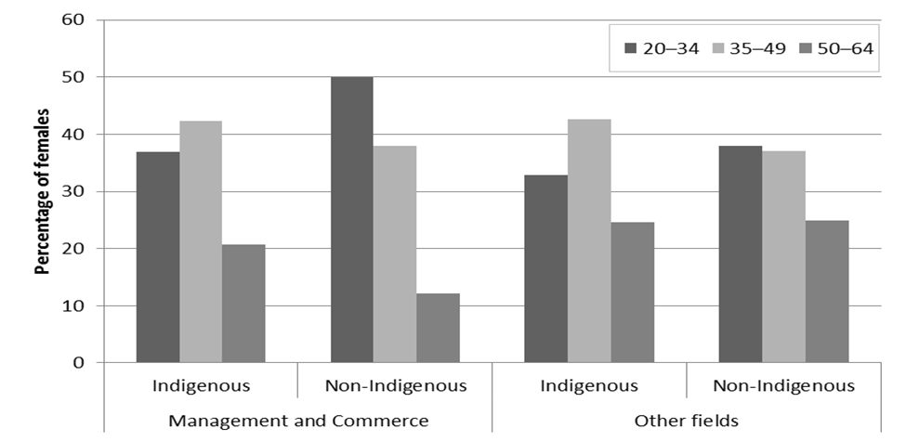
Females with bachelor or above by age & field of study, 2011
Source: 2011 Census accessed using Tablebuilder
Notes:
Females with bachelor or above by age, field of study & Indigenous status, 2011
Although female Indigenous students are slightly more inclined to enrol earlier than male.

Slide 12
Labour force status for males aged 20–64 with bachelor degree by field of study, 2011
Field of study | Employed (%) | Unemployed (%) | Not in labour force (%) | Total (%)
Indigenous
Management & commerce | 88.9 | 3.4 | 7.7 | 100.0
Other | 84.9 | 4.4 | 10.6 | 100.0
Total | 85.6 | 4.3 | 10.1 | 100.0
Non-Indigenous
Management & commerce | 90.0 | 3.4 | 6.6 | 100.0
Other | 88.7 | 2.9 | 8.4 | 100.0
Total | 89.1 | 3.0 | 7.9 | 100.0
Source: 2011 Census accessed using Tablebuilder
Notes:
Labour force status for males aged 20–64 with bachelor degree by field of study, 2011
Indigenous graduates enjoy good employment prospects, particularly those graduating in Management and Commerce.

Slide 13
Labour force status for females aged 20–64 with bachelor degree by field of study, 2011
Field of study | Employed (%) | Unemployed (%) | Not in labour force (%) | Total (%)
Indigenous
Management & commerce | 86.0 | 2.4 | 11.6 | 100.0
Other | 82.8 | 2.8 | 14.4 | 100.0
Total | 83.1 | 2.8 | 14.1 | 100.0
Non-Indigenous
Management & commerce | 80.6 | 3.9 | 15.5 | 100.0
Other | 81.3 | 2.5 | 16.1 | 100.0
Total | 81.2 | 2.8 | 16.0 | 100.0
Source: 2011 Census accessed using Tablebuilder
Notes:
Labour force status for females aged 20–64 with bachelor degree by field of study, 2011
Indigenous female graduates do even better than their non-Indigenous counterparts in terms of employment outcomes.

Slide 14
Labour force status for recent graduates aged 20–64 by field of study, 2010–12
Field of study | Working or accepted a job offer (%) | Not working, looking for work (%) | Neither working nor looking for work (%) | Total (%)
Indigenous
Management & commerce | 86.1 | 6.3 | 7.6 | 100.0
Total | 84.6 | 7.5 | 7.9 | 100.0
Non-Indigenous
Management & commerce | 72.2 | 15.2 | 12.6 | 100.0
Total | 77.5 | 11.2 | 11.4 | 100.0
Source: Graduate Careers Australia, Australian Graduate Survey
Notes:
Labour force status for recent graduates aged 20–64 by field of study, 2010–12
The employment outcomes of recent Indigenous graduates (as measured by the Graduate Survey) are even more pronounced, irrespective of field of study.

Slide 15
Current practice – consultations with 15 universities
What are the minimum entry requirements for your business degrees?
Do you have an alternative Indigenous entry program ?
Does your university have an Indigenous foundation, or Indigenous university preparation program or associate degree? Does this include business-related studies?
Do your Indigenous business students access the Indigenous Tutorial Assistance Scheme?
What would attract more Indigenous students into business studies?
What support do Indigenous students require in business degrees?
What do you think are the impediments to Indigenous students enrolling in business degrees
Notes:
Current practice – consultation with 15 universities
Universities were consulted by the researchers on a number issues relating to current practice.
They were asked about:
Entry requirements
Alternative entry programs
Indigenous preparatory programs
Support for Indigenous students
Barriers
Enablers

Slide 16
Current practice – summary remarks
Support centres are important factor in student success
Mode of teaching can play a role
Working with industry provides Indigenous role models
Students may need support to build basic competencies
Increasing Indigenous participation in business studies and related professions supports Indigenous business and economic development
Notes:
Current practice – findings
The researchers made a number of observations drawn from their discussions with universities.
They found that Indigenous support centres are an important factor in student success.
Mode of teaching can play a role in increasing Indigenous participation and success.
Working with industry can create more employment opportunities and provide Indigenous role models (as is occurring in accountancy).
Indigenous students may need additional support to build basic competencies required for completing their studies.
Increasing Indigenous participation in business-related studies and related professions is integral to supporting the rapidly expanding Indigenous business sector, and creating opportunities for economic development for Indigenous communities.

Slide 17
What can be done?
Notes:
What can be done?
The purpose of today’s roundtable discussion is to start the conversation.
You will be invited to consider what strategies you have at your disposal within your sphere of influence to support change.
As we’ve seen in other disciplines, sharing ideas about good practice is a good place to start.
I look forward to engaging in a productive conversation with you today.

Slide 18
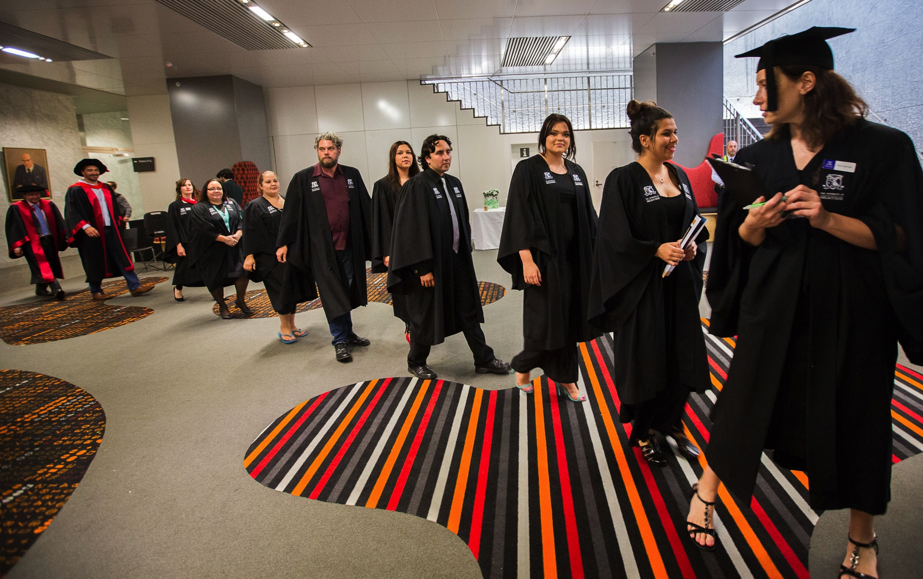
Thank you

