Slide 1
Growing an Indigenous professional workforce: the national agenda for change
Aboriginal and Torres Strait Islander Mathematics Alliance
National Conference 10 November 2014
Professor Ian Anderson
Co-Chair
Aboriginal and Torres Strait Islander
Higher Education Advisory Council
Notes:
Introduction
I would like to pay my respects to the traditional owners of this country, the Kaurna people [pronounced: gowna], and their elders past and present, and to Uncle Lewis O’Brien for his welcome to country.
I’d also like to pay my respects to other Aboriginal and Torres Strait Islander people here today.
I’m delighted to be here today and to have the opportunity to talk to you about the work of my council – the Aboriginal and Torres Strait Islander Higher Education Advisory Council – particularly its work to shape the national agenda for Indigenous participation in STEM educ.

Slide 2
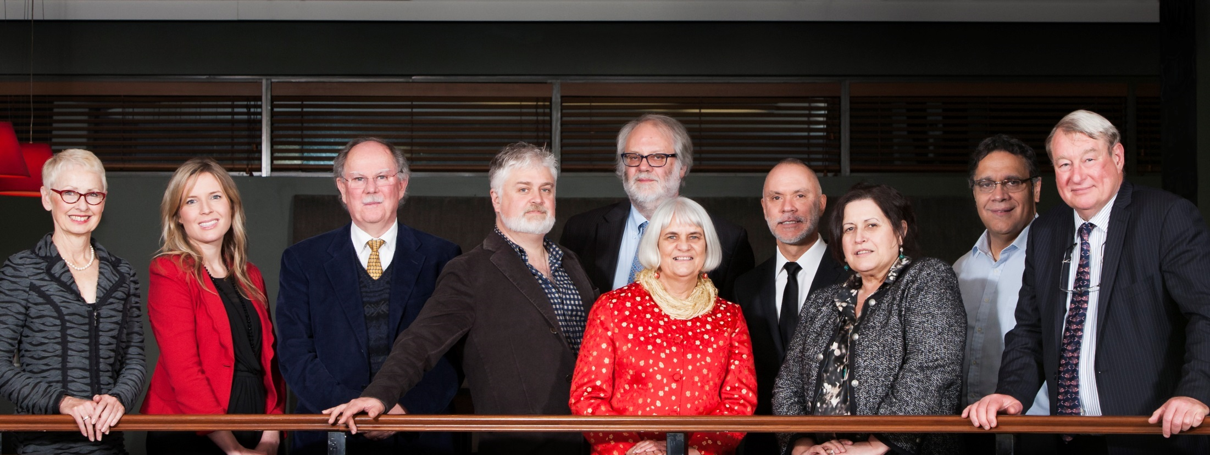
Aboriginal and Torres Strait Islander Higher Education Advisory Council
Notes:
About ATSIHEAC
The Council was established in 2012, following the Review of Higher Education Access and Outcomes for Aboriginal and Torres Strait Islander People, which was led by Professor Larissa Behrendt.
Council’s role is to provide independent advice to the Australian Government on Indigenous higher education, including progressing the agenda set by the Review.
Membership comprises Indigenous academics, and individuals selected for their expertise in business, governance and university leadership.
Universities Australia and the National Aboriginal and Torres Strait Islander Higher Education Consortium also send observers.
Current members
Professor Ian Anderson, University of Melbourne, Co-Chair and Executive Member
Professor Jill Milroy, University of Western Australia, Executive Member
Ms Rosie Southwood, Wesfarmers Limited, Executive Member
Professor Toni Downes, Charles Sturt University
Professor Sandra Eades, The University of Sydney
Professor Shane Houston, The University of Sydney
Professor Steven Larkin, Charles Darwin University
Professor Michael McDaniel, University of Technology, Sydney
Professor Michael McManus, The University of Queensland
Professor Andrew Wells, University of Tasmania
Professor Greg Hill, University of the Sunshine Coast
Ms Jillian Miller, University of South Australia
Mr Russell Taylor, Australian Institute of Aboriginal and Torres Strait Islander Studies [Observer]
Professor Peter Buckskin, Chair, NATSIHEC [Observer]

Slide 3
ATSIHEAC policy development framework
Broadening access across the disciplines
Whole of University Strategy
Academic Workforce
Sustainable financing
System level performance monitoring
Notes:
ATSIHEAC’s reform agenda
ATSIHEAC envisages a higher education sector where:
Indigenous people succeed across a broad range of disciplines. A simple focus on participation is not sufficient.
Indigenous knowledges and perspectives are valued and embedded across university business.
Indigenous people are represented at all levels of the academy, including in academic and decision-making roles.
Finance is sustainable and optimally configured to maximise outcomes.
Progress is monitored and reported at institutional and sectoral levels.

Slide 4
Broadening participation across the disciplines
11% of Indigenous people are employed in professional occupations, compared to 20% of non-Indigenous people
Most common occupation group for employed people:
For Indigenous people - Labourer (24%)
For non-Indigenous people - Professional (20%)
Drawn from Census data 2006 and 2011
Notes:
Review of Higher Education Access and Outcomes for Aboriginal and Torres Strait Islander People
Higher education plays a significant part in Indigenous social and economic development and should be conceptualised as part of broader human capital strategy.
The Review found that the clustering of Indigenous student participation within a narrow range of disciplines was working against access to professional careers.
It also reduces the capacity of non-Indigenous professionals to understand and incorporate Indigenous knowledges and perspectives.
According to recent Census data, Labourer is the most common occupation reported by Indigenous people, and only 11% of Indigenous people report being employed as professionals.
The Review highlighted the role of faculties in students’ professional preparation.
It recommended faculties work with professional bodies, employers and communities to drive growth in the number and breadth of Indigenous professionals.

Slide 5
Indigenous enrolments in STEM disciplines
Field of education | Indigenous enrolments 2013 | Growth since 2005 | Proportion of total enrolments in this field | Parity target
Natural & Physical Sciences | 719 | 116% | 0.67% | 2,896
Information Technology | 197 | 49% | 0.38% | 1,411
Engineering & Related Technologies | 362 | 160% | 0.37% | 2,641
Mathematical Sciences | 24 | 300% | 0.55% | 119
Notes:
Indigenous enrolments in STEM disciplines
The next couple of slides provide a snapshot of how the higher education sector is faring in attracting and supporting Indigenous students in STEM disciplines, including Mathematical Sciences.
It includes:
Indigenous enrolments for 2013 in Science, Information Technology, Engineering and Mathematics.
Growth in Indigenous enrolments in each of these areas since 2005.
Indigenous enrolments in each area as a proportion of total enrolments in that area.
The number of Indigenous enrolments we would need in order to achieve parity with population share.
Indigenous enrolments have risen significantly in all STEM disciplines since 2005.
This is particularly the case in Mathematical Sciences, which has experienced a 300% increase (but from a very low base).
In Mathematics, Indigenous enrolments were still well below parity in 2013.
Indigenous students accounted for only 0.55% of all Mathematics enrolments.
Indigenous people account for 2.7% of the working age population. To achieve parity, Mathematics would require 119 Indigenous enrolments (we achieved only 24 in 2013).
Indigenous enrolments in Mathematics were clustered into 11 universities (only 3 of these accounted for more than half of Indigenous enrolments).

Slide 6
Indigenous completions in STEM disciplines
Field of education | Indigenous completions 2013 | Growth since 2005 | Proportion of total completions in this field | Parity target
Natural & Physical Sciences | 85 | 70% | 0.39% | 593
Information Technology | 22 | 144% | 0.19% | 314
Engineering & Related Technologies | 35 | 84% | 0.19% | 494
Mathematical Sciences | <5 | 50% | 0.32% | 25
Notes:
Indigenous completions in STEM disciplines
This table shows how the sector is faring in supporting Indigenous student completions in the STEM disciplines, including Mathematical Sciences.
It includes:
Indigenous completions for 2013 in Science, Information Technology, Engineering and Mathematics.
Growth in Indigenous completions in each of these areas since 2005.
Indigenous completions in each area as a proportion of total enrolments in that area.
The number of Indigenous completions we would need in order to achieve parity with population share.
Indigenous completions have risen significantly in all STEM disciplines since 2005, albeit from a low base.
In Mathematics, Indigenous completions were negligible and well below parity.
Indigenous completions increased by 50% since 2005.
Indigenous students accounted for only 0.32% of Maths completions.
To achieve population parity, Mathematics would require 25 Indigenous completions (we achieved less than 5 in 2013).
All Indigenous completions in Mathematics occurred in only 3 universities in 2013.

Slide 7
Student performance on standardised tests
Standardised tests: PISA, TIMMS, PIRLS, NAPLAN
Indigenous students achieve well below non-Indigenous (by between 1.5 and 1.0 standard deviations)
Little change in the gap over time
Differences evident in Year 3 & remain until Year 9 or age 15
Source: Thomson, S. et al 2014, Indigenous Student Performance on Standardised Tests, (draft report to ATSIHEAC)
Notes:
Student proficiency levels
It will come as no surprise to you that participation in STEM subjects at university level is hampered by a significant gap in student proficiency in related learning areas in the school years.
We have commissioned the Australian Council for Educational Research to analyse Indigenous data from key standardised tests.
The tests are:
PISA – The Programme for International Student Assessment
TIMMS – The Trends in International Mathematics and Science Study
PIRLS – The Progress in International Reading Literacy Study
NAPLAN – The National Assessment Program – Literacy and Numeracy.
These assessments cover students in Years 3, 5, 7 and 9, and samples of students in Year 4 or Year 8, or aged 15.
The following slides are taken from ACER’s draft report.
PISA
In mathematical literacy 15 year-old Indigenous students were more than 2.5 years behind their non-Indigenous peers.
Indigenous students were underrepresented at the higher end of the mathematical literacy proficiency scale and overrepresented at the lower end.
There was no change in the difference between Indigenous and non-Indigenous students over time.
This chart shows performance on the science literacy tasks of PISA 2012 for both Indigenous and non-Indigenous students.
The numbers at the high performance end are difficult to read because some of them are so small…
Of the Indigenous students, only 2% performed at Level 5 and a negligible proportion performed at Level 6.
Of the non-Indigenous students, 11% performed at Level 5 and 2% performed at Level 6.

Slide 8
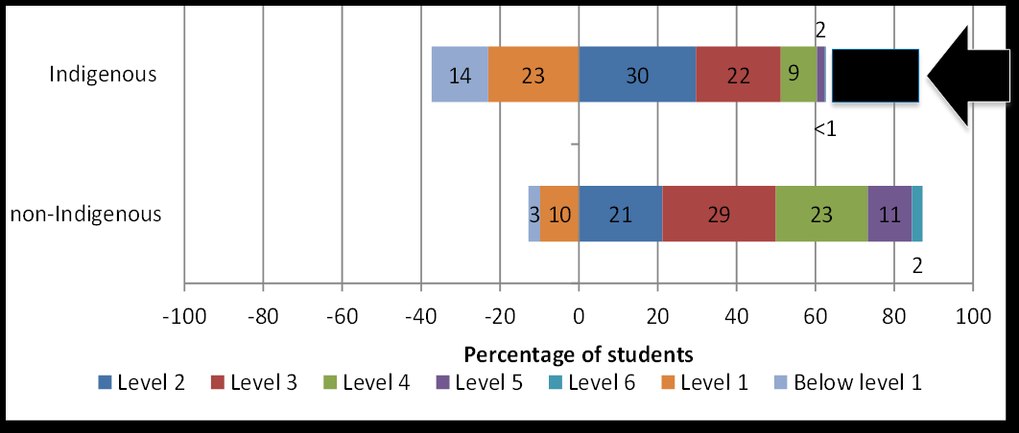
PISA 2012 science literacy proficiency
Source: Thomson, S. et al 2014, Indigenous Student Performance on Standardised Tests, (draft report to ATSIHEAC)
Notes:
PISA 2012 science literacy proficiency
In PISA scientific literacy, the difference in scores between Indigenous and non-Indigenous students equates to about 2.5 years of schooling.
37% of Indigenous students were low performers in scientific literacy compared to 13% of non-Indigenous.
Indigenous students were underrepresented at the higher end of the science literacy proficiency scale and overrepresented at the lower end.
The performance of Indigenous and non-Indigenous students in scientific literacy has not changed significantly between PISA 2006 and PISA 2012.
This chart shows performance on the science literacy tasks in PISA 2012.
The numbers at the high performance end are difficult to read because some of them are so small…
Of the Indigenous students, only 2% performed at Level 5 and a negligible proportion performed at Level 6.
Of the non-Indigenous students, 11% performed at Level 5 and 2% performed at Level 6.

Slide 9
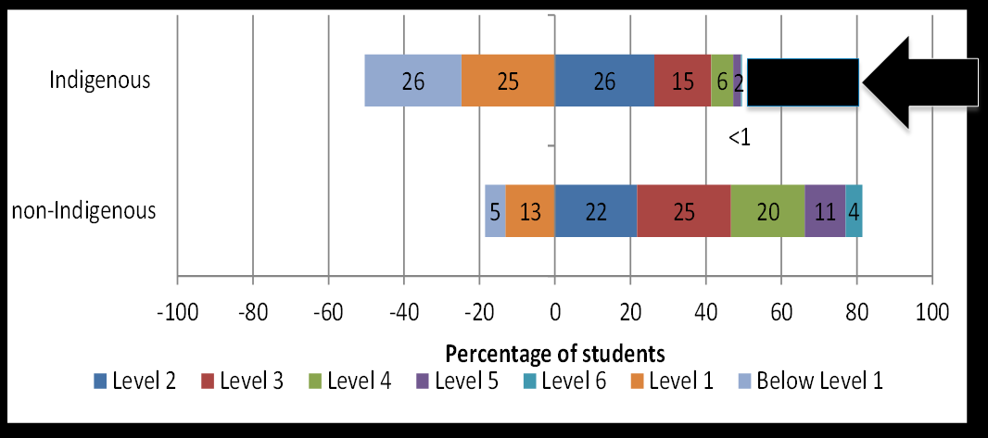
PISA 2012 mathematical literacy proficiency
Source: Thomson, S. et al 2014, Indigenous Student Performance on Standardised Tests, (draft report to ATSIHEAC)
Notes:
PISA 2012 mathematical literacy proficiency
In mathematical literacy, the performance of 15 year-old Indigenous students equates to more than 2.5 years behind their non-Indigenous peers.
Indigenous students were underrepresented at the higher end of the mathematical literacy proficiency scale and overrepresented at the lower end.
Change over time:
Indigenous students’ mean scores remained constant from PISA 2003 to PISA 2009.
Indigenous students’ mean scores were significantly lower in PISA 2012 than in 2003 (23 points on average).
Non-Indigenous students’ mean scores have been decreasing since PISA 2003, with a significant decline from PISA 2003 to PISA 2012 (19 points on average).
Mathematical literacy performance for Indigenous students remained constant from PISA 2003 to PISA 2009. In PISA 2012, Indigenous students achieved a mean score of 417 points, which was significantly lower, by 23 score points on average, than the mean mathematical literacy score in PISA 2003 (see Table 23). The average mathematical literacy performance for non-Indigenous students has been decreasing since PISA 2003, with a significant decline of 19 score points on average between PISA 2003 and PISA 2012.
In mathematics the gap at the high end is even greater than in science literacy.
This chart shows performance on the mathematics literacy tasks in PISA 2012.
Of the Indigenous students, only 2% performed at Level 5 and 0.3% performed at Level 6.
Of the non-Indigenous students, 11% performed at Level 5 and 4% performed at Level 6.

Slide 10
NAPLAN Numeracy proficiency 2008 - 2013
No change in % of Indigenous students at or above national minimum standard in Years 3, 5 & 7, decrease in Year 9
Some positive change in mean scores for all students in Years 3 & 5 in jurisdictions with higher proportion Indigenous students, but not significant for Indigenous students.
Indigenous students made gains from Year 3 to Year 7 & from Year 5 to Year 9 similar to non-Indigenous students.
Source: Thomson, S. et al 2014, Indigenous Student Performance on Standardised Tests, (draft report to ATSIHEAC)
Notes:
NAPLAN Numeracy 2008 to 2013
Results for NAPLAN Numeracy between 2008 and 2013 indicate no change in % of Indigenous students at or above the national minimum standard in Years 3, 5 and 7, and a decrease in Year 9.
There have been some statistically significant, positive changes in the mean scores for all students in Years 3 and 5 in jurisdictions with higher proportions of Indigenous students, but the changes are not recorded as significant for Indigenous students.
Indigenous students have made gains in NAPLAN numeracy from Year 3 to Year 7 and from Year 5 to Year 9 that are similar to the gains made by non-Indigenous students in the same cohorts.

Slide 11
TIMSS mathematics proficiency 1995 to 2011
Year 4
Over 50% of Indigenous students didn’t reach Intermediate benchmark
28% of Indigenous students didn’t reach Low benchmark
Year 8
1% of Indigenous students achieved Advanced benchmark
9% of non-Indigenous students achieved Advanced benchmark
32% of Indigenous students didn’t reach Low benchmark
9% of non-Indigenous students didn’t reach Low benchmark
No change in Indigenous student performance 1995 to 2011
Source: Thomson, S. et al 2014, Indigenous Student Performance on Standardised Tests, (draft report to ATSIHEAC)
Notes:
TIMSS Mathematics proficiency 1995 to 2011
Year 4
Indigenous students in Year 4 are more likely to be at or below the Intermediate International Benchmark.
Non-Indigenous students are generally closer to the High International Benchmark.
More than 50% of Indigenous students in Year 4 did not reach the Intermediate benchmark, including 28% who did not reach the Low International Benchmark.
Year 8
Only 1% of Indigenous students in Year 8 achieved the Advanced benchmark, compared to 9% of non-Indigenous students.
32% of Year 8 Indigenous students did not reach the Low benchmark, compared to 9% of non-Indigenous students.
Comparisons of TIMSS data between 1995 and 2011 indicate no change in mathematics performance among Indigenous students in Year 8.

Slide 12
The national challenge
The gap in STEM proficiency & participation persists over time
Better school retention & general performance are not sufficient to effect real change on their own
A national approach to Indigenous STEM is required
Notes:
The national challenge
There is a yawning gap between the experiences of Indigenous and non-Indigenous students in STEM education.
The maths and science proficiency of Indigenous school students is well below that of their non-Indigenous peers.
The rates at which Indigenous people access and succeed at STEM in higher education are well below parity.
These gaps have resisted improvement, even in the face of increasing school retention rates and overall student performance.
This is not translating into the high performance required for transition to higher education and STEM-based professions.
A particular challenge for schools, universities and education policy makers is to improve outcomes for the highest performing students – the top 25% of Indigenous students.

Slide 13
A national Indigenous STEM agenda
ATSIHEAC STEM Roundtable:
Collaborate with Deans of STEM
Leverage the national policy agenda
Chief Scientist’s push for a sensible debate on the future
Incremental change is not sufficient for Indigenous Australia
Building a national approach to Indigenous STEM
Notes:
A national Indigenous STEM agenda
In December last year, ATSIHEAC commenced a roundtable discussion with key players.
Participants recommended strategies for action. In particular:
Collaborating with Deans of STEM in the university sector to improve the participation and success of Indigenous students
Leveraging the national policy agenda to support Indigenous STEM education and transition to the professions.
Throughout 2014, I’ve met with most of the peak bodies representing the Deans of STEM.
Those conversations are helping to inform the development of ATSIHEAC’s STEM agenda.
In the policy space, I have commenced a dialogue with the Chief Scientist.
I’m keen to build on the momentum Professor Chubb has created with the release of his proposal for a national approach to STEM.
He has secured Government support for a more strategic approach – to position STEM within national economic policy.
I support his view that Australia needs to shift away from an incrementalist mindset and have a sensible debate on the future.
This applies equally to improving Indigenous access to the economic and professional life of this nation.
Incremental change will not see improvement for Indigenous people within our lifetimes.
I applaud the work that ATSIMA is doing to promote the national debate.
I look forward to your contribution to building a national approach to Indigenous STEM education.

Slide 14
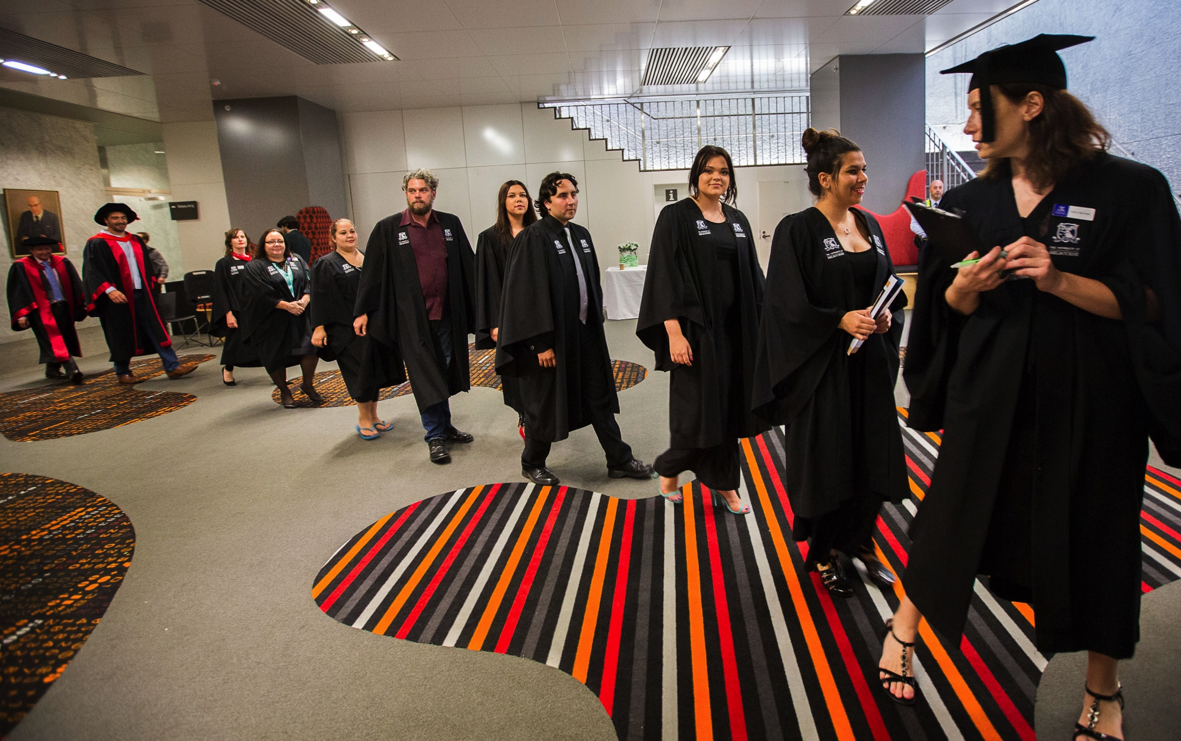
Thank you

