Slide 1
Broadening Indigenous participation across the disciplines:
Australian Council of Deans of Education
Annual Conference September 2014
Professor Ian Anderson
Co-Chair
Aboriginal and Torres Strait Islander
Higher Education Advisory Council

Slide 2
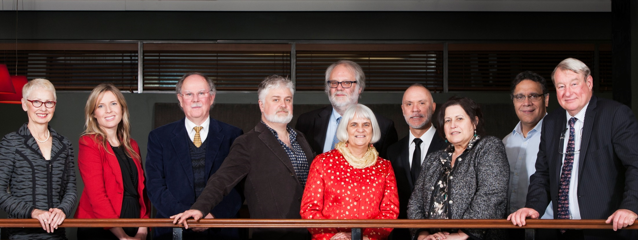
Aboriginal and Torres Strait Islander Higher Education Advisory Council
Notes:
About ATSIHEAC
The Council was established in 2012, following the Behrendt Review of Indigenous higher education
Membership comprises Indigenous academics, and individuals selected for their expertise in business, governance and university leadership
Universities Australia and the National Aboriginal and Torres Strait Islander Higher Education Consortium also send observers.
Current members
Professor Ian Anderson, University of Melbourne, Co-Chair and Executive Member
Professor Jill Milroy, University of Western Australia, Executive Member
Ms Rosie Southwood, Wesfarmers Limited, Executive Member
Professor Toni Downes, Charles Sturt University
Professor Sandra Eades, The University of Sydney
Professor Shane Houston, The University of Sydney
Professor Steven Larkin, Charles Darwin University
Professor Michael McDaniel, University of Technology, Sydney
Professor Michael McManus, The University of Queensland
Professor Andrew Wells, University of Tasmania
Professor Greg Hill, University of the Sunshine Coast
Ms Jillian Miller, University of South Australia
Mr Russell Taylor, Australian Institute of Aboriginal and Torres Strait Islander Studies [Observer]
Professor Peter Buckskin, Chair, NATSIHEC [Observer]

Slide 3
ATSIHEAC policy development framework
Broadening access across the disciplines
Whole of University Strategy
Academic Workforce
Sustainable financing
System level performance monitoring
Notes:
ATSIHEAC’s reform agenda
ATSIHEAC envisages a higher education sector where:
Indigenous people succeed across a broad range of disciplines. A simple focus on participation is not sufficient.
Indigenous knowledges and perspectives are valued and embedded across university business.
Indigenous people are represented at all levels of the academy, including in academic and decision-making roles.
Finance is sustainable and optimally configured to maximise outcomes.
Progress is monitored and reported at institutional and sectoral levels.

Slide 4
Why STEM?
11% of Indigenous people are employed in professional occupations, compared to 20% of non-Indigenous people
Most common occupation group for employed people:
For Indigenous people - Labourer (24%)
For non-Indigenous people - Professional (20%)
Participation clustered in three fields of study
STEM education critical to enhancing broader range of educational and employment opportunity
Drawn from Census data 2006 and 2011
Notes:
The Behrendt Review
Higher education plays a significant part in Indigenous social and economic development and should be conceptualised as part of broader human capital strategy.
The Behrendt Review found that the clustering of Indigenous student participation within a narrow range of disciplines was working against access to professional careers.
It also reduces the capacity of non-Indigenous professionals to understand and incorporate Indigenous knowledges and perspectives.
According to recent Census data, Labourer is the most common occupation reported by Indigenous people, and only 11% of Indigenous people report being employed as professionals.
The Behrendt Review highlighted the role of faculties in students’ professional preparation.
It recommended faculties work with professional bodies, employers and communities to drive growth in the number and breadth of Indigenous professionals.
ATSIHEAC has identified science, technology, engineering and mathematics (or STEM) as a priority for action. We will also be looking at business-related disciplines.
[Source for figures on slide: Anderson, I, 2011. Indigenous Pathways into the Professions, University of Melbourne]

Slide 5
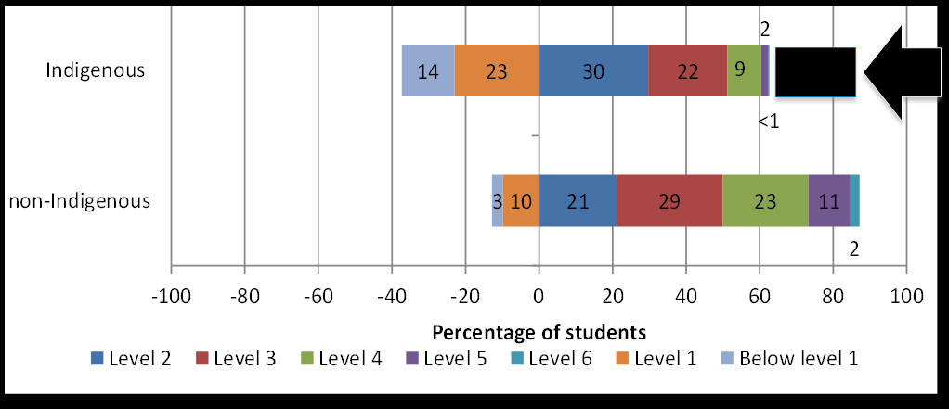
PISA 2012 science literacy proficiency
Source: Thomson, S. et al 2014, Indigenous Student Performance on Standardised Tests, (draft report to ATSIHEAC)
Notes:
PISA 2012 data
We have commissioned the Australian Council for Educational Research to analyse data from key standardised tests (namely PISA, TIMMS, PIRLS and NAPLAN).
The following two graphs are taken from their draft report.
[click to bring in successive elements: science chart, gap and arrow]
The cells are difficult to read because some of them are so small…
Of the Indigenous students, only 2% performed at Level 5 and a negligible proportion performed at Level 6.
Of the non-Indigenous students, 11% performed at Level 5 and 2% performed at Level 6.

Slide 6
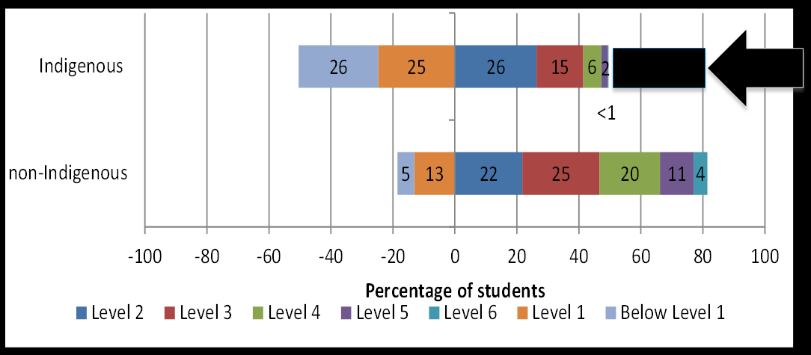
PISA 2012 mathematical literacy proficiency
Source: Thomson, S. et al 2014, Indigenous Student Performance on Standardised Tests, (draft report to ATSIHEAC)
Notes:
PISA data continued
[click to bring in successive elements: maths chart, gap and arrow]
In maths the gap at the high end is even greater.
Of the Indigenous students, only 2% performed at Level 5 and 0.3% performed at Level 6.
Of the non-Indigenous students, 11% performed at Level 5 and 4% performed at Level 6.
These charts highlight the issue we face in the STEM disciplines, and the challenge for Indigenous education policy.
The picture has not changed significantly from PISA 2006.
The yawning gap between high performing Indigenous students and high performing non-Indigenous students persists.
Improving school retention and overall student performance are not translating into the high performance required for transition to higher education and the professions.
Any intervention to improve Indigenous outcomes must address this.
STEM educators and policy-makers need to focus more attention on improving outcomes for the top 25%.

Slide 7
Science Literacy and Science Interest
Retrospective analysis of PISA 2006 (McConney et al 2011):
Indigenous science literacy lags non-Indigenous literacy by about 83.5 points (0.76 standard deviation units)
Indigenous science interest led that of non-Indigenous students by 10 points (0.1 SD)
Regression modelling: Reading Literacy accounted for 62 per cent of science literacy variance
Notes:
Science Literacy and Science Interest
Research published by McConney et al in 2011 picked up anomalies in PISA 2006 results relating to Indigenous student science proficiency and affective variables.
It found that:
Indigenous science literacy lags non-Indigenous literacy by about 83.5 points (0.76 SD)
Indigenous science interest led that of non-Indigenous students by 10 points (0.1 SD)
Regression modelling: Reading Literacy accounted for 62% of science literacy variance.

Slide 8
Implications for schools
There is a gap in achievement (science literacy)
The gap is not a result of lower interest in science but instead mainly associated with reading literacy
Use interest in science to improve reading literacy
Recognise that science is more than facts and definitions and knowledge in science can build on what students know
Notes:
Science Literacy and Science Interest (cont.)
Research published by McConney et al in 2011 picked up anomalies in PISA 2006 results relating to Indigenous student science proficiency and affective variables.
It found that:
Indigenous science literacy lags non-Indigenous literacy by about 83.5 points (0.76 SD)
Indigenous science interest led that of non-Indigenous students by 10 points (0.1 SD)
Regression modelling: Reading Literacy accounted for 62% of science literacy variance.
We have commissioned follow-up analysis on the PISA 2012.

Slide 9
Science Engagement and Literacy
Analysis of 2006 PISA Indigenous/Non-Indigenous Australian and NZ Students (Woods-McConney et al., 2013):
There is a gap in achievement (science literacy)
The gap is not a result of lower interest in science but instead mainly associated with reading literacy
Use the interest in science to improve reading literacy
Recognise that science is more than facts and definitions and knowledge in science can build on what students know
Notes:
Science Engagement and Literacy
Analysis of the 2006 PISA data for Australian and NZ students published by Woods-McConney et al published in 2013, found that the perception is that science engagement (attitudes, interests and self-beliefs) are correlated with science literacy.
Variations in Science Engagement most strongly correlated with the extent to which students engaged with science activities outside of school
Variations in Science literacy (achievement) most strongly correlated with SES status, time spent on science lessons and study, and the type of science teaching (but only weakly associated with engagement)

Slide 10
Implications for practice
Relationship among factors in science literacy and engagement not completely understood
Engagement in science not always associated with high science literacy
Engagement in science is valuable on its own, not only as a precursor to science literacy
Connecting out-of-school activities to ‘school science’ may help improve engagement in science for all students
Notes:
Implications for practice
Relationship among factors in science literacy and engagement not completely understood
Engagement in science not always associated with high science literacy
Engagement in science is valuable on its own, not only as a precursor to science literacy
Connecting out-of-school activities to ‘school science’ may help improve engagement in science for all students.
We have commissioned follow-up analysis on the PISA 2012. It’s bringing up some intriguing results…

Slide 11
Analysis of High Performing Indigenous Students (PISA) unpublished: KEY MESSAGES
Celebrate Success of high performers
Need to better understand the relationships that and factors in high performing Indigenous studies
Positive association with teacher led strategies. Negative correlation between student led investigations and high performance (for both Indigenous and Non-Indigenous)
Affective Issues: higher interest in science could be capitalised on. High Indigenous performers have postive profiles compared to all Indigenous and all non-Indigenous
SES correlation strong. Need to understand this.
Notes:
Implications for practice
Relationship among factors in science literacy and engagement not completely understood
Engagement in science not always associated with high science literacy
Engagement in science is valuable on its own, not only as a precursor to science literacy
Connecting out-of-school activities to ‘school science’ may help improve engagement in science for all students.
We have commissioned follow-up analysis on the PISA 2012. It’s bringing up some intriguing results…

Slide 12
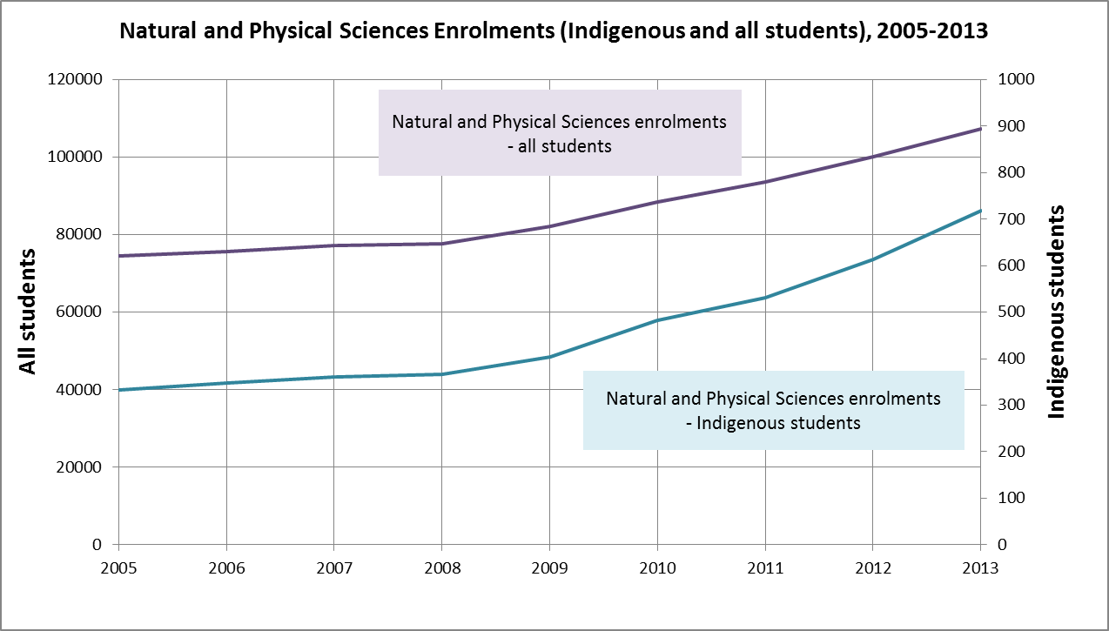
Indigenous participation in science - enrolments
Notes:
Indigenous participation in science – enrolments
The following charts show how the sector is faring in terms of attracting Indigenous students into the sciences.
In this chart, I’ve shown enrolments in the Natural and Physical Sciences for both Indigenous students and all students for the period 2005-2013.
Obviously, the scales are different for the two groups, but the trend lines are revealing.
Science enrolments for all students have grown substantially in recent years, but Indigenous enrolments have grown at more than twice the rate of non-Indigenous since 2005 (116% Indigenous, 44% non-Indigenous).
Despite this, Indigenous students are still well below parity.
Indigenous students accounted for 0.67% of science enrolments.
At 2.7% of the working age population, achieving population parity in science would require an additional 2,177 Indigenous enrolments per annum!

Slide 13
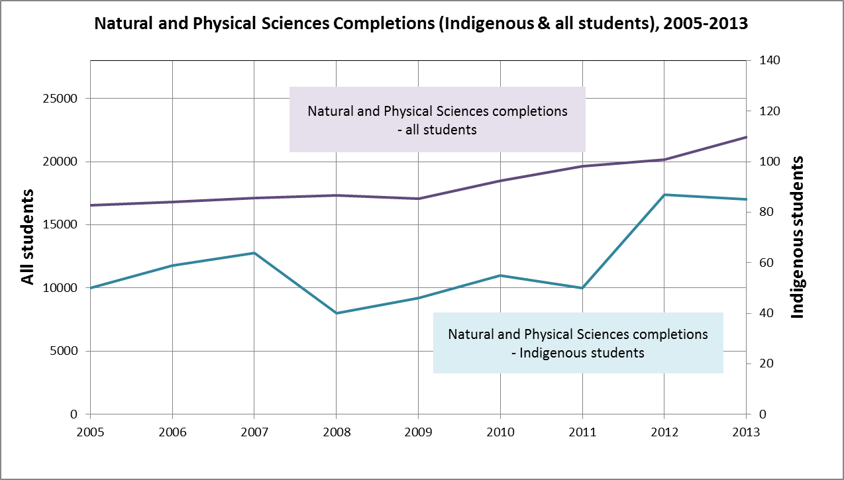
Indigenous participation in science - completions
Notes:
Indigenous participation in science – completions
Completions data are much worse.
Again, the scales for the Indigenous and All students are different.
Science completions for all students have grown substantially in recent years, but Indigenous completions have grown at more than twice the rate of non-Indigenous since 2005 (70% Indigenous, 33% non-Indigenous).
But Indigenous students are still well below parity.
Indigenous students accounted for 0.39% of science completions.
Achieving population parity in science would require an additional 508 Indigenous completions per annum!
This highlights the challenge for science faculties:
It is not enough to get Indigenous students interested and prepared for university-level studies.
Work is required to translate increased participation into academic success, and transition into professional careers.

Slide 14
What can Deans do?
ACDS – Enhanced Training of Mathematics and Science Teachers project (build Indigenous focus)
Engagement and Success in Teacher Education (build STEM focus)
Respect, Relationships and Reconciliation (explore STEM focus)
Notes:
What can Deans do?
ACDS - Enhanced Training of Mathematics and Science Teachers project (build Indigenous focus)
ACDE - Engagement and Success in Teacher Education (build STEM focus)
ACDE - Respect, Relationships and Reconciliation (explore STEM focus)

Slide 15
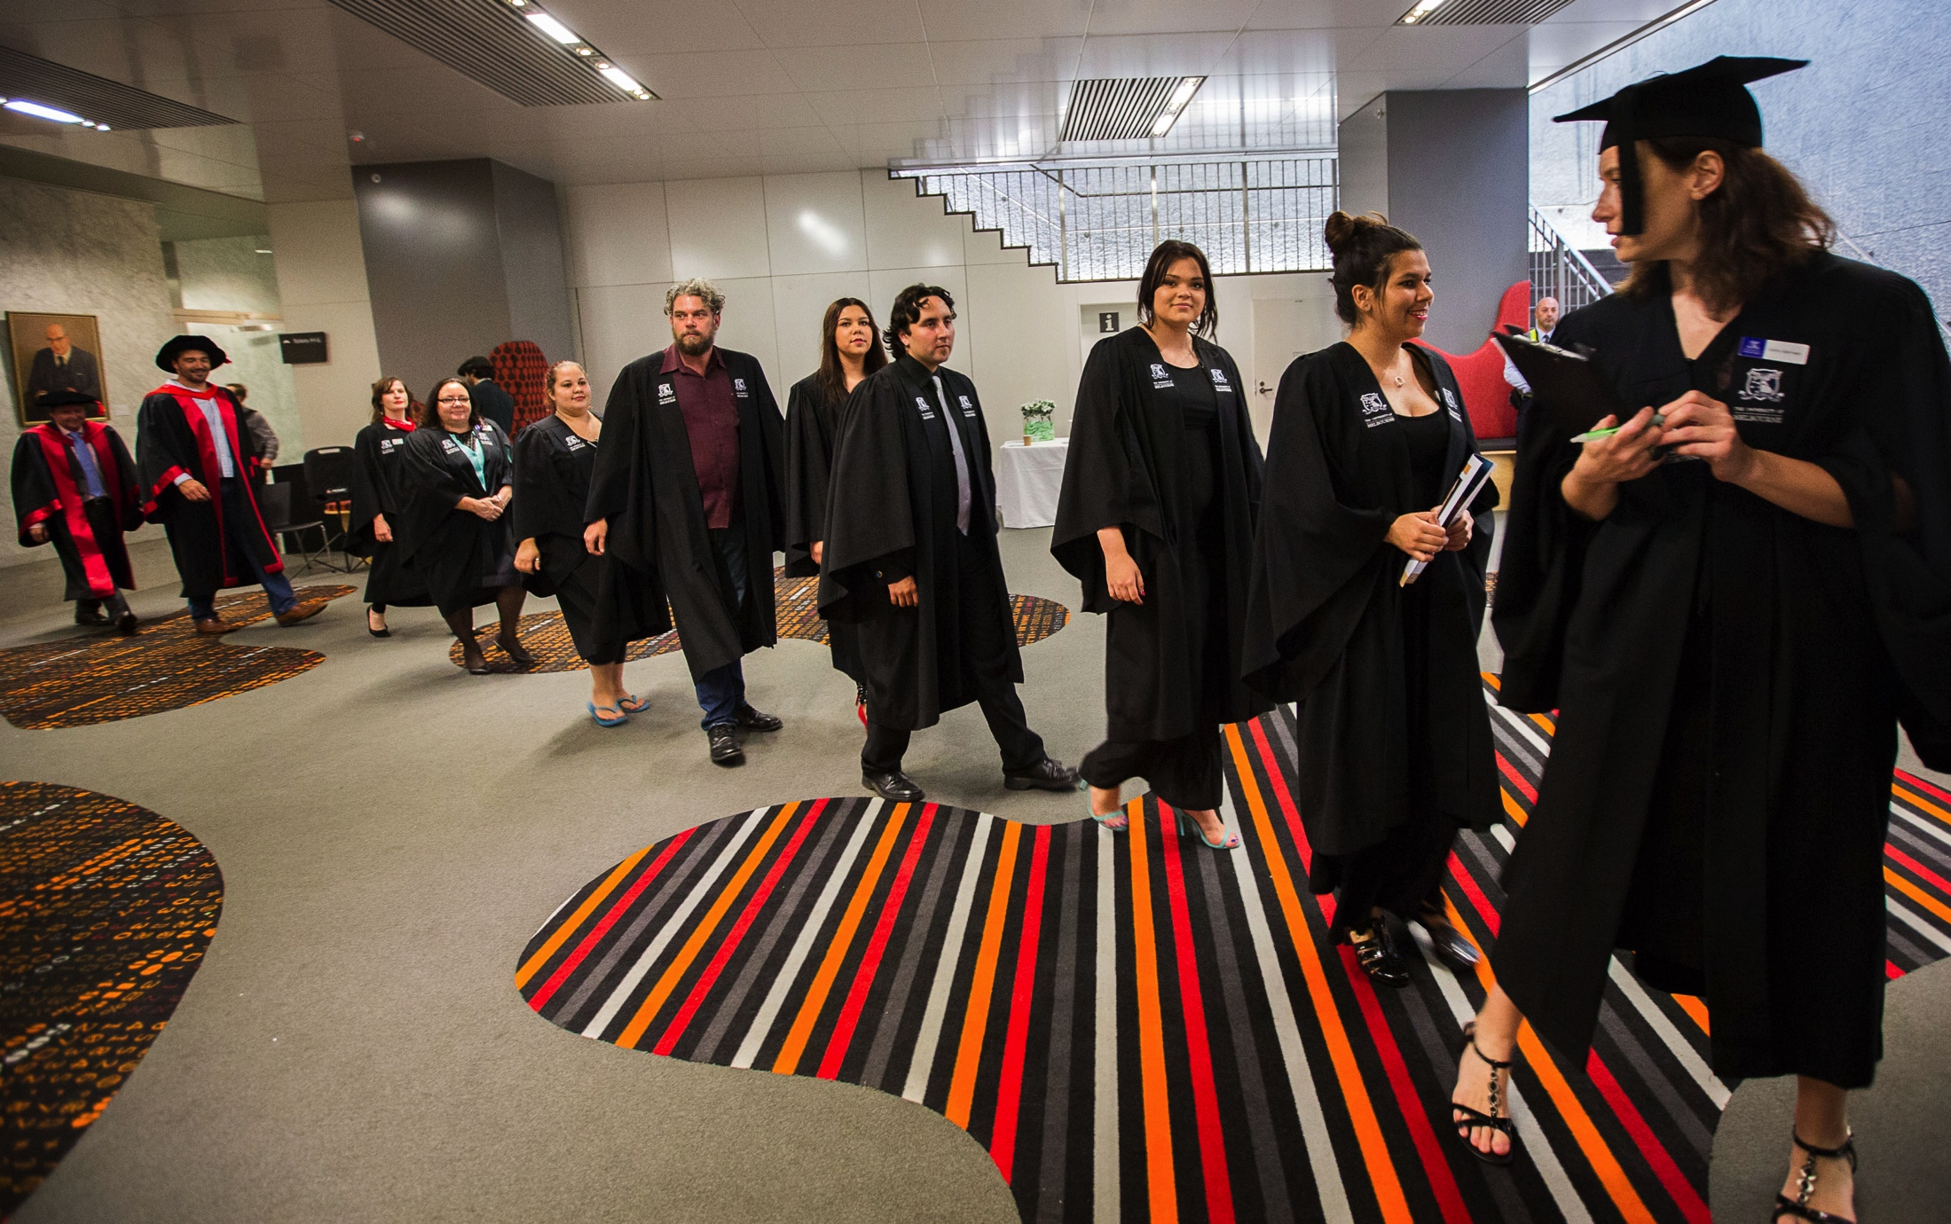
Than k you

