Slide 1
Broadening Indigenous participation across the disciplines:
Australian Council of Deans of Science
Executive Meeting 29 September 2014
Professor Ian Anderson
Co-Chair
Aboriginal and Torres Strait Islander
Higher Education Advisory Council

Slide 2
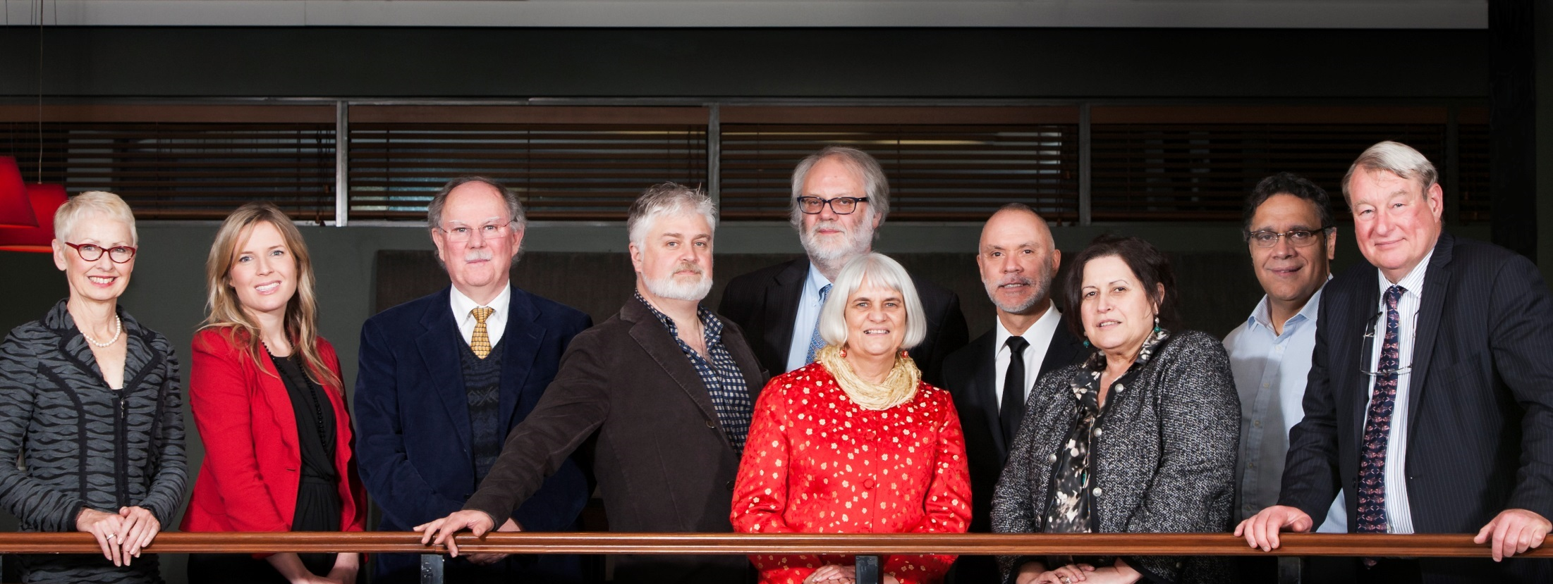
Aboriginal and Torres Strait Islander Higher Education Advisory Council
Notes:
About ATSIHEAC
The Council was established in 2012, following the Behrendt Review of Indigenous higher education
Membership comprises Indigenous academics, and individuals selected for their expertise in business, governance and university leadership
Universities Australia and the National Aboriginal and Torres Strait Islander Higher Education Consortium also send observers.
Current members
Professor Ian Anderson, University of Melbourne, Co-Chair and Executive Member
Professor Jill Milroy, University of Western Australia, Executive Member
Ms Rosie Southwood, Wesfarmers Limited, Executive Member
Professor Toni Downes, Charles Sturt University
Professor Sandra Eades, The University of Sydney
Professor Shane Houston, The University of Sydney
Professor Steven Larkin, Charles Darwin University
Professor Michael McDaniel, University of Technology, Sydney
Professor Michael McManus, The University of Queensland
Professor Andrew Wells, University of Tasmania
Professor Greg Hill, University of the Sunshine Coast
Ms Jillian Miller, University of South Australia
Mr Russell Taylor, Australian Institute of Aboriginal and Torres Strait Islander Studies [Observer]
Professor Peter Buckskin, Chair, NATSIHEC [Observer]

Slide 3
ATSIHEAC policy development framework
Broadening access across the disciplines
Whole of University Strategy
Academic Workforce
Sustainable financing
System level performance monitoring
Notes:
ATSIHEAC’s reform agenda
ATSIHEAC envisages a higher education sector where:
Indigenous people succeed across a broad range of disciplines. A simple focus on participation is not sufficient.
Indigenous knowledges and perspectives are valued and embedded across university business.
Indigenous people are represented at all levels of the academy, including in academic and decision-making roles.
Finance is sustainable and optimally configured to maximise outcomes.
Progress is monitored and reported at institutional and sectoral levels.

Slide 4
Broadening participation across the disciplines
11% of Indigenous people are employed in professional occupations, compared to 20% of non-Indigenous people
Most common occupation group for employed people:
For Indigenous people - Labourer (24%)
For non-Indigenous people - Professional (20%)
Drawn from Census data 2006 and 2011
Notes:
The Behrendt Review
Higher education plays a significant part in Indigenous social and economic development and should be conceptualised as part of broader human capital strategy.
The Behrendt Review found that the clustering of Indigenous student participation within a narrow range of disciplines was working against access to professional careers.
It also reduces the capacity of non-Indigenous professionals to understand and incorporate Indigenous knowledges and perspectives.
According to recent Census data, Labourer is the most common occupation reported by Indigenous people, and only 11% of Indigenous people report being employed as professionals.
The Behrendt Review highlighted the role of faculties in students’ professional preparation.
It recommended faculties work with professional bodies, employers and communities to drive growth in the number and breadth of Indigenous professionals.
[Source for figures on slide: Anderson, I, 2011. Indigenous Pathways into the Professions, University of Melbourne]

Slide 5
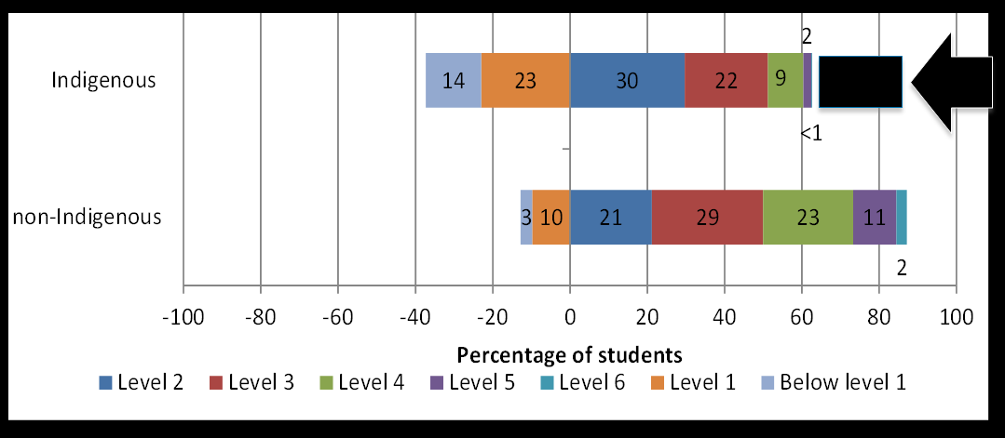
PISA 2012 science literacy proficiency
Source: Thomson, S. et al 2014, Indigenous Student Performance on Standardised Tests, (draft report to ATSIHEAC)
Notes:
PISA 2012 data
We have commissioned the Australian Council for Educational Research to analyse data from key standardised tests (namely PISA, TIMMS, PIRLS and NAPLAN).
The following two graphs are taken from their draft report.
[click to bring in successive elements: science chart, gap and arrow]
The numbers are difficult to read because some of them are so small…
Of the Indigenous students, only 2% performed at Level 5 and a negligible proportion performed at Level 6.
Of the non-Indigenous students, 11% performed at Level 5 and 2% performed at Level 6.

Slide 6
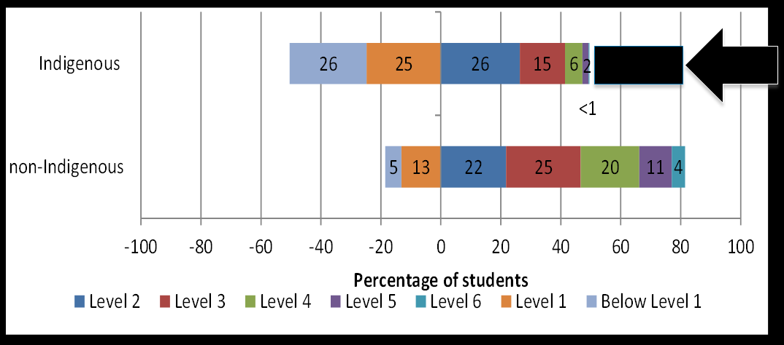
PISA 2012 mathematical literacy proficiency
Source: Thomson, S. et al 2014, Indigenous Student Performance on Standardised Tests, (draft report to ATSIHEAC)
Notes:
PISA data continued
[click to bring in successive elements: maths chart, gap and arrow]
In maths the gap at the high end is even greater.
Of the Indigenous students, only 2% performed at Level 5 and 0.3% performed at Level 6.
Of the non-Indigenous students, 11% performed at Level 5 and 4% performed at Level 6.
These charts highlight the issue we face in the STEM disciplines, and the challenge for Indigenous education policy.
The picture has not changed significantly from PISA 2006.
The yawning gap between high performing Indigenous students and high performing non-Indigenous students persists.
Improving school retention and overall student performance are not translating into the high performance required for transition to higher education and the professions.
Any intervention to improve Indigenous outcomes must address this.
STEM educators and policy-makers need to focus more attention on improving outcomes for the top 25%.

Slide 7
Science Literacy and Science Interest
Retrospective analysis of PISA 2006 (McConney et al 2011):
Indigenous science literacy lags non-Indigenous literacy by about 83.5 points (0.76 standard deviation units)
Indigenous science interest led that of non-Indigenous students by 10 points (0.1 SD)
Regression modelling: Reading Literacy accounted for 62 per cent of science literacy variance
Notes:
Science Literacy and Science Interest
Research published by McConney et al in 2011 picked up anomalies in PISA 2006 results relating to Indigenous student science proficiency and affective variables.
It found that:
Indigenous science literacy lags non-Indigenous literacy by about 83.5 points (0.76 SD)
Indigenous science interest led that of non-Indigenous students by 10 points (0.1 SD)
Regression modelling: Reading Literacy accounted for 62% of science literacy variance.

Slide 8
Implications for schools
There is a gap in achievement (science literacy)
The gap is not a result of lower interest in science but instead mainly associated with reading literacy
Use interest in science to improve reading literacy
Recognise that science is more than facts and definitions and knowledge in science can build on what students know
Notes:
Science Literacy and Science Interest (cont.)
Research published by McConney et al in 2011 picked up anomalies in PISA 2006 results relating to Indigenous student science proficiency and affective variables.
It found that:
Indigenous science literacy lags non-Indigenous literacy by about 83.5 points (0.76 SD)
Indigenous science interest led that of non-Indigenous students by 10 points (0.1 SD)
Regression modelling: Reading Literacy accounted for 62% of science literacy variance.
We have commissioned follow-up analysis on the PISA 2012.

Slide 9
Science Engagement and Literacy
Analysis of 2006 PISA Indigenous/Non-Indigenous Australian and NZ Students (Woods-McConney et al., 2013):
There is a gap in achievement (science literacy)
The gap is not a result of lower interest in science but instead mainly associated with reading literacy
Use the interest in science to improve reading literacy
Recognise that science is more than facts and definitions and knowledge in science can build on what students know
Notes:
Science Engagement and Literacy
Analysis of the 2006 PISA data for Australian and NZ students published by Woods-McConney et al published in 2013, found that the perception is that science engagement (attitudes, interests and self-beliefs) are correlated with science literacy.
Variations in Science Engagement most strongly correlated with the extent to which students engaged with science activities outside of school
Variations in Science literacy (achievement) most strongly correlated with SES status, time spent on science lessons and study, and the type of science teaching (but only weakly associated with engagement)

Slide 10
Implications for practice
Relationship among factors in science literacy and engagement not completely understood
Engagement in science not always associated with high science literacy
Engagement in science is valuable on its own, not only as a precursor to science literacy
Connecting out-of-school activities to ‘school science’ may help improve engagement in science for all students
Notes:
Implications for practice
Relationship among factors in science literacy and engagement not completely understood
Engagement in science not always associated with high science literacy
Engagement in science is valuable on its own, not only as a precursor to science literacy
Connecting out-of-school activities to ‘school science’ may help improve engagement in science for all students.
We have commissioned follow-up analysis on the PISA 2012. It’s bringing up some intriguing results…

Slide 11
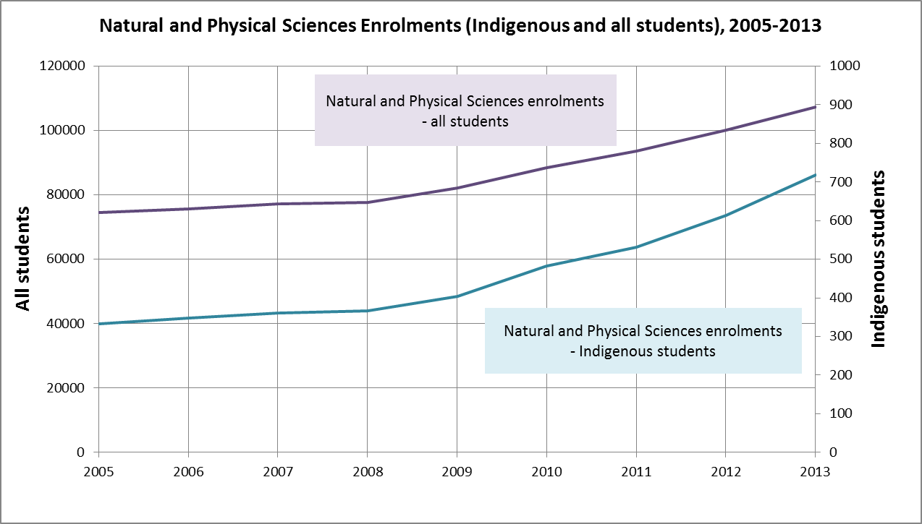
Indigenous participation in science - enrolments
Notes:
Indigenous participation in science – enrolments
The following charts show how the sector is faring in terms of attracting Indigenous students into the sciences.
In this chart, I’ve shown enrolments in the Natural and Physical Sciences for both Indigenous students and all students for the period 2005-2013.
Obviously, the scales are different for the two groups, but the trend lines are revealing.
Science enrolments for all students have grown substantially in recent years, but Indigenous enrolments have grown at more than twice the rate of non-Indigenous since 2005 (116% Indigenous, 44% non-Indigenous).
Despite this, Indigenous students are still well below parity.
Indigenous students accounted for 0.67% of science enrolments.
At 2.7% of the working age population, achieving population parity in science would require an additional 2,177 Indigenous enrolments per annum!

Slide 12
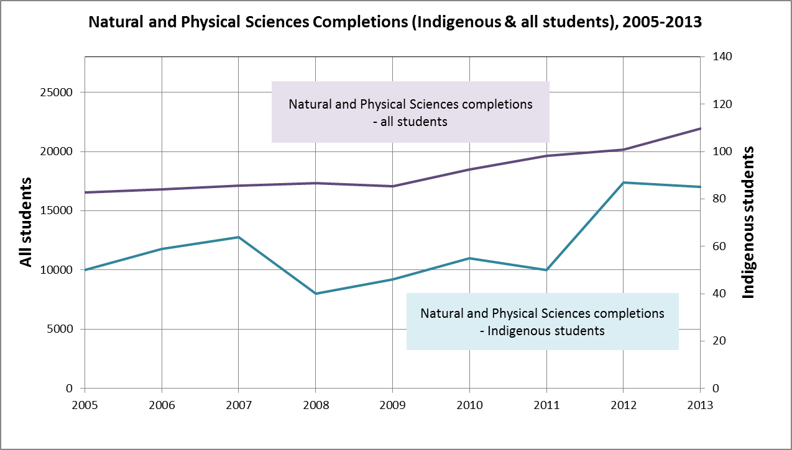
Indigenous participation in science - completions
Notes:
Indigenous participation in science – completions
Completions data are much worse.
Again, the scales for the Indigenous and All students are different.
Science completions for all students have grown substantially in recent years, but Indigenous completions have grown at more than twice the rate of non-Indigenous since 2005 (70% Indigenous, 33% non-Indigenous).
But Indigenous students are still well below parity.
Indigenous students accounted for 0.39% of science completions.
Achieving population parity in science would require an additional 508 Indigenous completions per annum!
This highlights the challenge for science faculties:
It is not enough to get Indigenous students interested and prepared for university-level studies.
Work is required to translate increased participation into academic success, and transition into professional careers.

Slide 13
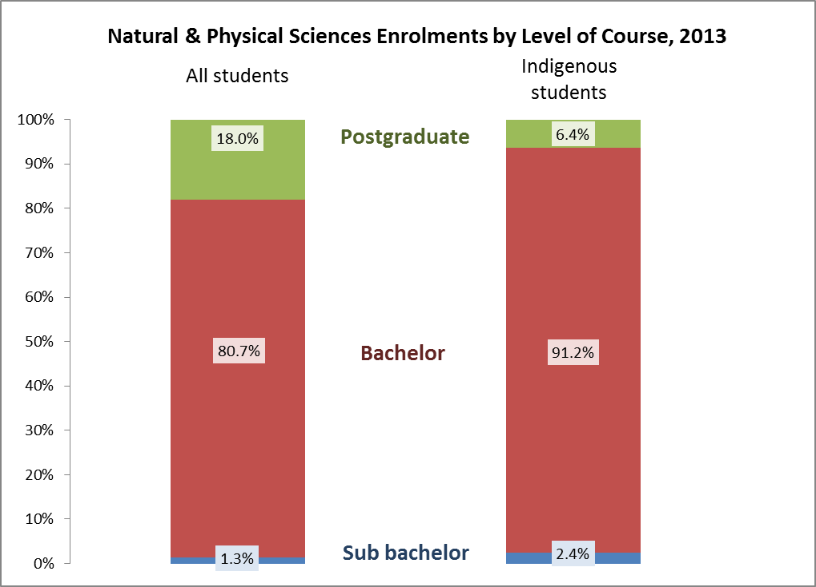
Natural & Physical Sciences Enrolments by Level of Course, 2013
Notes:
Science enrolments by level of course
There are also differences in the level of course in which Indigenous students are enrolling.
This chart shows enrolments in for 2013 by level of course, for both all students and Indigenous students.
It’s not surprising that those Indigenous people who do make it into science, progress to higher level study at a much lower rate than their non-Indigenous counterparts.
This has implications for the pipeline into STEM-related professions.

Slide 14
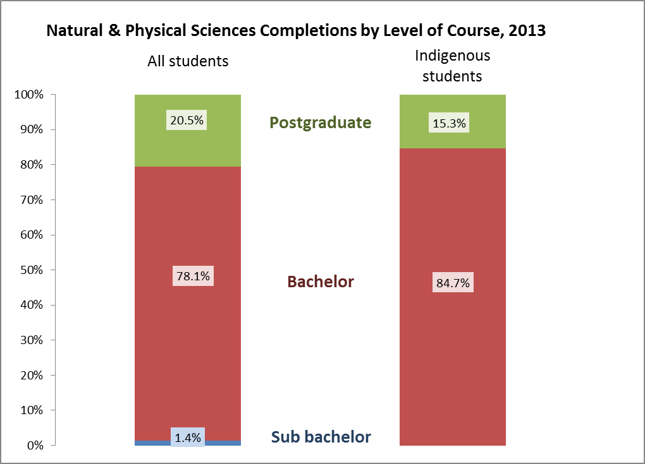
Natural & Physical Sciences Completions by Level of Course, 2013
Notes:
Science completions by level of course
The difference in level of course is also evident with completions.

Slide 15
Areas where Deans can make a difference
Outreach
Pedagogy
Curriculum
Preparation
Accountability
Pathways
Network
Sharing information
Notes:
What can Deans do?
[Click once for each item to appear]
As you know ATSIHEAC hosted a roundtable in December last year to engage the sector in improving Indigenous participation in STEM education and professions.
We were fortunate to have a strong presence by the Deans of Science and Deans of Education.
The strategies proposed by roundtable participants strongly underscored the role that faculties play – a principle that I can vouch for from the experience of Indigenous medicine.
The strategies for action fall into eight broad areas.
1. Outreach:
Working with schools, students and communities to grow student demand and capacity to transition to university and professional careers.
2. Pedagogy:
Developing and supporting inclusive practice among educators at the school and university levels.
3. Curriculum:
Working with the professions on standards for accreditation of courses delivered by higher education faculties.
Inclusion of Indigenous perspectives in course content, where appropriate, improves the relevance of courses to Indigenous communities and the preparation of all professionals (Indigenous and non-Indigenous alike).
4. Preparation
Indigenous education units within universities work best when they have a collaborative relationship with the faculties.
The development of enabling courses for highly specialised disciplines, such as ICT, is one area where IEUs and faculties can create powerful partnerships to support success.
5. Accountability
The Behrendt Review found that at high-performing universities Indigenous business was a shared responsibility across the institution, and the faculties took seriously their role in setting targets and reporting outcomes against those targets.
6. Pathways
High attrition rates undermine the hard work done to get Indigenous students to university.
Improving transition to professional employment must be a focus. This is where working with employers comes in.
7. Network
A critical factor in growing the Indigenous medical workforce was establishment of networks that present opportunities for students to meet and learn from professional practitioners.
8. Sharing information
Sharing information on leading practice is essential to supporting change.
Journals, websites and professional conferences are a great medium for this.

Slide 16
What can Deans do?
Notes:
What can Deans do? (cont.)
I would particularly highlight a few strategies from the roundtable that lie within your sphere of influence and would serve to support the change agents:
Sharing information about good practice, including through online technologies.
Bring together a group of scientists to advise on reform to pathways, curriculum etc
Collaborate with Indigenous education centres on discipline specific enabling courses and events
Embed Indigenous targets into faculty plans and reports.

Slide 17
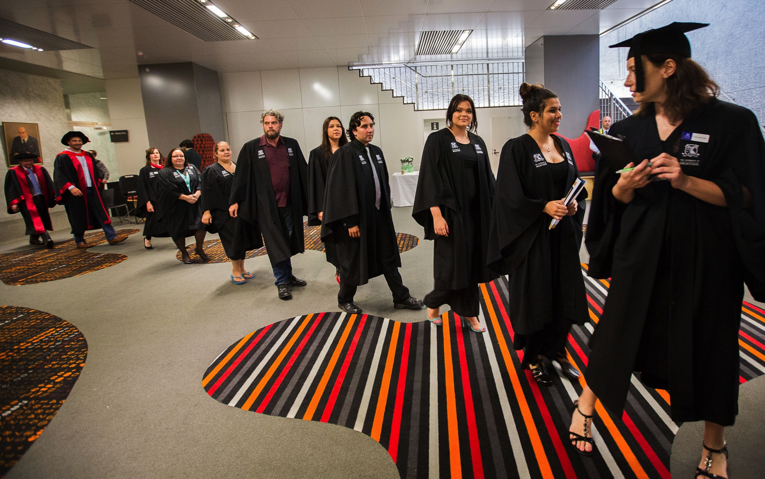
What can Deans do? (cont.)
Notes:
What can Deans of Science do?
ATSIHEAC is keen to build on the momentum being created by the Chief Scientist’s work on a national approach to STEM.
We support Professor Chubb’s view that Australia needs to shift away from “incrementalist, self-protectionist, denialism” and have a sensible debate on the future.
This applies equally to improving Indigenous access to the economic and professional life of this nation.
I have commenced a dialogue with the Chief Scientist about how to achieve better outcomes for Indigenous people in STEM-related education and careers.
I would like to get your views on how you might participate in that, as the people responsible for shaping our future professional workforce.
Teaching and learning
Tomorrow I’ll be addressing the Australian Council of Deans of Education.
The work being done by your two councils on teaching and learning will improve the capacity of education to cater to diverse populations.
But I’d like to see greater emphasis on Indigenous students as an explicit focus of these initiatives.
Proposed Indigenous STEM Framework
One option that my council is considering is the development of an Indigenous STEM framework.
I recognise that STEM is already a crowded policy space for educators.
And I don’t necessarily see a need for new initiatives to address Indigenous issues.
My focus would be on creating a coherence of effort.
Building on the good practice that is already out there.
Supporting you to meet your obligations to improve outcomes in a demand-driven, increasingly diverse system.
I’d would value your support and participation in developing a framework that works for you.
And I’d be interested to hear your views about this proposal.

