Slide 1
Broadening Indigenous participation across the disciplines:
Address to Australian Council of Deans of ICT
Annual Council Meeting 7 July 2014
Professor Ian Anderson
Co-Chair
Aboriginal and Torres Strait Islander
Higher Education Advisory Council

Slide 2
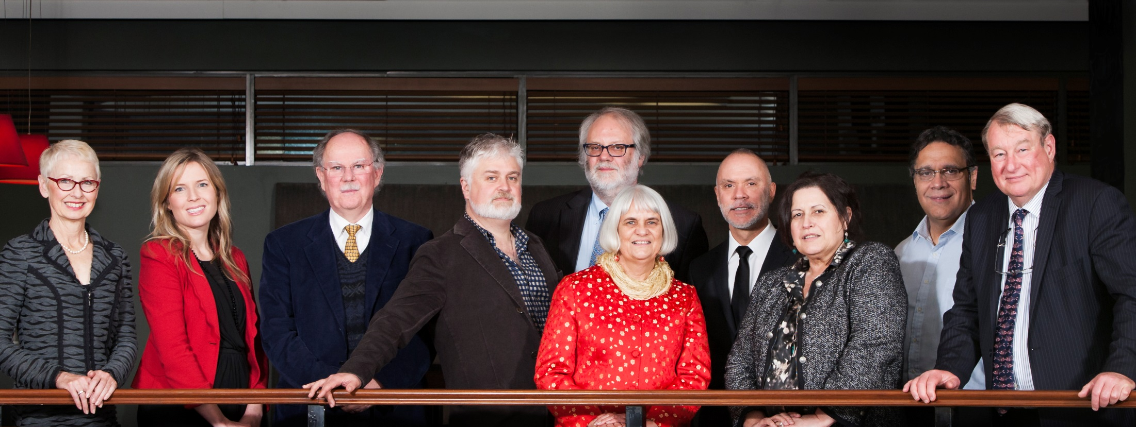
Aboriginal and Torres Strait Islander Higher Education Advisory Council
Notes:
About ATSIHEAC:
The Council was established in 2012, following the Behrendt Review of Indigenous higher education
Membership comprises Indigenous academics, and individuals selected for their expertise in business, governance and university leadership
Universities Australia and the National Aboriginal and Torres Strait Islander Higher Education Consortium also send observers.
Current members:
Professor Ian Anderson, University of Melbourne, Co-Chair and Executive Member
Professor Jill Milroy, University of Western Australia, Executive Member
Ms Rosie Southwood, Wesfarmers Limited, Executive Member
Professor Toni Downes, Charles Sturt University
Professor Sandra Eades, The University of Sydney
Professor Shane Houston, The University of Sydney
Professor Steven Larkin, Charles Darwin University
Professor Michael McDaniel, University of Technology, Sydney
Professor Michael McManus, The University of Queensland
Professor Andrew Wells, University of Tasmania
Professor Greg Hill, University of the Sunshine Coast
Ms Jillian Miller, University of South Australia
Mr Russell Taylor, Australian Institute of Aboriginal and Torres Strait Islander Studies [Observer]
Professor Peter Buckskin, Chair, NATSIHEC [Observer]

Slide 3
ATSIHEAC policy development framework
Broadening access across the disciplines
Whole of University Strategy
Academic Workforce
Sustainable financing
System level performance monitoring
Notes:
The Aboriginal and Torres Strait Islander Higher Education Advisory Council envisages a higher education sector where:
Indigenous people succeed across a broad range of disciplines. A simple focus on participation is not sufficient.
Indigenous knowledges and perspectives are valued and embedded across university business.
Indigenous people are represented at all levels of the academy, including in academic and decision-making roles.
Finance is sustainable and optimally configured to maximise outcomes.
Progress is monitored and reported at institutional and sectoral levels.

Slide 4
Broadening participation across the disciplines
11% of Indigenous people are employed in professional occupations, compared to 20% of non-Indigenous people
Most common occupation group for employed people:
For Indigenous people - Labourer (24%)
For non-Indigenous people - Professional (20%)
Drawn from Census data 2006 and 2011
Notes:
Behrendt Review:
Higher education plays a significant part in Indigenous social and economic development and should be conceptualised as part of broader human capital strategy.
The Behrendt Review found that the clustering of Indigenous student participation within a narrow range of disciplines was working against access to professional careers.
It also reduces the capacity of non-Indigenous professionals to understand and incorporate Indigenous knowledges and perspectives.
According to recent Census data, Labourer is the most common occupation reported by Indigenous people, and only 11% of Indigenous people report being employed as professionals.
The Behrendt Review highlighted the role of faculties in students’ professional preparation.
It recommended faculties work with professional bodies, employers and communities to drive growth in the number and breadth of Indigenous professionals.
[Source for figures on slide: Anderson, I, 2011. Indigenous Pathways into the Professions, University of Melbourne]

Slide 5
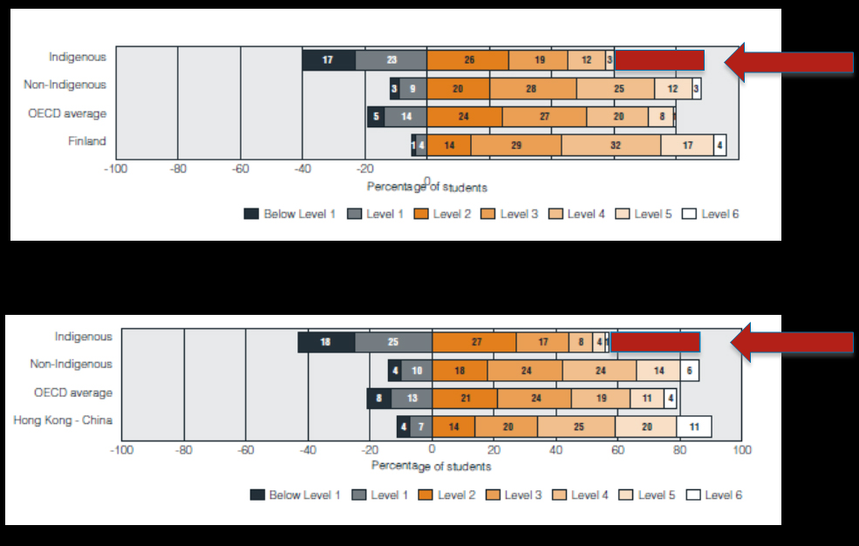
PISA results in Mathematics and Science, 2006
Science
Maths
Source: De Bortoli & Thomson 2009, The achievement of Australia’s Indigenous students in PISA 2000-2006
Notes:
PISA data:
This graph highlights the issue we face in the STEM disciplines, and the challenge for Indigenous education policy.
As you know, on PISA Maths and Science results, there is a yawning gap between high performing Indigenous and non-Indigenous students.
Improved school retention and overall student performance over time has not necessarily translated into the high performance required for transition into higher education and the professions.
Any intervention to improve Indigenous outcomes must address this.
STEM educators and policy-makers need to focus attention on improving outcomes for the top 25%.
ATSIHEAC STEM roundtable:
Last December, our council started a roundtable conversation on participation by Aboriginal and Torres Strait Islander people in STEM education and related professions.
Deans of STEM and Education faculties, and other leaders in the sector, were involved.
They strongly endorsed the role of faculties in improving outcomes for Indigenous people, and suggested areas for action.

Slide 6
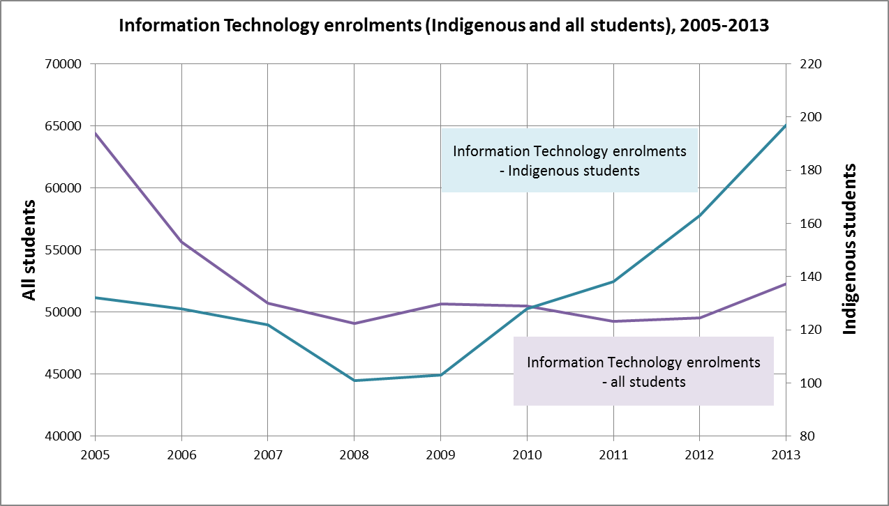
Information Technology enrolments (Indigenous and all students), 2005-2013
Notes:
Information Technology enrolments (Indigenous v. all students):
I’d like to show you some charts for Indigenous participation and outcomes in Information Technology.
In this chart, I’ve shown enrolments in Information Technology for both Indigenous students and all students for the period 2005-2012.
Obviously, the scales are different for the two groups, but the trend lines are revealing.
While non-Indigenous enrolments have remained stable in recent years, Indigenous enrolments have been growing steadily (with a 61% rise since 2009).

Slide 7
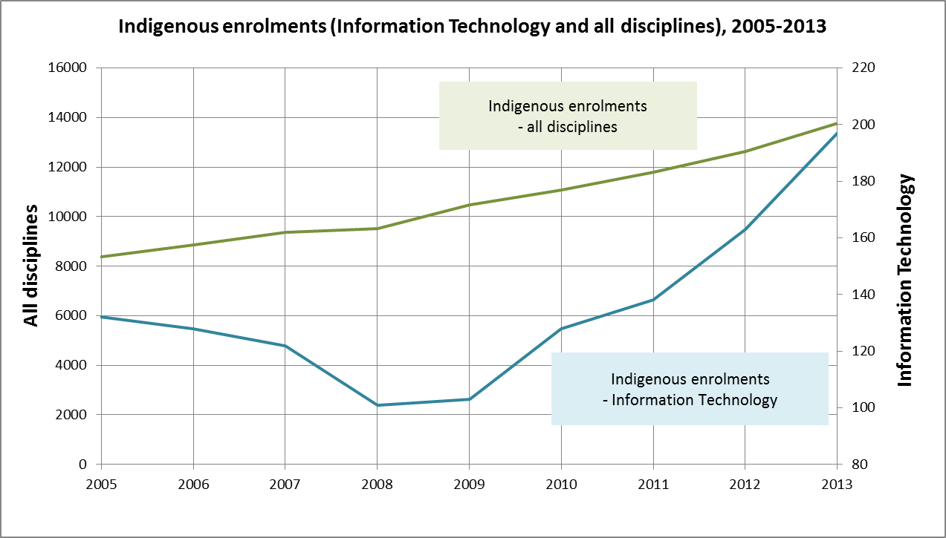
Indigenous enrolments (Information Technology and all disciplines), 2005-2013
Notes:
Indigenous enrolments (Information Technology v. all disciplines):
In this chart, I’ve compared Indigenous IT enrolments with Indigenous enrolments in all disciplines.
Recent growth in Indigenous enrolments in IT has been better than that across all disciplines.
However, Indigenous students still account for only 0.33% of all enrolments in Information Technology.
This is well below population parity:
Indigenous people account for 2.4% of Australian 15-64 year olds.
Achieving population parity in IT would require an additional 1,200 Indigenous students!

Slide 8
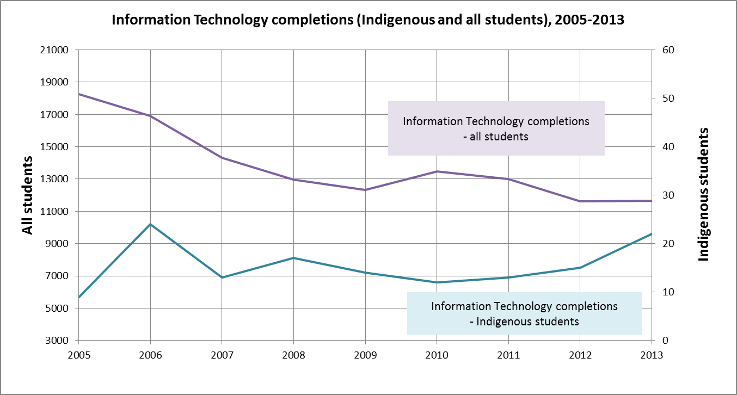
Information Technology completions (Indigenous and all students), 2005-2013
Notes:
Information Technology completions (Indigenous v. all students):
The data on Indigenous completions in Information Technology are also well below par.
Again, the scales are different.
But the trend lines show that while non-Indigenous completions have been declining in recent years, completions by Indigenous students have remained quite stable.

Slide 9
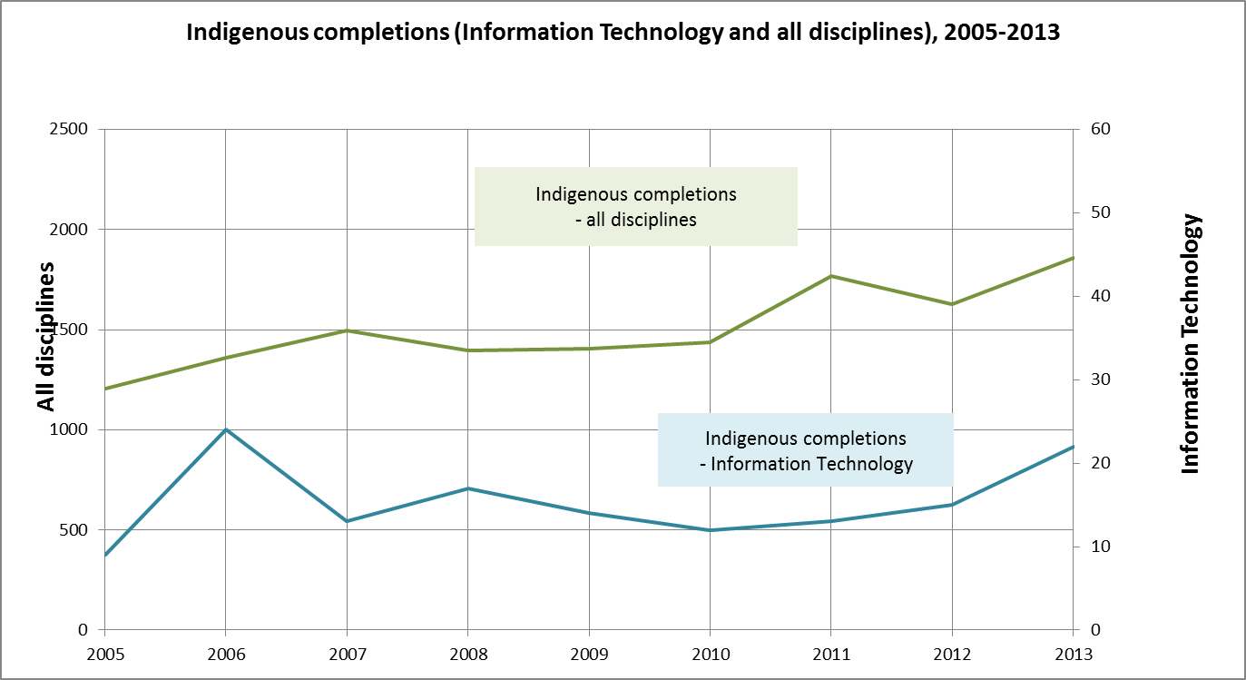
Indigenous completions (Information Technology and all disciplines), 2005-2013
Notes:
Indigenous completions (Information Technology v. all disciplines):
This chart shows the pattern in Indigenous IT completions is consistent with growth in Indigenous completions generally.
But Indigenous completions data are in a much more parlous state than enrolments:
Indigenous students accounted for only 0.13% of all completions in Information Technology in 2012.
This highlights the challenge for ICT faculties:
It is not enough to get Indigenous students interested and prepared for ICT studies.
Work is required to translate increased participation into academic success, and transition into professional careers.

Slide 10
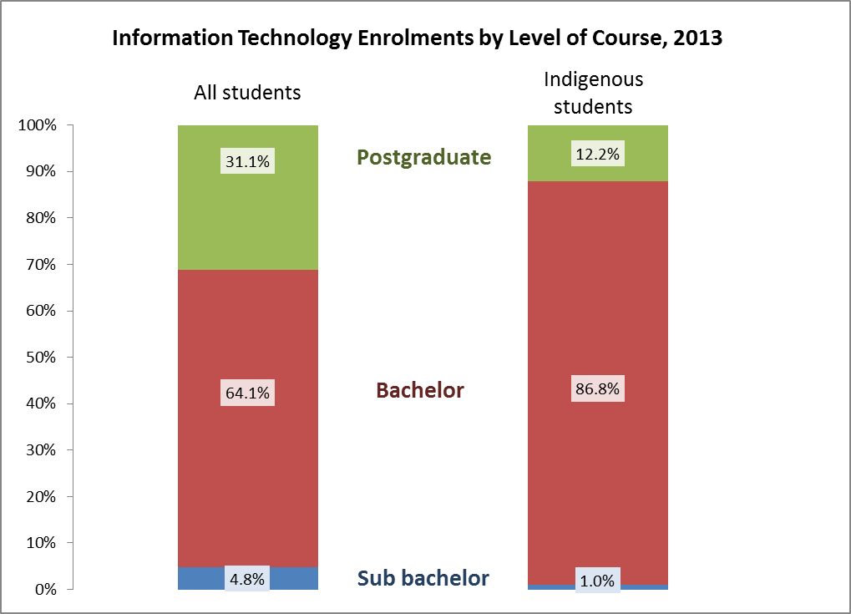
Information Technology Enrolments by Level of Course, 2013
Notes:
IT enrolments by level of course (all students v. Indigenous students):
There are also differences in the level of course in which Indigenous students are enrolling.
This chart shows enrolments in IT for 2012 by level of course, for both all students and Indigenous students.
It’s not surprising that those Indigenous people who do make it into IT courses in higher education, progress to higher level study at a much lower rate than their non-Indigenous counterparts.
This has implications for the pipeline into ICT professions.

Slide 11
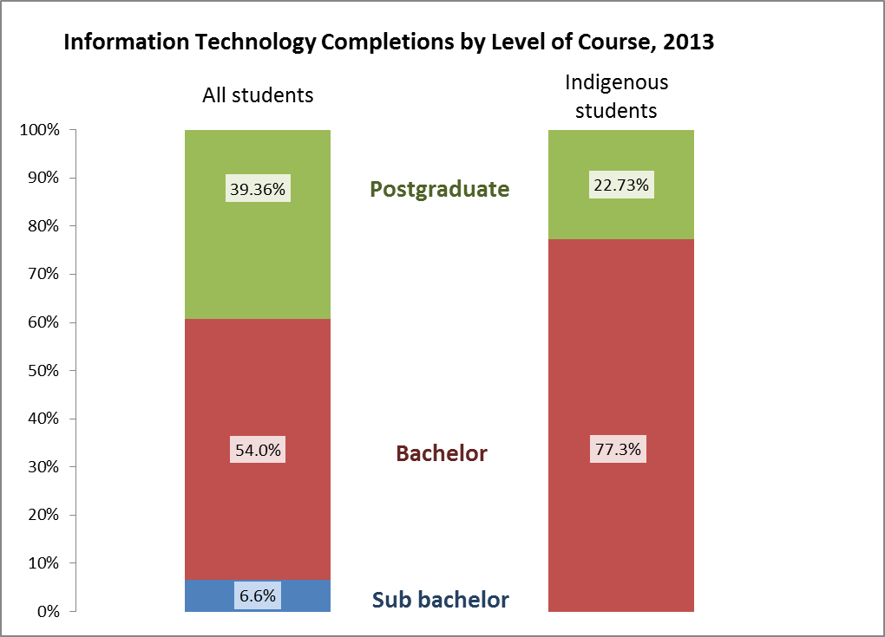
Information Technology Completions by Level of Course, 2013
Notes:
IT completions by level of course (all students v. Indigenous students):
The difference in level of course is particular stark when we look at completions.
The proportion of students completing at the bachelor and sub bachelor degree levels are very similar for Indigenous and all students, except that there were no Indigenous students completing at postgraduate level.

Slide 12
Areas where Deans can make a difference
Outreach
Pedagogy
Curriculum
Preparation
Accountability
Pathways
Network
Sharing information
Notes:
Areas where Deans can make most impact
Based on the discussions at the Roundtable - and my own experience in Indigenous medicine - I’d suggest eight areas where heads of university faculties can maximise impact.
1. Outreach:
Working with schools, students and communities to grow student demand and capacity to transition to university and professional careers.
2. Pedagogy
Developing and supporting inclusive practice among educators at the school and university levels.
3. Curriculum
Working with the professions on standards for accreditation of courses delivered by higher education faculties.
Inclusion of Indigenous perspectives in course content, where appropriate, improves the relevance of courses to Indigenous communities and the preparation of all professionals (Indigenous and non-Indigenous alike).
4. Preparation
Indigenous education units within universities work best when they have a collaborative relationship with the faculties.
The development of enabling courses for highly specialised disciplines, such as ICT, is one area where IEUs and faculties can create powerful partnerships to support success.
[CONTINUED ON NEXT SLIDE]

Slide 13
Areas where Deans can make a difference (cont.)
Outreach
Pedagogy
Curriculum
Preparation
Accountability
Pathways
Network
Sharing information
Notes:
Areas where Deans can make a difference
[CONTINUED FROM PREVIOUS SLIDE]
5. Accountability
The Behrendt Review found that at high-performing universities Indigenous business was a shared responsibility across the institution, and the faculties took seriously their role in setting targets and reporting outcomes against those targets.
6. Pathways
High attrition rates undermine the hard work done to get Indigenous students to university.
Failure doesn’t serve anyone’s needs.
Improving transition to professional employment must be a focus.
This is where working with employers comes in.
7. Network
A critical factor in growing the Indigenous medical workforce was establishment of networks that present opportunities for students to meet and learn from professional practitioners.
8. Sharing information
Sharing information on leading practice is essential to supporting change.
Journals, websites and professional conferences are a great medium for this.

Slide 14
ACDICT Action Plan
Building subject knowledge and pedagogical skills of educators
Improving perceptions of ICT careers
Working with industry on skills
Notes:
Australian Council of Deans of ICT Action Plan:
I’ve read ACDICT’s Action Plan with interest.
I can see familiar themes to the eight areas I’ve just outlined - and much scope for accommodating the needs of Indigenous students.
After all, what happens in Indigenous STEM doesn’t occur in isolation from the state of STEM education generally.
In particular, I would highlight 3 areas that readily relate to Aboriginal and Torres Strait Islander students:
Your Plan includes a strong focus on building the subject knowledge and pedagogical skills of educators at both school and university levels.
What happens in the classroom has a profound effect on the aspirations and academic preparation of Indigenous students.
I’m very interested in the work that Frances Rosamond and Mike Fellows are doing for your Council on incorporating Both Ways approaches into ICT curriculum and pedagogy.
Your Plan identifies the need to improve student perceptions of ICT careers.
Indigenous school leavers are vastly over-represented in vocational education and training and under-represented in higher education.
This is particularly dire for the STEM disciplines, where Indigenous enrolments are well below population parity.
Teachers, students and communities don’t see ICT careers as a ‘normal’ choice for Indigenous people.
Your Plan acknowledges the need to work with industry to address ICT skills needs.
Labour market research for ICT professions shows that competition for vacancies from qualified applicants is strong, and employers are able to fill vacancies without difficulty.*
Building the competitiveness of Indigenous graduates matters more in a tightening market.
Working with industry on career transitions for Indigenous students (for example through industry placement), offers concrete mechanisms for this to happen.
[Note * DEEWR 2013, Labour Market Research – Information and Telecommunications (ICT) Professions, https://employment.gov.au/occupational-skill-shortages-information]

Slide 15
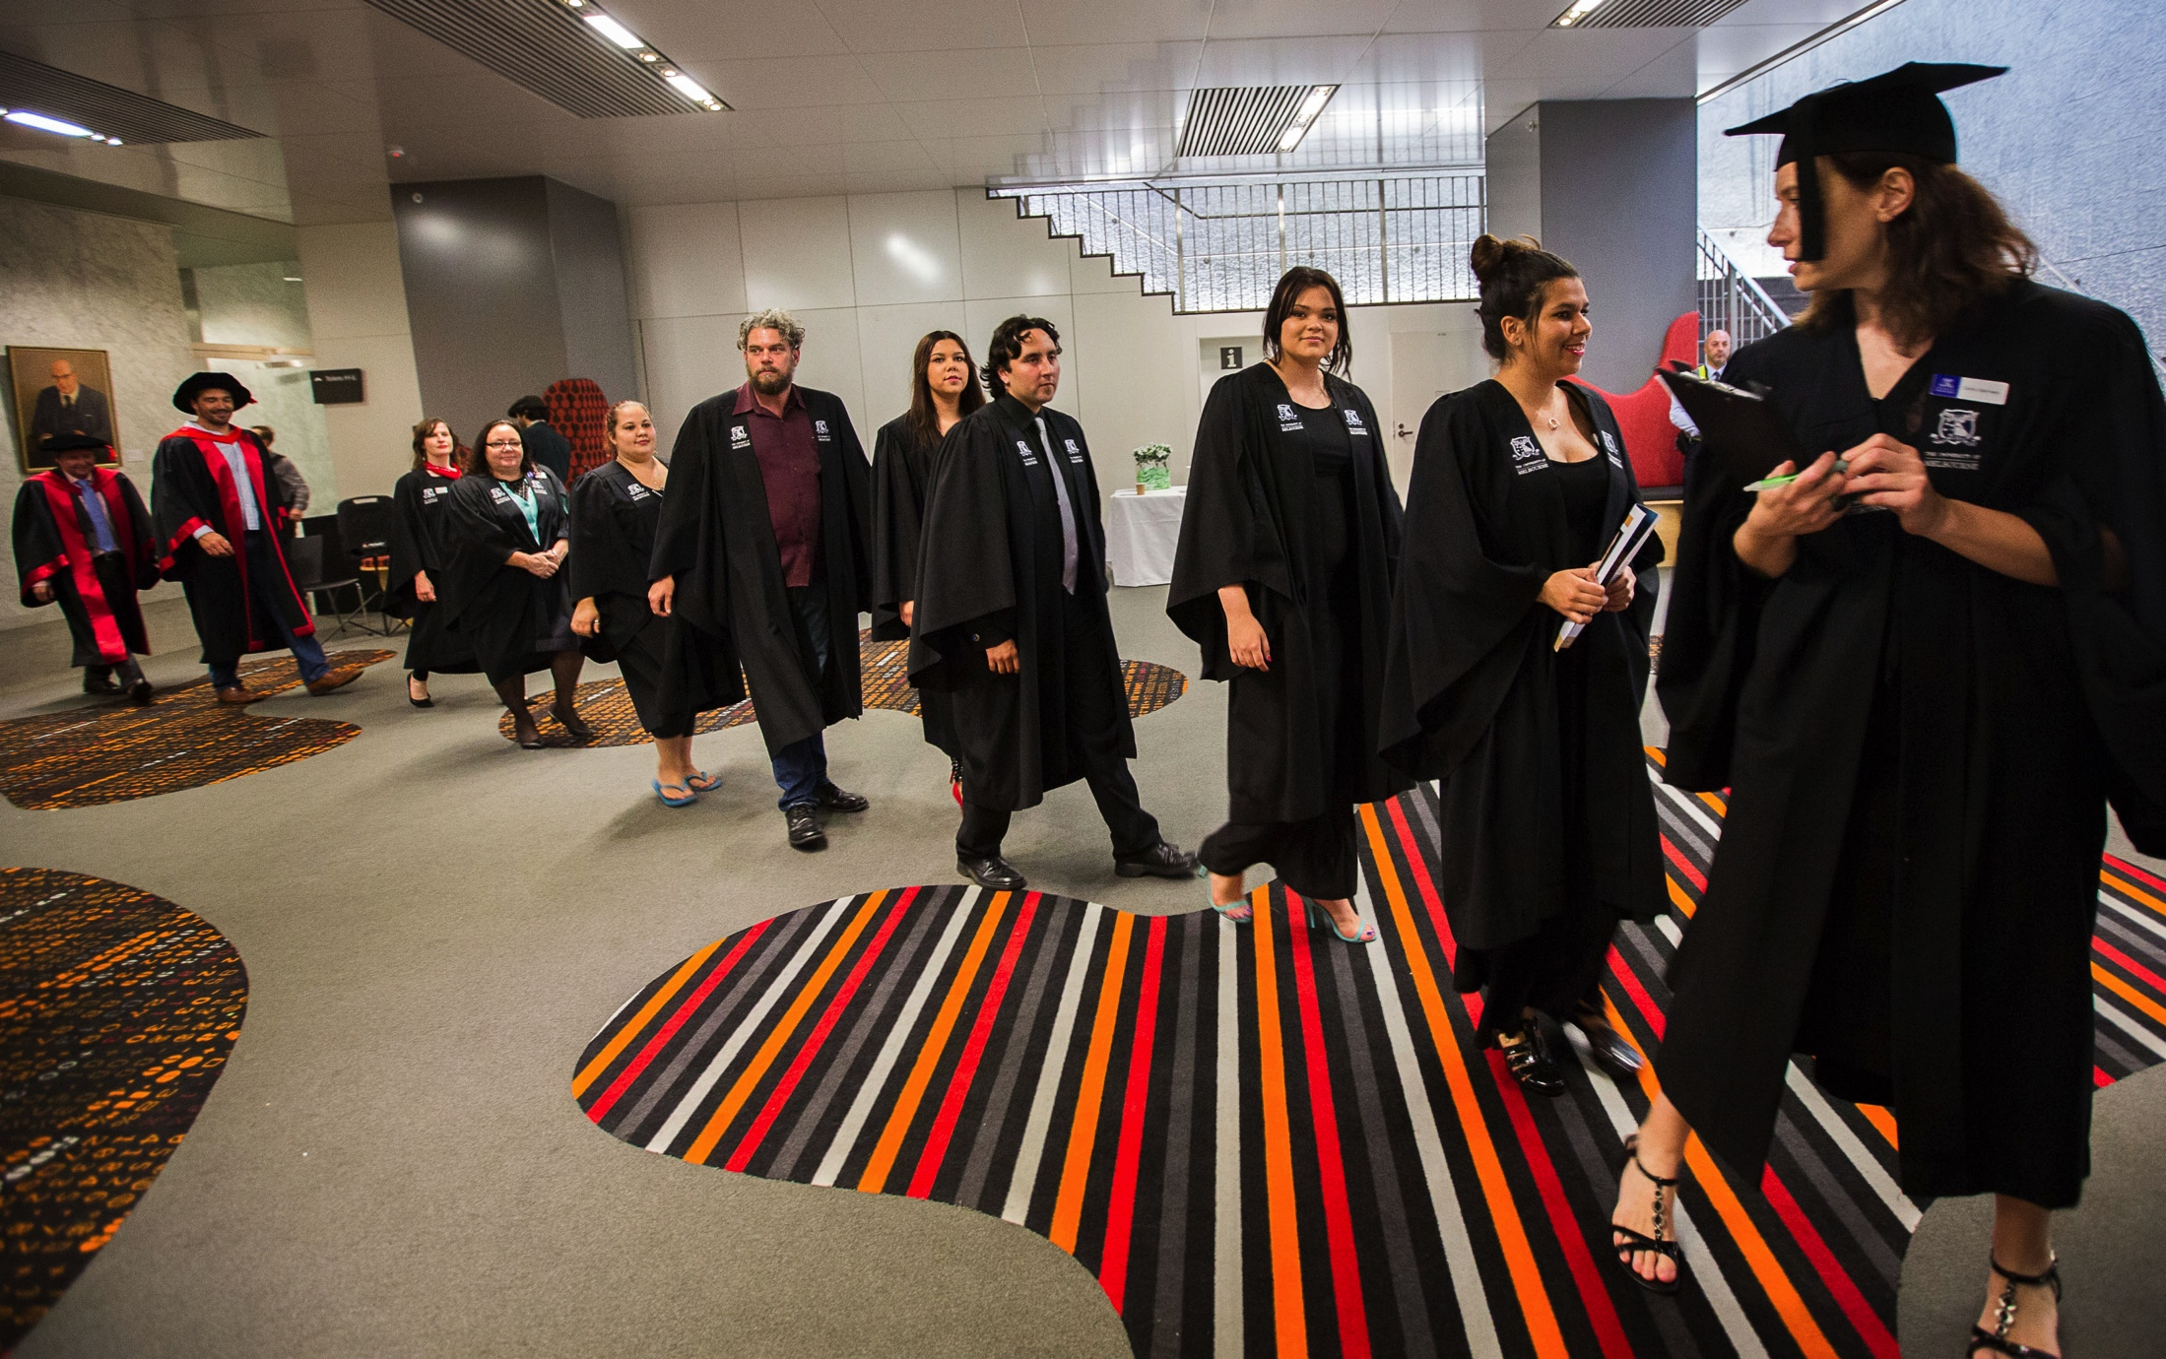
Supporting student success
Notes:
Supporting student success:
If there is one area of the Action Plan that I’d suggest ACDICT could provide more focus, it is in supporting the success of the students you recruit.
The challenge for Indigenous students starts early in the education experience.
Even the highly motivated, brightest students can require academic and other support.
Retention and completion rates for Aboriginal and Torres Strait Islander students in higher education are appalling.
Universities’ Mission-Based Compacts show their commitment to growing Indigenous enrolments.
The challenge for faculties is to turn those enrolments into student outcomes, ie completion of courses and transition to professional careers.

Slide 16
National Indigenous Engineering Summit 2015
Participate in National Indigenous Engineering Summit 2015
Contribute to discussion of longer term targets and goals
Actively promote the Summit amongst your peers
Timeline
19 September 2014: Pre-Summit Forum
18-19 June 2015: Summit
Notes:
National Indigenous Engineering Summit 2015:
I’d like to finish with an invitation for you to participate in a National Indigenous Engineering Summit being planned for 2015.
It is being organised by the University of Melbourne and its partners under the Higher Education Participation and Partnerships Program.
It will be an opportunity for Deans to lead change at the national level.
It was just such collaboration that drove improvements in enrolment, graduation and employment of Indigenous doctors.
The purpose of the Summit is to promote shared responsibility to improve pathways into Engineering studies and related professions.
It will focus on real outcomes: more graduates over time and ultimately parity with non-Indigenous people.
Participants will be drawn from: Deans of Engineering, ICT and Education; Principals of TAFE colleges; Mathematics teachers; and Indigenous role models.
Outcomes will include:
A white paper on Indigenous engineering
Initiatives and strategies for developing engineering pathways
Commitment from all key stakeholders
Momentum and follow through.
The National Summit will be held on 18-19 June next year.
There will also be a pre-summit forum held on 19 September this year to give key stakeholders an opportunity to contribute to shaping the Summit.
Other elements of the HEPPP project being run by the University of Melbourne are:
A pilot scholarship for Indigenous student on an engineering pathway
An Indigenous academic enrichment program for Indigenous school students and their teachers (with initial STEM focus)
A Bachelor of Science (Extended) including bridging subjects in mathematics and science.

Slide 17
Contacts
National Indigenous Engineering Summit
Associate Professor Shanika Karunasekera
(03) 8344 1410
karus@unimelb.edu.au
ATSIHEAC Secretariat, Department of Education:
ATSIHEACSecretariat@education.gov.au
Notes:
Contacts:
If you’d like to attend the pre-summit forum and/or the summit itself, or you would like more information, please contact Shanika Karunasekera, who is Assistant Dean (Equity and Diversity), in the Department of Computing and Information Systems at the Melbourne School of Engineering.
If you’d like more information on ATSIHEAC’s work, please contact the Council’s secretariat in the Department of Education.
I’m happy to take questions

