Slide 1
Broadening Indigenous participation across the disciplines:
Address to the Go8+ Deans of Engineering
Meeting 8 May 2014
Professor Ian Anderson
Co-Chair
Aboriginal and Torres Strait Islander
Higher Education Advisory Council

Slide 2
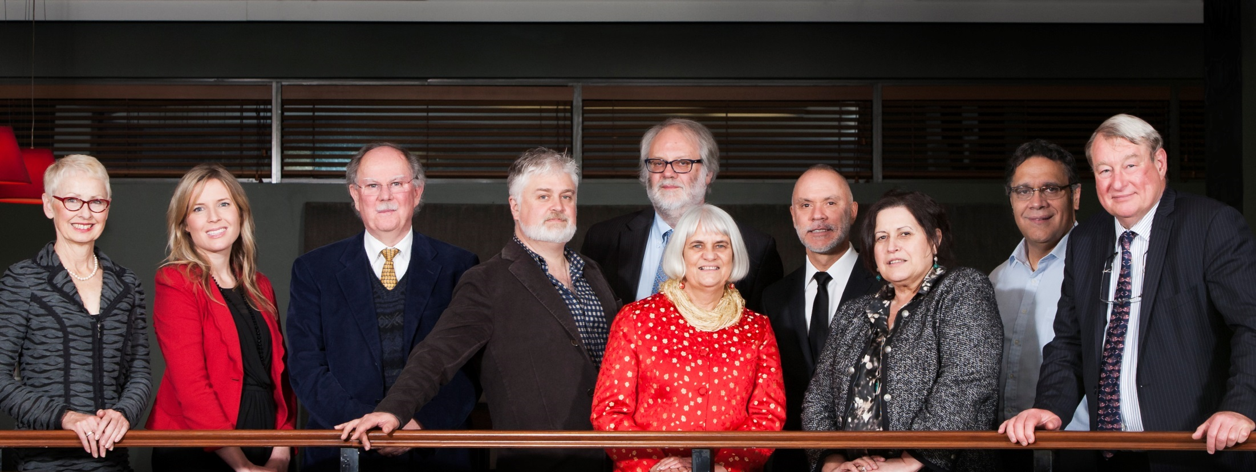
Aboriginal and Torres Strait Islander Higher Education Advisory Council
Notes:
About ATSIHEAC:
The Council was established in 2012, following the Behrendt Review of Indigenous higher Education
Membership comprises Indigenous academics, and individuals selected for their expertise in business, governance and university leadership
Also includes representatives from Universities Australia and the National Aboriginal and Torres Strait Islander Higher Education Consortium
Current members:
Professor Ian Anderson, University of Melbourne, Co-Chair and Executive Member
Professor Jill Milroy, University of Western Australia, Executive Member
Ms Rosie Southwood, Wesfarmers Limited, Executive Member
Professor Toni Downes, Charles Sturt University
Professor Sandra Eades, The University of Sydney
Professor Shane Houston, The University of Sydney
Professor Steven Larkin, Charles Darwin University
Professor Michael McDaniel, University of Technology, Sydney
Professor Michael McManus, The University of Queensland
Professor Andrew Wells, University of Tasmania
Professor Greg Hill, University of the Sunshine Coast
Ms Jillian Miller, University of South Australia
Mr Russell Taylor, Australian Institute of Aboriginal and Torres Strait Islander Studies [Observer]
Professor Peter Buckskin, Chair, NATSIHEC [Observer]

Slide 3
Policy Development Framework
Council has a policy development framework focussed on:
Broadening access across the disciplines
Whole of University Strategy
Academic Workforce
Sustainable financing
System level performance monitoring
Notes:
Council envisages a higher education sector characterised by:
Aboriginal and Torres Strait Islander people are represented at all levels of the academy, including:
Growing the Indigenous academic workforce, and
Preparing Indigenous leaders for decision-making roles
Indigenous Knowledges and perspectives are valued and embedded across institution life
Aboriginal and Torres Strait Islander students succeed across a broader range of disciplines
Outcomes should take into account the social and economic impact of the type and quality of graduates being produced
A simple focus on broad measures of participation and completion is not sufficient
Sustainable financing, optimally configured to improve outcomes
Analysis is required to ensure financing provides a platform for achieving Indigenous higher education policy objectives
Effective monitoring of progress at institutional and sectoral levels

Slide 4
Developing the STEM agenda
Engagement with Deans of relevant disciplines to co-develop strategy
Developing an Indigenous foucs in the national STEM education agenda
Promotion of STEM to Indigenous secondary school students
Research and data for monitoring
Notes:
This will mean:
Responsibility for improving outcomes is shared from the highest levels, throughout the university
Full and effective support for Indigenous education units with appropriate resourcing
Appropriate Indigenisation of curricula
Leadership at the Faculty level to support student success
Governance and accountability mechanisms that incorporate Indigenous leadership in decision-making, and whole-of-institution responsibility for outcomes
Council’s work is focussed on developing a better understanding of:
Universities’ leadership models and the relative strengths and weaknesses of those models
How Indigenous units and Faculties complement each other’s roles
We already have a whole-of-university approach for non-Indigenous people.
The same rigour that an institution brings to other activities (like internationalisation) should apply to Indigenous education.

Slide 5
Increasing Indigenous participation and attainment in a broader range of disciplines
11 per cent of Indigenous people were employed in professional occupations, compared to 20 per cent of non-Indigenous people.
The most common occupation group for employed Indigenous people was Labourer (24 per cent) and for non-Indigenous people it was Professional (20 per cent).
Drawn from Census data 2006 and 2011
Notes:
Behrendt Review:
The Behrendt Review found that Indigenous enrolments were clustered within a narrow range of disciplines
Limits access of Indigenous people to professional careers
Limits capacity of professional service providers to understand and incorporate Indigenous knowledges and perspectives
The Review highlighted the role of Faculties in supporting professional preparation of students
It recommended Faculties work with professional bodies, employers and communities to drive growth in the number and breadth of Indigenous professionals
Indigenous higher education plays a significant part in Indigenous social and economic development and should be conceptualised as part of broader human capital strategy
Progress in this area will depend on leadership by and collaboration with Deans and the professions
ATSIHEAC STEM roundtable:
Held in December to discuss priorities for work to be undertaken in the Indigenous STEM policy space
Participants were drawn from Deans councils, teaching professional associations, Australian government agencies and researchers
Follow up meetings are now occurring with individual Deans groups
Go8+ Deans of Engineering are well placed to lead a national dialogue in the Engineering space
[Source for figures on slide: Anderson, I, 2011. Indigenous Pathways into the Professions, University of Melbourne]

Slide 6
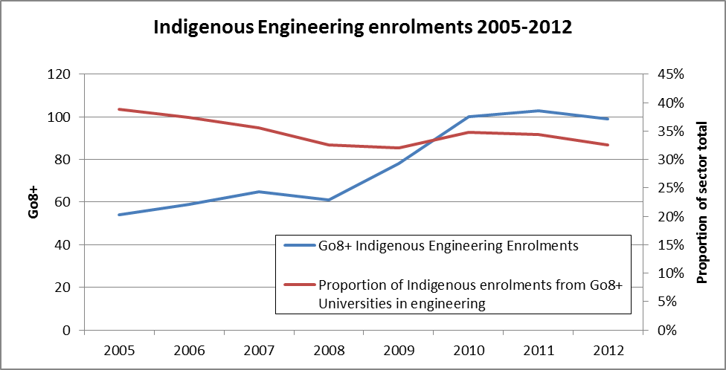
Indigenous Engineering enrolments 2005-2012
Notes:
Indigenous Engineering enrolments:
This chart shows all Indigenous Engineering enrolments for the period 2005-2012 at Go8+ universities
It also shows their share of Indigenous Engineering enrolments for all higher education providers
Numbers are increasing across all higher education providers (with the exception of Melbourne), for the Go8 clustering in NSW, Queensland (east coast)
Enrolments significantly greater than completions, possibly reflecting growth in part 14/1000 in 2012
Spread across the engineering disciplines
Enrolments and completions by level of study are shown in following slides
Largest cluster in NSW/Queensland; Lowest Victoria; ? WA.
Administrative data on Aboriginality tends to undercount rather than overcount (the degree depending on the collection method)

Slide 7
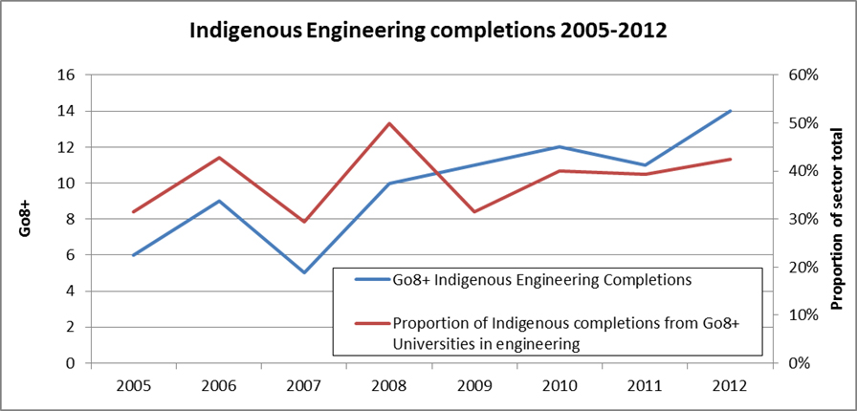
Indigenous Engineering completions 2005-2012
Notes:
Indigenous Engineering completions:
This chart shows all Indigenous Engineering completions for the period 2005-2012 at Go8+ universities
It also shows their share of Indigenous Engineering completions for all higher education providers

Slide 8
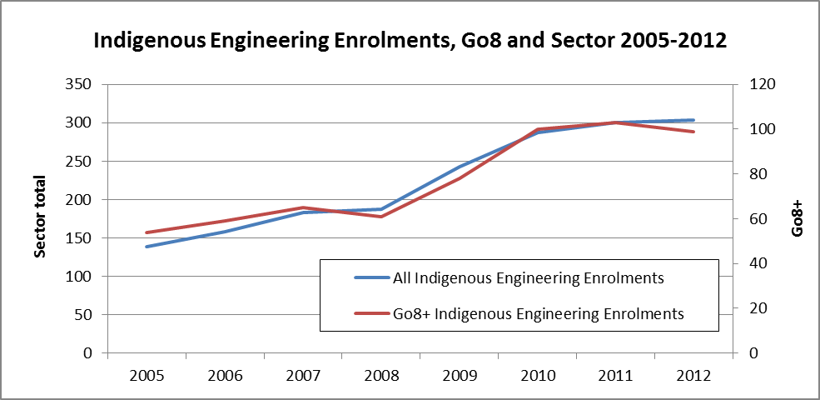
Indigenous Engineering Enrolments, Go8 and Sector 2005-2012
Notes:
Indigenous Engineering enrolments
This slide provides a comparison of Engineering enrolments for Go8+ universities and the sector as a whole

Slide 9
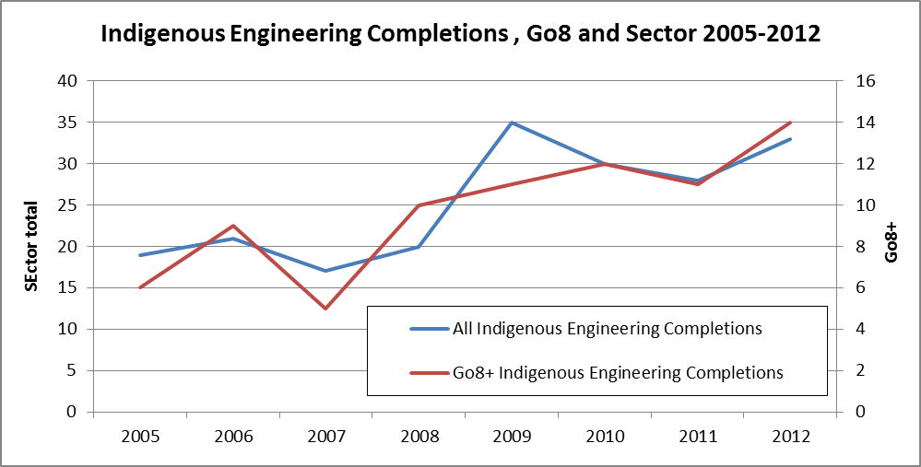
Indigenous Engineering Completions, Go8 and Sector 2005-2012
Notes:
Indigenous Engineering enrolments
This slide provides a comparison of Engineering completions for Go8+ universities and the sector as a whole

Slide 10
Indigenous Engineering Enrolments by broad level of course 2005-2012
University Name | Degree | Enrolment
 |  | 2005 | 2006 | 2007 | 2008 | 2009 | 2010 | 2011 | 2012
Monash University | Bachelors | <5 | <5 | <5 | <5 | <5 | <5 | <5 | <5
The University of Adelaide | Bachelors | 5 | <5 | <5 | <5 | <5 | 5 | 5 | <5
University of Newcastle | Bachelors | 8 | 11 | 15 | 15 | 16 | 27 | 27 | 20
The Australian National University | Postgraduate | <5 | <5 | 0 | <5 | <5 | 0 | 0 | <5
 | Bachelors | 0 | 0 | <5 | <5 | <5 | <5 | <5 | <5
The University of Melbourne | Postgraduate | <5 | 0 | <5 | <5 | 0 | 0 | 0 | 0
 | Bachelors | <5 | 5 | 5 | <5 | <5 | <5 | 0 | 0
The University of Queensland | Postgraduate | <5 | 0 | 0 | <5 | <5 | <5 | 0 | <5
 | Bachelors | 8 | 6 | 7 | 7 | 12 | 13 | 15 | 16
The University of Sydney | Postgraduate | <5 | 0 | 0 | <5 | <5 | <5 | 0 | <5
 | Bachelors | <5 | <5 | <5 | <5 | 5 | 5 | 6 | 6
The University of Western Australia | Postgraduate | 0 | 0 | 0 | <5 | <5 | 0 | 0 | 0
 | Bachelors | <5 | <5 | <5 | <5 | <5 | 5 | 7 | 7
The University of Wollongong | Postgraduate | 0 | 0 | 0 | 0 | 0 | <5 | <5 | <5
 | Bachelors | 5 | 7 | 7 | 7 | 10 | 14 | 11 | 11
University of New South Wales | Postgraduate | <5 | 7 | 8 | 6 | 7 | 5 | 5 | 7
 | Bachelors | 9 | 8 | 7 | 6 | 12 | 14 | 17 | 17
 | Sub bachelors | 0 | 0 | 0 | 0 | 0 | <5 | 5 | <5
TOTAL |  | 139 | 158 | 182 | 187 | 243 | 286 | 299 | 301
Notes:
Indigenous Engineering enrolments:
This chart shows all Indigenous Engineering enrolments, by level of course, at Go8+ universities for the period 2005-2012

Slide 11
Indigenous Engineering Completions by broad level of course 2005-2012
University Name | Degree | Enrolment
 |  | 2005 | 2006 | 2007 | 2008 | 2009 | 2010 | 2011 | 2012
Monash University | Bachelors | 0 | 0 | 0 | <5 | <5 | 0 | <5 | 0
The University of Adelaide | Bachelors | <5 | <5 | <5 | 0 | 0 | <5 | 0 | 0
University of Newcastle | Bachelors | <5 | <5 | <5 | <5 | <5 | 0 | <5 | <5
The Australian National University | Postgraduate | 0 | 0 | 0 | 0 | <5 | 0 | 0 | 0
 | Bachelors | 0 | 0 | 0 | <5 | 0 | 0 | <5 | <5
The University of Melbourne | Postgraduate | <5 | <5 | 0 | 0 | <5 | 0 | 0 | 0
 | Bachelors | 0 | <5 | <5 | <5 | 0 | <5 | 0 | 0
The University of Queensland | Postgraduate | 0 | 0 | 0 | 0 | 0 | 0 | 0 | 0
 | Bachelors | <5 | 0 | 0 | <5 | 0 | <5 | <5 | <5
The University of Sydney | Postgraduate | 0 | 0 | 0 | 0 | 0 | 0 | 0 | 0
 | Bachelors | <5 | 0 | 0 | <5 | <5 | <5 | 0 | <5
The University of Western Australia | Postgraduate | 0 | 0 | 0 | 0 | 0 | 0 | 0 | 0
 | Bachelors | 0 | <5 | 0 | <5 | <5 | <5 | 0 | <5
The University of Wollongong | Postgraduate | 0 | 0 | 0 | 0 | 0 | 0 | 0 | <5
 | Bachelors | 0 | 0 | <5 | <5 | 0 | <5 | <5 | <5
University of New South Wales | Postgraduate | 0 | 0 | 0 | <5 | <5 | <5 | <5 | <5
 | Bachelors | <5 | <5 | <5 | 0 | 0 | <5 | <5 | <5
 | Sub bachelors | 0 | 0 | 0 | 0 | 0 | 0 | 0 | 0
TOTAL |  | 19 | 21 | 17 | 20 | 35 | 30 | 28 | 32
Notes:
Indigenous Engineering completions:
This chart shows all Indigenous Engineering completions, by level of course, at Go8+ universities for the period 2005-2012

Slide 12
National Indigenous Engineering Summit 2015
Participate in National Indigenous Engineering Summit 2015
Contribute to discussion of longer term targets and goals
Actively promote the Summit amongst your peers
Timeline
19 September 2014: Pre-Summit Forum
18-19 June 2015: Summit
Notes:
National Indigenous Engineering Summit 2015:
I’d like to finish with an invitation for you to participate in a National Indigenous Engineering Summit being planned for 2015.
It is being organised by the University of Melbourne and its partners under the Higher Education Participation and Partnerships Program.
It will be an opportunity for Deans to lead change at the national level.
It was just such collaboration that drove improvements in enrolment, graduation and employment of Indigenous doctors.
The purpose of the Summit is to promote shared responsibility to improve pathways into Engineering studies and related professions.
It will focus on real outcomes: more graduates over time and ultimately parity with non-Indigenous people.
Participants will be drawn from: Deans of Engineering, ICT and Education; Principals of TAFE colleges; Mathematics teachers; and Indigenous role models.
Outcomes will include:
A white paper on Indigenous engineering
Initiatives and strategies for developing engineering pathways
Commitment from all key stakeholders
Momentum and follow through.
The National Summit will be held on 18-19 June next year.
There will also be a pre-summit forum held on 19 September this year to give key stakeholders an opportunity to contribute to shaping the Summit.
Other elements of the HEPPP project being run by the University of Melbourne are:
A pilot scholarship for Indigenous student on an engineering pathway
An Indigenous academic enrichment program for Indigenous school students and their teachers (with initial STEM focus)
A Bachelor of Science (Extended) including bridging subjects in mathematics and science.

Slide 13
Contacts
National Indigenous Engineering Summit
Associate Professor Shanika Karunasekera
(03) 8344 1410
karus@unimelb.edu.au
ATSIHEAC Secretariat, Department of Education:
ATSIHEACSecretariat@education.gov.au
Notes:
Contacts:
If you’d like to attend the pre-summit forum and/or the summit itself, or you would like more information, please contact Shanika Karunasekera, who is Assistant Dean (Equity and Diversity), in the Department of Computing and Information Systems at the Melbourne School of Engineering.
If you’d like more information on ATSIHEAC’s work, please contact the Council’s secretariat in the Department of Education.
I’m happy to take questions

