Slide 1
Building STEM pathways for Indigenous Australians: a higher education perspective
Professor Ian Anderson
Co-Chair: Aboriginal and Torres Strait Islander Higher Education Advisory Council (ATSIHEAC)

Slide 2
Breakdown of students by discipline
Narrow field of education | Indigenous
 | Commencing students | All students
0100 Natural and Physical Sciences | 52 | 125
0101 Mathematical Sciences | 6 | 11
0103 Physics and Astronomy | < 5 | 8
0105 Chemical Sciences | < 5 | 5
0107 Earth Sciences | 5 | 20
0109 Biological Sciences | 45 | 100
0199 Other Natural and Physical Sciences | 112 | 265
0200 Information Technology | 5 | 8
0300 Engineering and Related Technologies | 28 | 55
0500 Agriculture, Environmental and Related Studies | 8 | 18
0601 Medical Studies | 89 | 258
0605 Pharmacy | 11 | 22
0607 Dental Studies | 14 | 40
0609 Optical Science | 0 | < 5
0611 Veterinary Studies | 9 | 30
0615 Radiography | 10 | 27
0907 Behavioural Science | 154 | 350
Notes:
This table shows the breakdown of students by specific disciplines.
The numbers represented in this table – taken from 2011 – are indicative of the fact that further work needs to be done to attract Indigenous peoples to STEM disciplines.

Slide 3
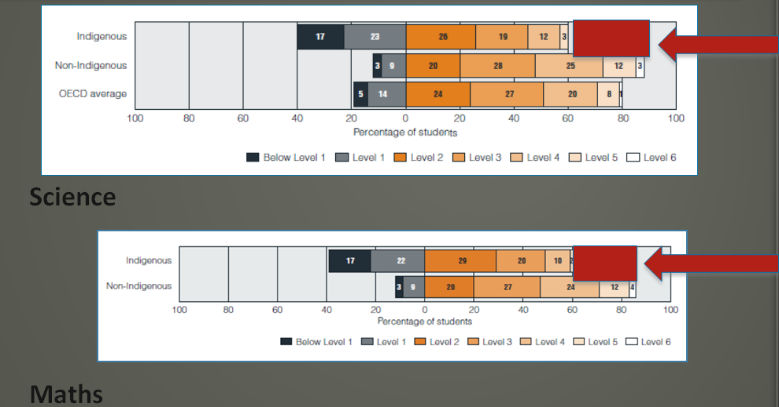
PISA Maths Science Literacy Indigenous and non-Indigenous students
Maths & Science Literacy: PISA 2006
NIHEC 2011
Notes:
A key reason as to why indigenous students are not entering STEM disciplines is shown in an analysis of PISA data from 2006. Indigenous students are not scoring as highly on PISA tests in science, or maths literacy than their non-indigenous counterparts.
For us, it is not about trying to remediate the bottom 75%, but trying to improve the top 25% to give them access to those STEM courses.
This Requires an educational focus on the top end of the outcomes curve
However, interventions to improve secondary schools retention are not enough
Requires a focus on maths/science
Careers, Aspirations, Families

Slide 4
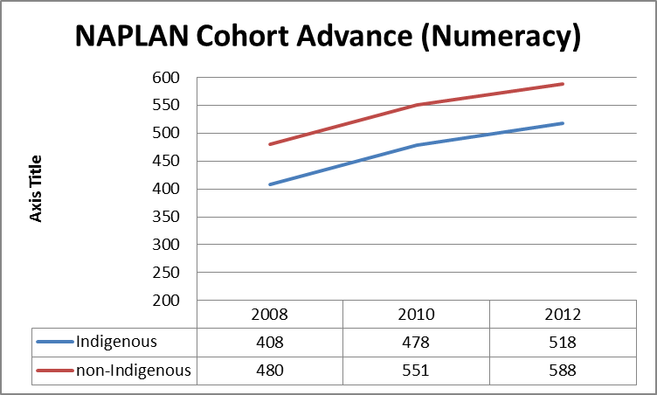
NAPLAN Cohort Advance – Numeracy and Literacy
NAPLAN analysis shows that Indigenous and non-Indigenous students experience the same value add from Education.
However, Indigenous children start from a lower base do not ‘catch-up’.
Notes:
The two graphs show a comparison of non-Indigenous and Indigenous students as they were followed from year 5 (in 2008) to year 9 (in 2012).
Analysis conducted by the Department of Education shows that Indigenous and non-Indigenous children gain the same value add from education. However, Indigenous children start at a lower base on the NAPLAN scale, and never catch up.
Just changing secondary school retention will not be sufficient, it is required that Indigenous students ‘catch up’ to non-Indigenous students before they enter year 3 (the first year of NAPLAN testing). For those students who have passed this threshold, there is an impetus to put more resourcing into catching those children up in the years between year 3 and year 12.

Slide 5
Science Engagement and Literacy
Analysis of 2006 PISA Indigenous/Non-Indigenous Australian and New Zealand (Woods McConney et al 2013)
Science Engagement (student attitutes, interestes and self-beliefs) shown to have a correlation with Science Literacy
Variations in Science Engagement most strongly correlated with the extent to which students engaged with science activities outside of school
SES status, time spent on science lessons and study, character of science teaching explained most of the literacy variance but only weak correlation with engagement
Notes:
The Woods-McConney paper compares Indigenous students in New Zealand and Australia on their engagement in science education. The paper finds that engagement, interest, enjoyment, personal and general valuing, self-efficacy, and self-concept in science are greatest where students are engaged in science activities outside of school.

Slide 6
Science Literacy and Science Interest
Retrospective analysis of PISA 2006 (McConney et al 2011):
Indigenous science literacy lags non-Indigenous literacy by about 83.5 points or .76 standard deviation units
Indigenous science interest led that of non-Indigenous students by 10 points of 0.1 SD
Regressions modelling: Reading Literacy accounted for 62 per cent of science literacy variance, Science interest had a weak effect
Notes:
(both normally distributed but non-Indigenous curve slightly more left leaning)
The most significant variable which related to science literacy was not interest but rather socio economic status, time spent on science lessons and study, ‘and the character of science teaching experienced by students in their schools were the factors most explanatory of variations in science literacy.’
The interest that Indigenous children had in science was slightly higher than that of non-Indigenous children. However, the interest in learning science was 2 points, or .2 of a SD.
‘For the other six variables that comprise engagement in science, however, small to medium gaps favouring non-Indigenous students were observed for … Australian 15-year-olds.’ Woods-McConney et al.

