Slide 1
Aboriginal and Torres Strait Islander Higher Education Advisory Council
Indigenous Leaders Forum
Research Training and Participation by Indigenous Candidates –
Closing the Gap.
Address to Australian Council of
Deans And Directors of Graduate Studies
Annual Council Meeting 14 Nov 2014
Professor Ian Anderson
Co-Chair
Aboriginal and Torres Strait Islander
Higher Education Advisory Council

Slide 2
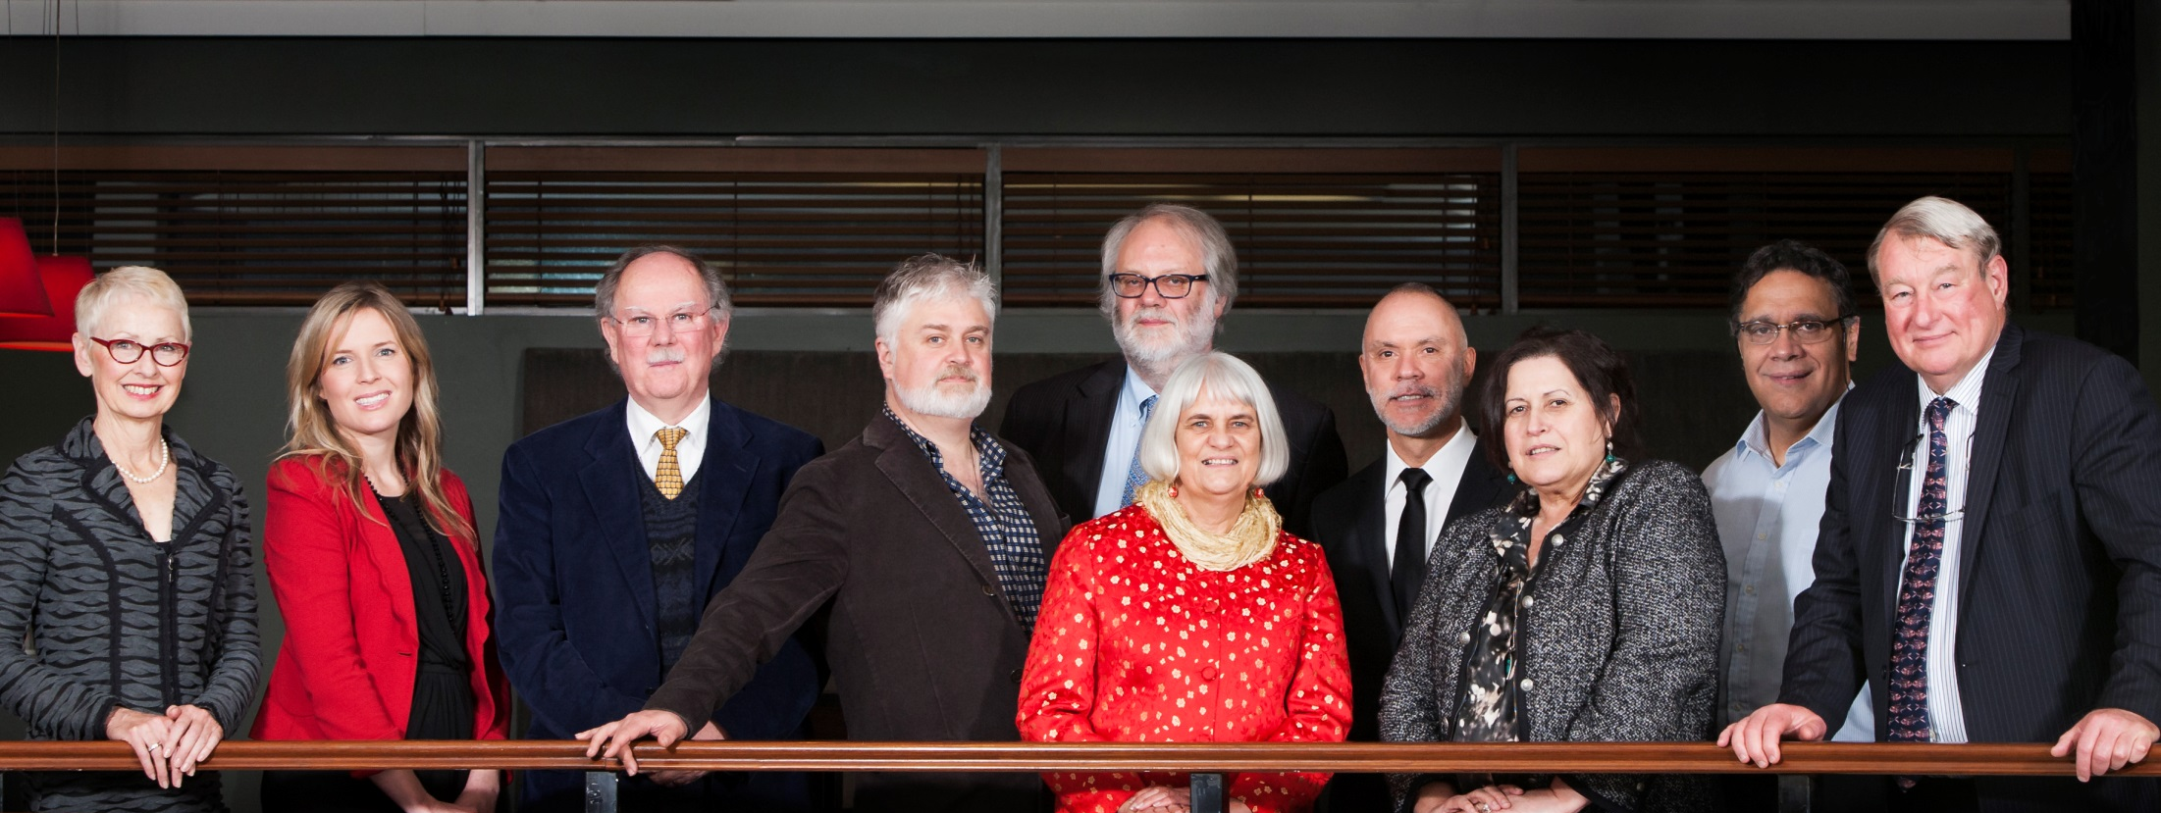
Aboriginal and Torres Strait Islander
Higher Education Advisory Council

Slide 3
ATSIHEAC policy development framework
Broadening access across the disciplines
Whole of University Strategy
Academic Workforce
Sustainable financing
System level performance monitoring

Slide 4
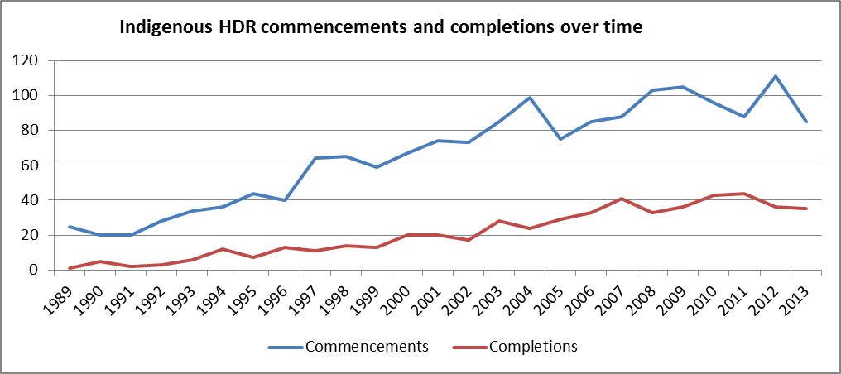
Indigenous HDR Commencements and Completions

Slide 5
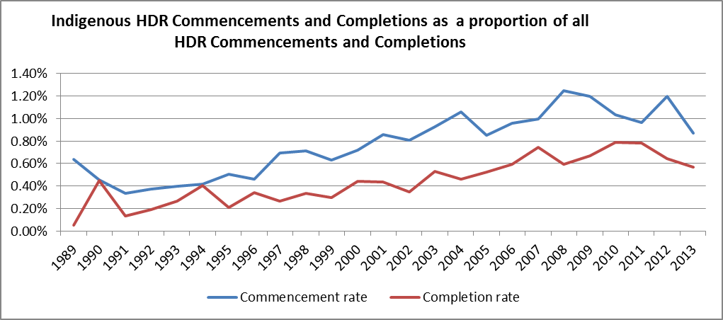
Indigenous as a proportion of all HDR commencements and completions

Slide 6
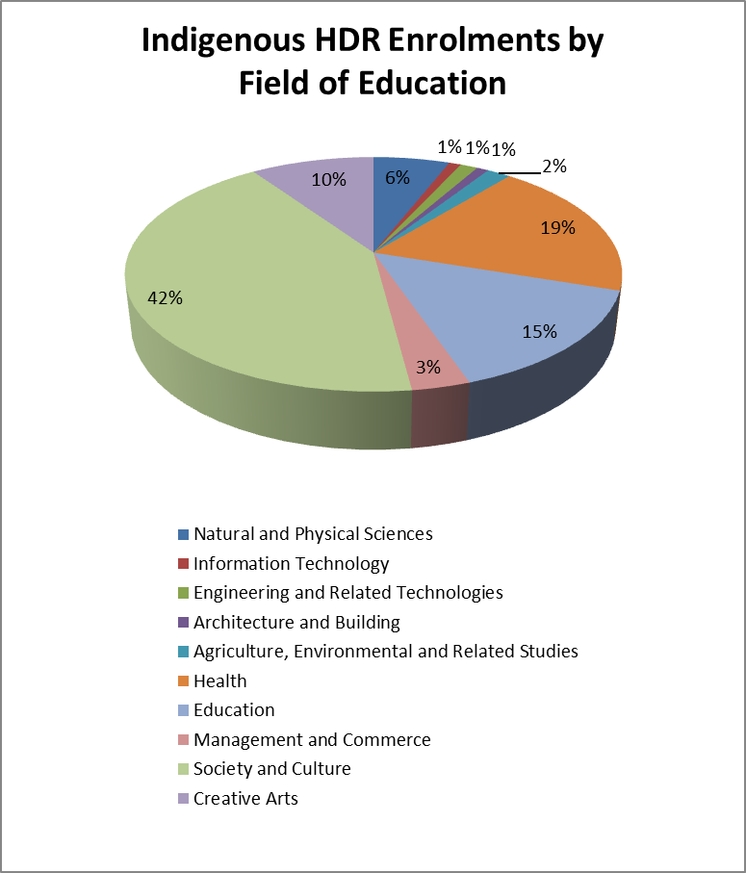
Indigenous HDR Enrolments by Field of Education

Slide 7
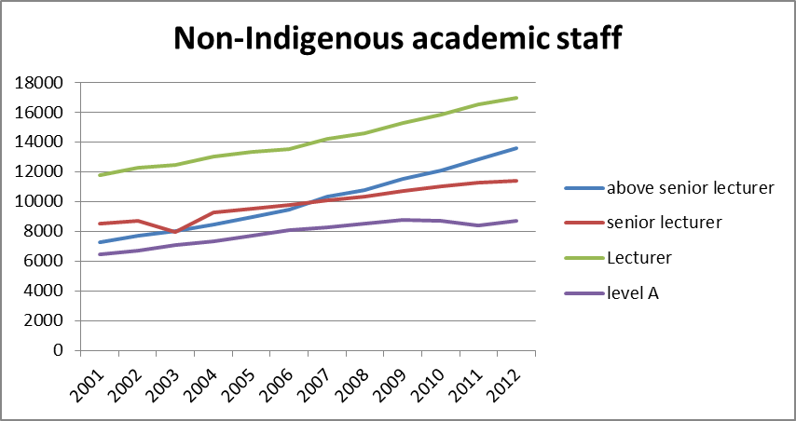
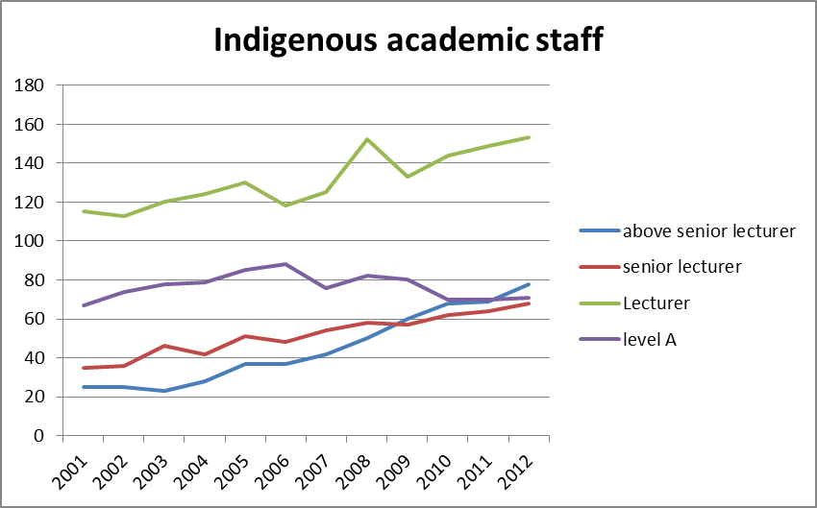
The Indigenous Academic workforce

Slide 8
What is ATSIHEAC doing?
ATSIHEAC is looking at strategies to, among other things:
Maximise the PhD pipeline for Indigenous students
Identify and address barriers to Indigenous students considering HDR options including cultural, financial and structural
Identifying and clarifying lateral entry pathways from professions

Slide 9
Areas where DDoGs can make a difference
Identification of high flyers
Supervision – Awareness of Cultural Competency
https://www.lowitja.org.au/lowitja-publishing/C023
https://www.universitiesaustralia.edu.au/uni-participation-quality/Indigenous-Higher-Education/Indigenous-Cultural-Compet#.VGGLtHIU-Uk
Curriculum for HDR programmes
Outreach

Slide 10
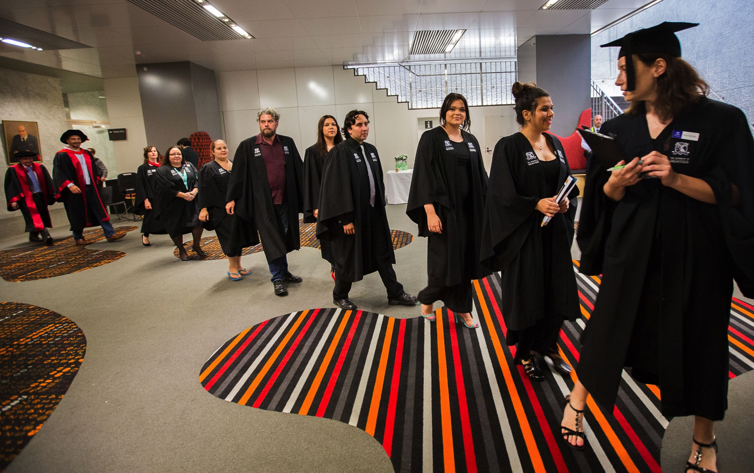
Supporting student success
[Ian: do you have an image we could use in this slide – one of students doing STEM-related studies - one that you have permission to use?]

Slide 11
Contacts
ATSIHEAC Secretariat, Department of Education:
ATSIHEACSecretariat@education.gov.au
Notes:
Contacts:
If you’d like more information on ATSIHEAC’s work, please contact the Council’s secretariat in the Department of Education.
I’m happy to take questions

