Slide 1
Aboriginal and Torres Strait Islander Higher Education Advisory Council
Indigenous Leaders Forum
Aboriginal and Torres Strait Islander Higher Education Advisory Council.
Universities Australia March 2015
Professor Ian Anderson
Co-Chair
Aboriginal and Torres Strait Islander
Higher Education Advisory Council

Slide 2
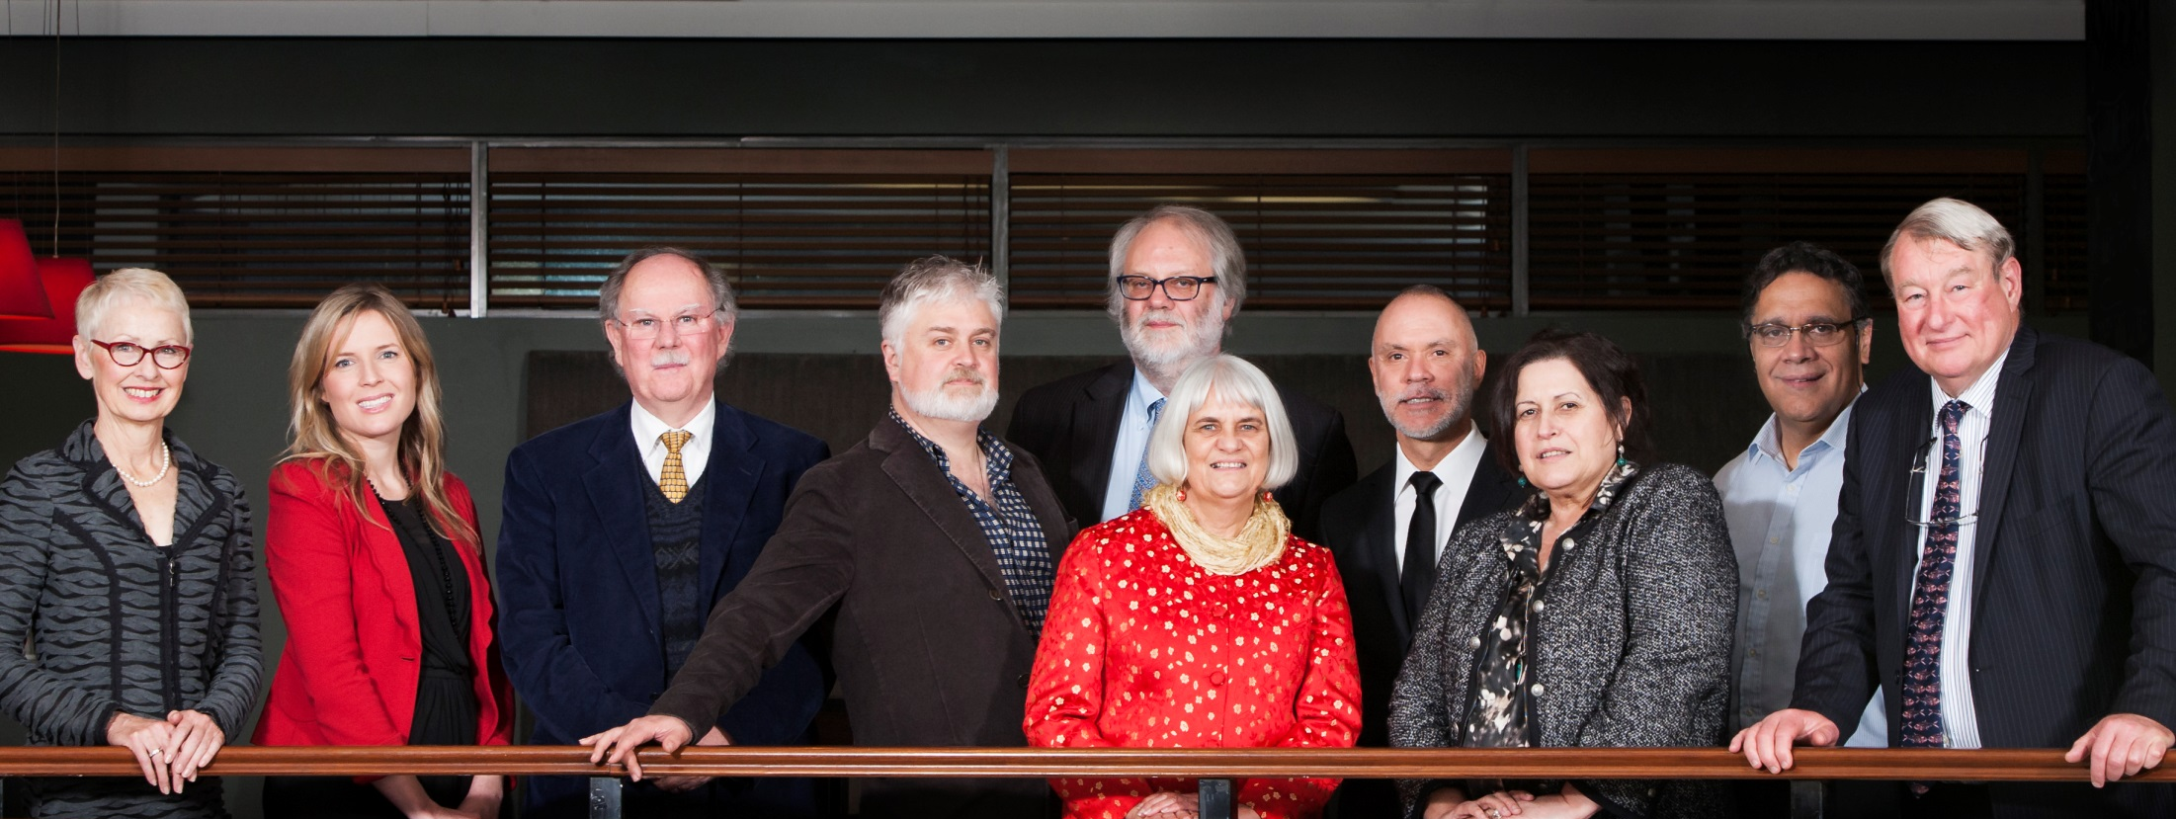
Aboriginal and Torres Strait Islander
Higher Education Advisory Council
(The Council)

Slide 3
ATIHEAC strategic policy priorities
Broadening access across the disciplines
Whole of University Strategy
Academic Workforce
Sustainable financing
System level performance monitoring

Slide 4
Commencing and all Indigenous students 2003–2013
Source: Commonwealth Department of Education 2014

Slide 5
Indigenous students AS A proportion of domestic students
Source: Commonwealth Department of Education 2014

Slide 6
Completion rates for Indigenous students
 | Cohort (commencing) | Completed (in any year) | Still enrolled at the end of the 6 year cohort period
Indigenous | 2005 | 40.9% | 13.8%
 | 2006 | 41.1% | 13.4%
 | 2007 | 40.0% | 15.1%
Non-Indigenous | 2005 | 67.2% | 11.0%
 | 2006 | 67.2% | 11.0%
 | 2007 | 67.0% | 11.4%
Source: Commonwealth Department of Education 2014

Slide 7
AWARD COURSE COMPLETIONS BY BROAD FIELD OF EDUCATION

Slide 8
Indigenous higher education in 2020
Vision
Success in Indigenous higher education is seen as indivisible from the success of individual institutions and the higher education system as a whole.
Success is more than a headline parity measure. As envisaged in the Review of Higher Education Access and Participation for Aboriginal and Torres Strait Islander People, it means more students, succeeding in a wider range of disciplines, more academics, more graduates and more Indigenous professionals.
Indigenous knowledges are valued and represented across the academic agenda
Research is strategically engaged with Indigenous researchers, communities and issues, documenting and valuing the contribution of Indigenous peoples to the human story.
Universities are not only culturally safe they celebrate and connect students and staff to the rich cultural history of Indigenous peoples.

Slide 9
What will we need to get there?
A shift away from a deficit model and towards institutional change
embracing Indigenous perspectives & knowledges
creating a culturally competent and safe environment
supporting excellence as well as targeting need
‘Success’ will be measurable, accountabilities clear and shared.
Resourced and incentivised by policy settings which leverage mainstream funding.

Slide 10
Progress
ATSIHEAC activities and priorities are targeted towards that vision by facilitating collaborations and identifying actions to accelerate change.
University consultations
STEM and Business roundtables
Performance frameworks
Academic workforce
Policy forum

Slide 11
University visits
Met with almost all universities over the past 18 months
Some best practice emerging
Need for information exchange mechanisms
Effective leadership essential
Outcomes of visits are being synthesised into a report to assist Council in development of advice to government
Visits are also informing the development of a report on successful whole-of-university approaches.
Will include high level principles to guide development and implementation of universities’ own models

Slide 12
Broadening Pathways – STEM and business
STEM is a determining pathway, especially for professions. Council’s approach aims to:
Embed Indigenous STEM in national policy agenda
Move conversation towards targeted intervention
Build partnership between leading players
Provide evidence base for accelerated change
Business roundtable in planning for April 2015. Also aims to build coalition of key players to identify targeted actions for accelerated change.

Slide 13
Performance frameworks
Working with project at National Centre for Student Equity in higher education to develop a conceptually-based performance measurement framework for equity (MFE) in higher education .
Focussing on how to ensure that performance framework maps to the sorts of outcomes envisaged in the Review of Higher Education Access and Outcomes for Aboriginal and Torres Strait Islander People.
Important to pick up broader concept of success outlined above including systemic change.

Slide 14
Academic workforce
Commenced development of policy advice to address development of Indigenous academic workforce.
Maximise PhD pipeline for Indigenous students
Identify and clarify lateral entry pathways
Description & analysis of current Indigenous academic workforce and PhD cohort
Strategies that are oriented towards the needs of a future academic workforce
Addressing the policy barriers to success for future Indigenous academics
Where and how Indigenous Employment strategy coordinators are developing supporting strategies

Slide 15
Indigenous Academic Staff as a Proportion of All Academic Staff by Level 2001-2012

Slide 16
Indigenous HDR Commencements and Completions 1989-2013

Slide 17
Indigenous HDR Field of Education

Slide 18
Policy forum
April 15 in Canberra.
Will pick up the various issues outlined here – focus is on how we can work together to share good practice and lessons learned since the 2012 Review.
Aims to identify what’s needed to accelerate change.

Slide 19
Contacts:
ATSIHEAC Secretariat, Department of Education:
ATSIHEACSecretariat@education.gov.au

