Slide 1
PRISMS MODERNISATION: TECHNICAL WORKING GROUP

Slide 2
PRESENTATION OVERVIEW
Introduction
Engagement
Implementation and Delivery
PRISMS API functions and Design
PRISMS API Features
API Support
Next steps

Slide 3
SHARE

Slide 4
ENGAGEMENT

Slide 5
Engagement
BY WHAT MEANS
Technical Working Group Webinars
Software Vendor
Other channels – specialised GovTeams groups
PRISMS Modernisation website

Slide 6
Engagement
AIM
Continue to develop an understanding of the PRISMS API technical scope
Provide progressive updates to the sector
Participate in valuable technical information exchange between the sector and the department
Work through operational challenges for implementation
Provide timely feedback to questions

Slide 7
PRISMS MODERNISATION WEBSITE

Slide 8
Implementation and Delivery

Slide 9
Implementation Plan
Project Planning and Scheduling
Discovery and Solution Architecture
Ongoing API releases and sector onboarding
Jul-Aug 2022
Jul-Dec 2022
Jul 2023- Jun 2024
1
1
2
3
1
2
3
4
Aug 2022 – Jul 2024
Jan 2023 – Jun 2024
Jan 2023 – Jun 2024
Jun 2024
Stakeholder Consultations
Agile Development and co-design
Onboarding Support Workshops
API as BAU
Project Phase 1 | Project Phase 2 | Project Phase 3 | Project Phase 4
Establishment | Implementation | Transition | BAU

Slide 10
PRISMS API Functions and Design

Slide 11
PRISMS API FUNCTIONS: CoE Create functionality
The first goal of this project is to allow providers to create approved CoEs in PRISMS from their admission management and student management software via APIs.

Slide 12
CREATE CoE API FUNCTION DESIGN: Features
Maintain existing CoE data requirements
Single endpoint call to create approved CoEs
Supporting reference value endpoints
Dependencies on client systems having certain PRISMS data e.g., Student details, CRICOS Course, Location, Enrolment Dates and Fees, Overseas Health Cover etc
Automatic student identification
User Authentication & Authorisation

Slide 13
CREATE COE API FUNCTION: Student Identification
Existing CoE code or passport number
Check for matching student details - First name, middle name, family name, gender, Country of birth etc ingle endpoint call to create approved CoEs
Where multiple student records are found, the latest created record verified

Slide 14
CREATE COE API FUNCTION: API Interaction overview

Slide 15
PRISMS API: Future Functions
Generation of CoE Certificates
CoE Creation for under 18 students
Generation of accommodation and welfare arrangement letters
Creation of incomplete, saved or pending CoEs
Reporting of basic student course variations (SCVs)
Retrieval of PRISMS data to support CoE creation

Slide 16
API Features

Slide 17
API FEATURES: Overview
REST based industry standards
Secured
Authentication and Authorisation
Data Validation

Slide 18
API FEATURES: Industry API Standards
The PRISMS Provider API will be REST based following industry standards:
GET (read), POST (create), PUT (Update), DELETE operations
Standard error codes
Filtering, sorting, pagination
API Versioning

Slide 19
API FEATURES: API Security
The PRISMS Provider API will follow government API security standards
Authentication and Authorisation
Input Validation
Rate Limiting
Audit Logging
Asynchronous where appropriate

Slide 20
API FEATURES: Authentication
Authentication and authorisation approach based around some key concepts
Alignment with Whole of Government approach​ and guidance
Analysis of existing authentication models in place in the department with a focus on opportunities for alignment and re-use
Leverage modern OpenID/Connect and OAuth2.0 flows.

Slide 21
API FEATURES: Attended and unattended workflows
Legislative and business requirements for both attended and unattended flows
Some flows will need to be triggered by a user with appropriate authorisation
We will use PRISMS identity management as part of these flows
Whether a call is attended or unattended will depend on the nature of the API call

Slide 22
API FEATURES: API Authorisation
The PRISMS Provider API will support both provider user (attended) and provider organisation (unattended) authorisation.
The PRISMS Provider API will implement API Authorisation at a request level
Generally:
Requests that will involve manipulation of data will require an authorised user to be authenticated on attended flows
Requests to retrieve some types of data will be one by provider organisations using an unattended flow through their client system

Slide 23
API FEATURES: Data Validation
Data will be validated with reference to existing PRISMS validation and business rules.
Validated against core PRISMS validation and business rules
Error messages returned
Warnings will be available at a later date

Slide 24
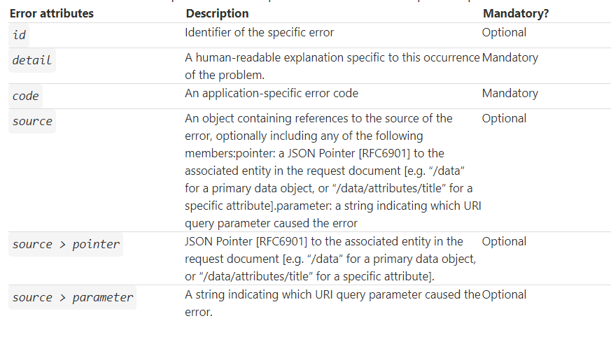
API FEATURES: PRISMS Errors

Slide 25
API FEATURES: Warnings

Slide 26
API SUPPORT

Slide 27
Onboarding and Assessment of Vendors and Providers
Onboarding to PRISMS API consists of four sequential steps:
Indicate Interest / Sign-up
Set-up to Develop and test
Commence Developing and testing
On-board to production environment

Slide 28
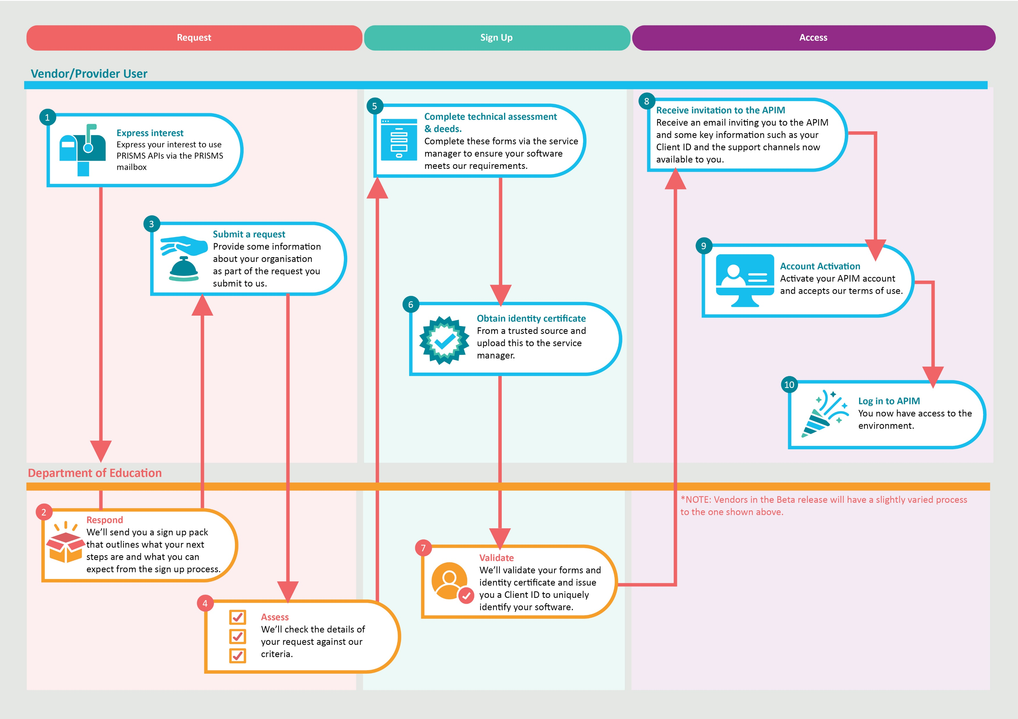

Slide 29
WHAT’S NEXT?

Slide 30
What’s next: Staging environment Beta release
Beta release – second quarter of 2023-2024August 2023
Initial release –
Scope – Test environment, API functionality, documentation, API portal etc
Iterative future releases (with added functionality & API refinement)
Sector communication and engagement (ongoing)

Slide 31
QUESTIONS

Slide 32
KEEP SHARING PRISMSAPI@education.gov.au https://www.education.gov.au/prisms-modernisation-project

Slide 33
CLOSING

