Slide 1
PRISMS Modernisation Project Technical Working Group #2 22 Feb 2023
We’ll be with you shortly……

Slide 2
PRISMS Modernisation Project Technical Working Group #2 22 Feb 2023
Warwick Miles | Director – PRISMS Modernisation
Department of Education

Slide 3
Today’s session
Today’s session
PRISMS Modernisation Project -Project Overview -Progress to date
-Dep. of Education
-Dep. of Employment and Workplace Relations
-Project documentation
-Next steps
-Q&A
Today’s session

Slide 4
PRISMS Modernisation Project: Overview
Background
Scope
Stakeholders
Over $17m allocated over two years (2022-2024) to streamline enrolment processes for international students.
The sector has long advocated to modernise PRISMS through direct representations and consultation.
Implement a new Application Programming Interface (API) for PRISMS to directly connect with education enrolment systems.
The project will focus on high use PRISMS functions. No change to PRISMS/Home Affairs interactions, legislation or reporting requirements.
The PRISMS website will remain functional and available.
CRICOS providers and PRISMS users
Software vendors
Home Affairs and Regulators

Slide 5
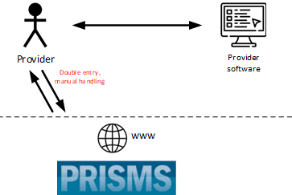
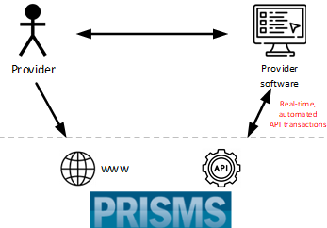
PRISMS: Current & Future
Future
Benefits
The enhancement of the PRISMS application make it easier for providers to submit student enrolment data by using the Business to Government (B2G) Application Programming Interface (API) automation.
The new integration capability is expected to:
save the sector an estimated $10 million in regulatory compliance costs each year
improve the timeliness and accuracy of PRISMS reporting
aid in the sustainable sector recovery post COVID-19
reduce double data handling for providers to improve business efficiencies.

Slide 6
The vision – CoE creation
You are in your admissions system or student management system.
At the point where you would normally log in to PRISMS to create a CoE, you might instead click a ‘Create CoE’ button.
The system would then input relevant data from your system to PRISMS then PRISMS would return any validations or warnings.
Once the validations are cleared in your system, you’d send it back to PRISMS to ‘Create CoE’.
If successful, PRISMS will create an approved CoE, then send back the CoE code and certificate to your system.

Slide 7
Progress to date
Key achievements
Next steps
Discovery phase complete – key decisions on architecture, infrastructure and authentication.
Technical documentation complete
Software vendor engagement meetings and surveys
Delivery timeframes refined
Technical design phase – regular document release to TWG members and software vendors
Software Vendor engagement to continue

Slide 8
Project key dates
July 2022
Project commenced
Discovery
.
September 2022
March 2023
Initial documentation flow to Stakeholders (vendors) through TWG
Internal IT release
April 2023
Initial IT release of testing environment for CoE Create/Approve API functionality
August - September 2023
Live (Production) pilot release
September - October 2023
Final IT release (External)
June 2024

Slide 9
PRISMS Modernisation Project
Technical update – 22 February 2023

Slide 10
Introduction
Framing the problem
Questions from November
Current priorities and delivery focus

Slide 11
Re-introduction to the Delivery team
We sit within Digital Services Division in Department of Employment and Workplace Relations (DEWR)
Manage IT solutions on behalf of the Department of Education
Multi-disciplinary team to deliver this project
Provider and vendor engagement and consultation managed out of the business team in Department of Education

Slide 12
What’s the problem we’re trying to solve?

Slide 13
Questions from November TWG
Impacts on current PRISMS functionality
Engagement with vendors
Continuation of manual processes through existing UI
Future API capabilities

Slide 14
Update from November TWG – Approved CoE Create
Defining the data flows and validations that underpin the UI process
Defining the data entities
Developing base API specifications from the CoE Create service flow

Slide 15
CoE Create Service Flow – PRISMS UI

Slide 16
3 Focus areas
Building the enabling infrastructure
Establishing API Lifecycle
API design and build
​

Slide 17
Infrastructure
Setting up environments and infrastructure to support external API capability
This is a new requirement for PRISMS as we haven't had system-to-system interfaces previously
This environment is for provider software suppliers to consume, not for providers.
In April we'll be doing an internal test to make sure that it can be accessed from an external source.

Slide 18
API Lifecycle
Onboarding and Assessment of Vendors and Providers
Defining the API lifecycle – both for us as producers and also consumers
Determining timings

Slide 19
API Design
We've identified the key data elements that make up a CoE – need to validate that these are all held in provider systems
Now breaking down common data required between the systems - reference data - eg States, Countries, Titles, Course Locations etc.
There are two types of reference data we see at this point
Global (eg countries and states) and
Provider specific (eg course locations).
Focus only on validation and supporting reference data for initial release (August)
Each API call will have its own particular nuances, engagement with end users will be key. Some reference calls will require little to no consultation (eg States), others may require more consideration and consultation

Slide 20
API Design
Example list of reference data for the CoE create process
Australian States
Country
Title
Gender
Provider Location
Country Of Birth
Nationality

Slide 21
Questions? Contact prismsAPI@education.gov.au

Slide 22
Project Documentation
PRISMS Data Elements: CoE Create Input Data Requirements
Target audience – vendors and education providers without direct PRISMS access
Details the current state data inputs for a user to create an approved Confirmation of Enrolment (CoE)
To assist in preparing own systems for upcoming (API) functionality being exposed to create CoE function

Slide 24
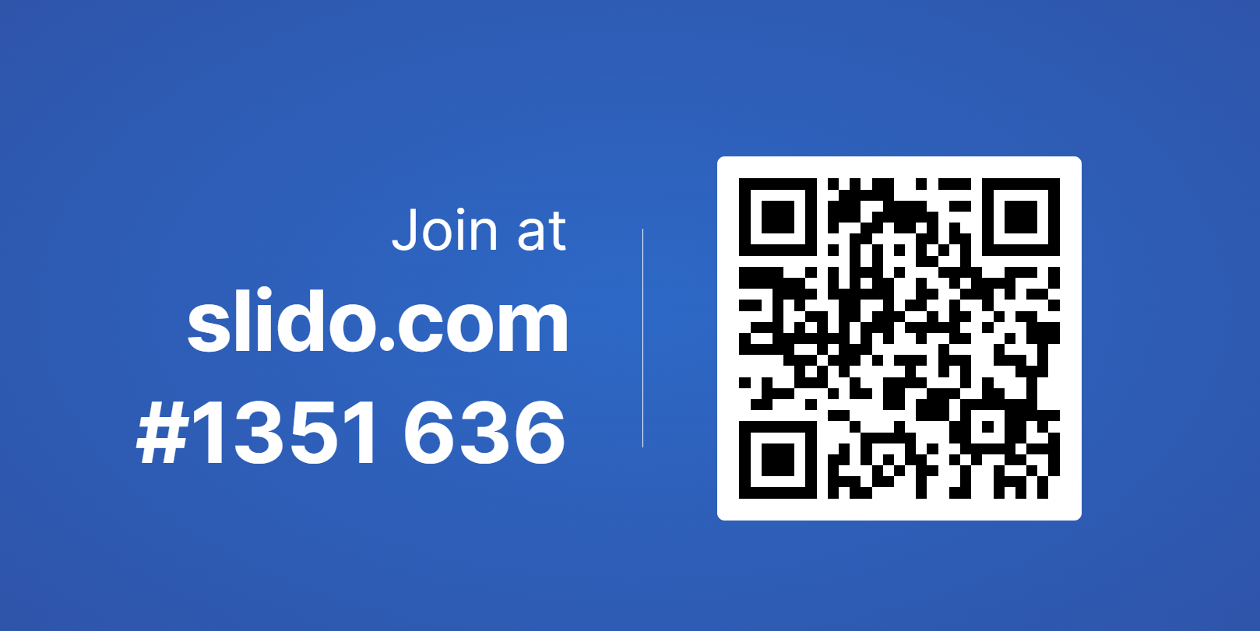
Project Documentation
Future PRISMS Functions

Slide 25
Future PRISMS Function - options
Retrieve CoE details
Retrieve visa alerts
Cancel CoEs
Update (expired) CoE status to approve
Confirm study commencement
Update CoE location
Basic Student Course Variation (SCV) reporting (non-commencement, completed course early, cessation of studies, transferred to another course, etc.)
Complex SCV (Suspension / Deferment, Change to enrolment, Extensions, etc.)
Report provider or student defaults

Slide 26
Future PRISMS Function – options cont.
Update welfare arrangement
End welfare arrangement
Terminate (non-approved) welfare
Retrieve welfare details
Print welfare Letter
Retrieve welfare information
Update student details (provider student ID, passport number, comments)
Update student contact details
Retrieve student details

Slide 27
Future PRISMS Function – options cont.
Record student releases
Record refusal of student releases
Retrieve courses and course information
Retrieve locations and location information
Add agent
Remove agent
Edit agent / agency information
Retrieve agents and agencies
Reset password of colleague

Slide 28
Key messages from CRICOS providers: Recap #1 TWG
Providers will look to us to approach their software vendors
Stakeholders want access to project documentation to better understand impacts on their business processes
Some providers are concerned that using the API will be mandatory – FACT: the PRISMS website will remain operational
The importance of a good test strategy and a test environment before implementation remains a priority for providers

Slide 29
PRISMS: Implementation Plan
Project Planning and Scheduling
Discovery and Solution Architecture
Ongoing API releases and sector onboarding
Jul-Aug 2022
Jul-Dec 2022
Jul 2023- Jun 2024
1
1
2
3
1
2
3
4
Aug 2022 – Jul 2024
Jan 2023 – Jun 2024
Jan 2023 – Jun 2024
Jun 2024
Stakeholder Consultations
Agile Development and co-design
Onboarding Support Workshops
API as BAU
Project Phase 1 | Project Phase 2 | Project Phase 3 | Project Phase 4
Establishment | Implementation | Transition | BAU

Slide 30
Next steps
Technical Working Group
Email updates and any documentation release on the web – March/April 2023
Next TWG meeting - April/May 2023
PRISMS News items will provide updates, and we have you on our stakeholder list
Software vendor engagement - ongoing
Key dates:
March - July 2023 – release of documentation to vendors through TWG
August - September 2023 – release of testing environment for CoE Create/Approve API functionality
September – October 2023 – live (Production) release of COE Create/Approve API functionality

Slide 31
Questions?

Slide 32
Thank you! Contact: prismsAPI@education.gov.au Website: https://www.education.gov.au/prisms-modernisation-project

