Slide 1
PRISMS Modernisation Project Inaugural Technical Working Group 30 November 2022
Warwick Miles | Director – PRISMS Modernisation
Department of Education

Slide 2
Today’s session
PRISMS Modernisation
-Overview
-Timeframes
-Stakeholder feedback
Panel session – Q and A

Slide 3


PRISMS Modernisation Project: Overview
Background
Scope
Stakeholders
The PRISMS modernisation initiative announced by the Australian Government in December 2021 under their deregulation agenda.
Over $17m allocated over two years (2022-2024) to streamline enrolments for international students.
The sector has long advocated to modernise PRISMS through direct representations and consultations.
Implement a new Application Programming Interface (API) for PRISMS to directly connect with education enrolment systems.
The project will focus on high use PRISMS functions. No change to PRISMS/Home Affairs interactions, legislation or reporting requirements.
The project will expand the department’s B2G (business to government) interactions.
The PRISMS website will remain functional and available.
CRICOS providers and PRISMS users
Software vendors
Home Affairs and Regulators

Slide 4


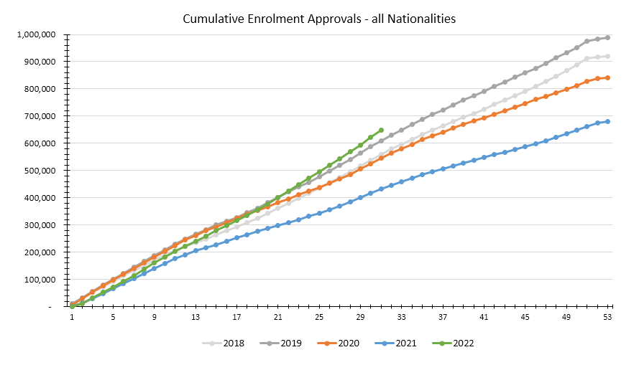
International student enrolments
Source: PRISMS

Slide 5
Student visa lodgements
Source: Department of Home Affairs

Slide 6

Why modernise PRISMS now?
2005
2020
Last major PRISMS upgrade in 2005
Impact of COVID-19 on enrolments and the sector
.
2015/2021
Sector consultations and feedback.

Slide 7

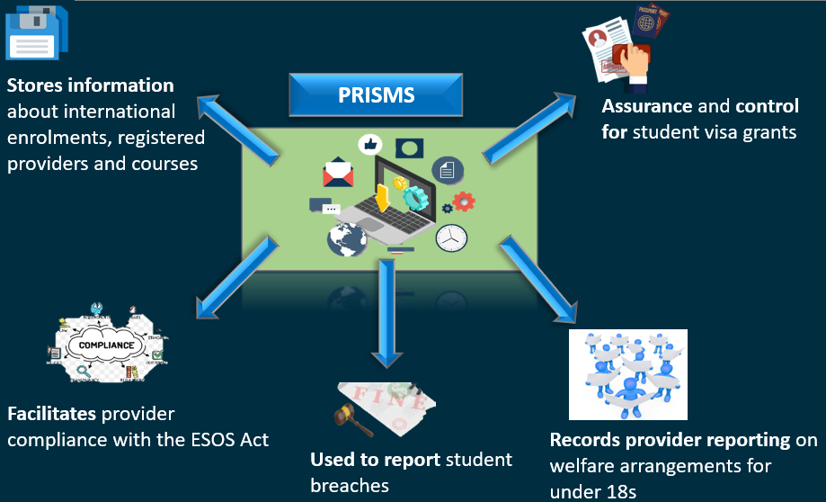
PRISMS: Introduction
PRISMS Quick Stats
PRISMS
Currently, there are:
> 7,000 active users
> 1,300 registered providers
In 2019, there were approximately:
999,000 enrolments (CoEs) created
550,000 variations (SCVs) created
Approx. 755,000 students
In 2021, there were approximately:
680,000 enrolments (CoEs) created
515,000 variations (SCVs) created
Approx. 570,000 students

Slide 8


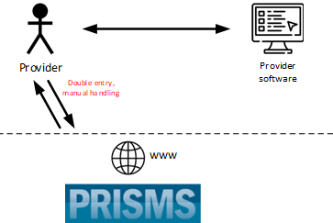
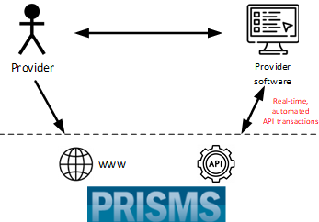
PRISMS: Current & Future
Future
Benefits
The enhancement of the PRISMS application make it easier for providers to submit student enrolment data by using the Business to Government (B2G) Application Programming Interface (API) automation.
The new integration capability is expected to:
  save the sector an estimated $10 million in regulatory compliance costs each year
  improve the timeliness and accuracy of PRISMS reporting
  aid in the sustainable sector recovery post COVID-19
  reduce double data handling for providers to improve business efficiencies.

Slide 9



The vision – CoE creation
You are in your admissions system or student management system.
At the point where you would normally log in to PRISMS to create a CoE, you might instead click a ‘Create CoE’ button.
The system would then input relevant data from your system to PRISMS then PRISMS would return any validations or warnings.
Once the validations are cleared in your system, you’d send it back to PRISMS to ‘Create CoE’.
If successful, PRISMS will create an approved CoE, then send back the CoE code and certificate to your system.

Slide 10

PRISMS: Implementation Plan
Project Planning and Scheduling
Discovery and Solution Architecture
Ongoing API releases and sector onboarding
Jul-Aug 2022
Jul-Dec 2022
Jul 2023- Jun 2024
1
1
2
3
1
2
3
4
Aug 2022 –
Jul 2024
Jan 2023 –
Jun 2024
Jan 2023 –
Jun 2024
Jun 2024
Stakeholder Consultations
Agile Development and co-design
Onboarding Support Workshops
API as BAU
Project Phase 1 | Project Phase 2 | Project Phase 3 | Project Phase 4
Establishment | Implementation | Transition | BAU

Slide 11
PRISMS Modernisation Survey Responses
PRISMS Modernisation Survey Responses
1344
Registered CRICOS Providers
961,423
CoEs Created in 2019 by registered CRICOS providers
510,879
SCVs Reported in 2019 by registered CRICOS providers
1,472,522
CoEs and SCVs Combined Reported in 2019 by registered CRICOS providers
49.93%
Survey Response Rate
67.88%
% of CoEs Created in 2019* by respondent providers*
68.55%
% Of SCVs Reported in 2019* by respondent providers*
68.10%
% Of CoEs and SCVs Combined Reported in 2019* by respondent providers
Notes:
Survey data as at 21 July 2022

Slide 12
Intention to use API by Provider Main Sector
Intention to use API by Provider Main Sector
Notes:
As at 25 July 2022

Slide 13
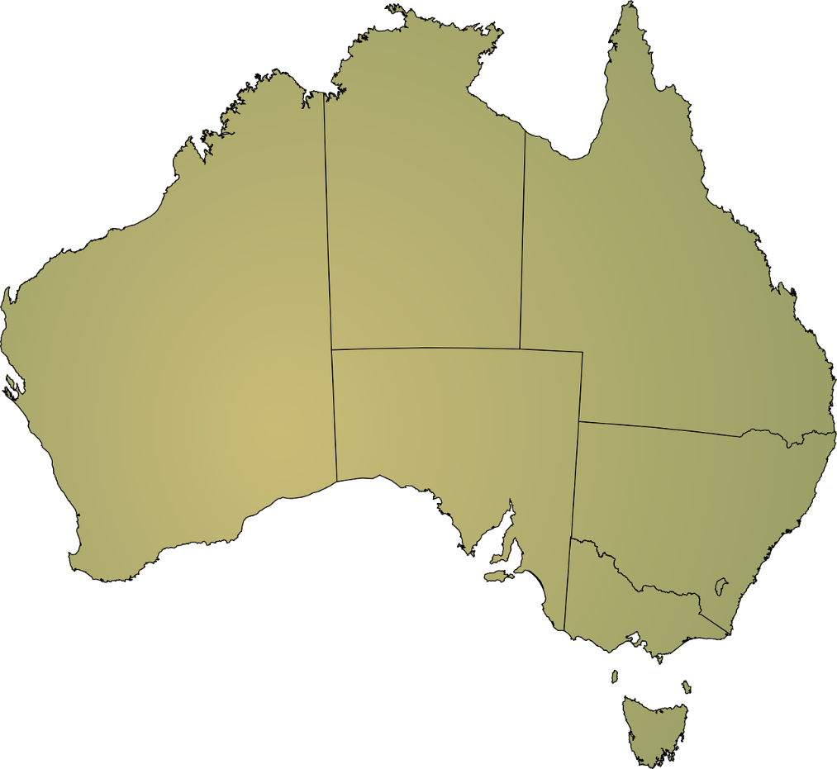
Provider Visits – Penetration by State
Provider Visits – Penetration by State:
3 Providers
8095 Transactions
49 Providers visited
430,058 Transactions
(56.9% of target)
8 Providers
74,271 Transactions
430,058 transactions
Target: ≈ 756,000 transactions
8 Providers
116,842 Transactions
10 Providers
34,537 Transactions
11 Providers
163,335 Transactions
8 Providers
32,978 Transactions

Slide 14
Provider System Usage
Sample Size: 682 Providers
Admissions Management
System
Student Management
System
15 providers
(2%)
59002 transactions
(5.7%)
197 providers
(28.9%)
606,273 transactions
(58.4%)
398 providers
(58.4%)
368,081 transactions
(35.5%)
72 providers (10.6%)
4168 transactions (0.4%)

Slide 15



ESOS Reporting Future State
Provider Systems
PRISMS Web UI
PRISMS
PRISMS API
Admission Management Systems
CoE Creation
Provider
Users
Enrolment Change Management
Student Details Management
Student Management Systems
Welfare Management
Agent Management
Course Management
Agent Management Systems
Contact Management
User Account Management

Slide 16
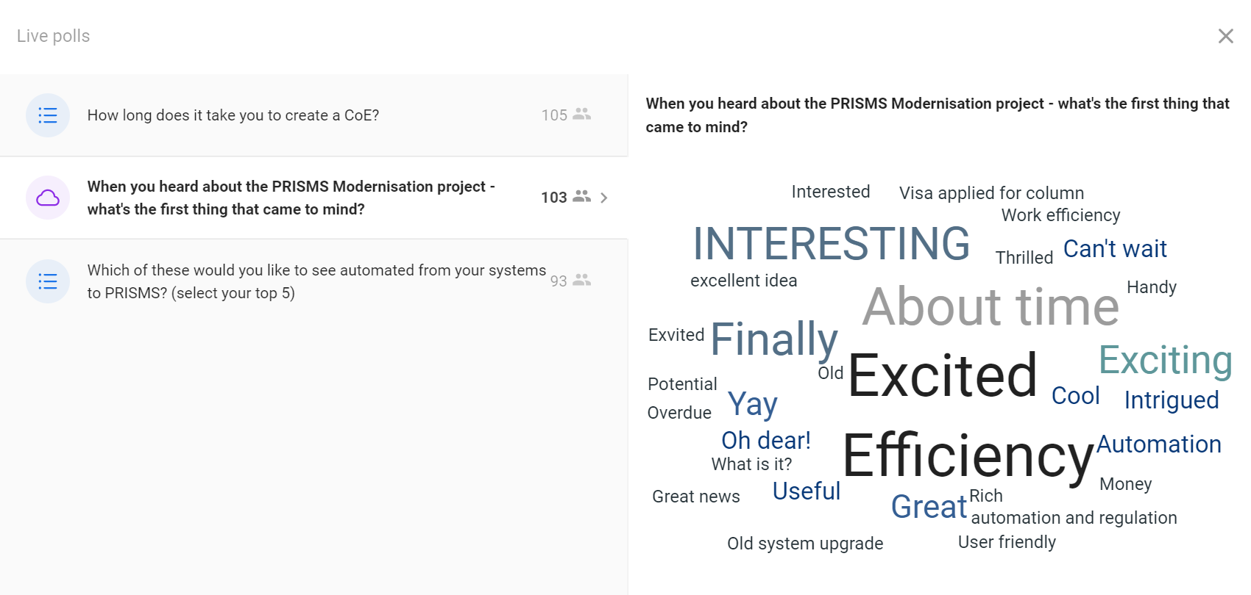
SLIDO questionnaire results from 2022 AIEC presentation

Slide 17
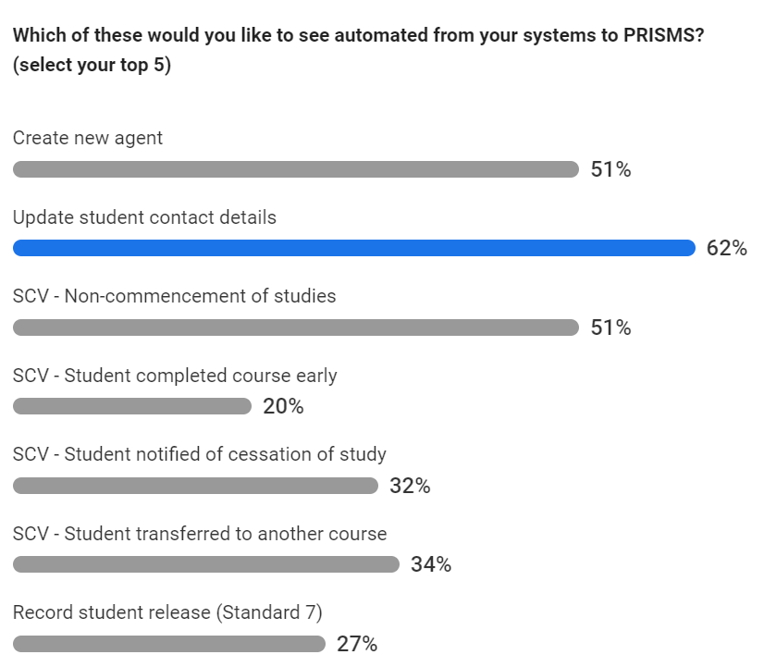

Slide 18
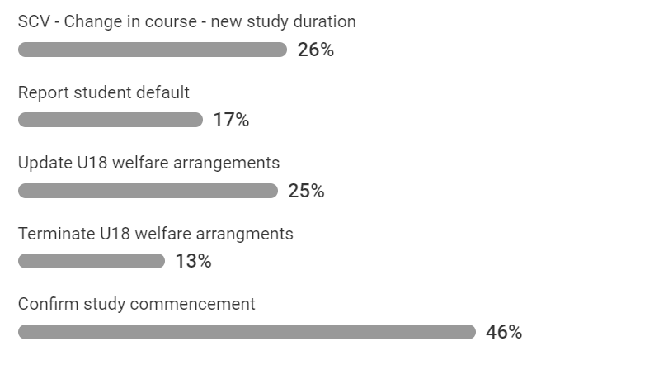

Slide 19
Key messages from CRICOS providers:
Majority in favour of an API for data entry. Providers can see the benefit
Providers will look to us to approach their vendors
Providers want us to understand the impact on their business processes
Some providers are concerned that using the API will be mandatory – FACT: the PRISMS website will remain operational
Providers stressed the importance of a good test strategy and a test environment before implementation
Notes:
Survey data as at 21 July 2022

Slide 20
Next steps:
Technical working group continuation –
  January will be Technical Working Group 2
  Technical Working Group will be held monthly thereafter
Look out on the PRISMS news page – or subscribe if you haven’t already.
Key dates:
March – April 2023 - test environment and documentation for CoE creation by API available.
August 2023 - live release of CoE create by API.
September 2023 - June 2024 - regular releases of additional API functionality, ongoing technical support with API transition phase

Slide 21
Thank you!
Questions?
Contact prismsAPI@education.gov.au

Slide 22
PRISMS Modernisation Project
Technical update – 30 November 2022

Slide 23
Introduction
Delivery approach
Framing the problem
Current state interactions
Assumptions
Authentication and Authorisation
Next steps

Slide 24
Introduction to the Delivery team
We sit within Digital Services Division in Department of Employment and Workplace Relations (DEWR)
Manage IT solutions on behalf of the Department of Education
Multi-disciplinary delivery team to deliver this project
Provider and vendor engagement and consultation managed out of the business team in Department of Education

Slide 25
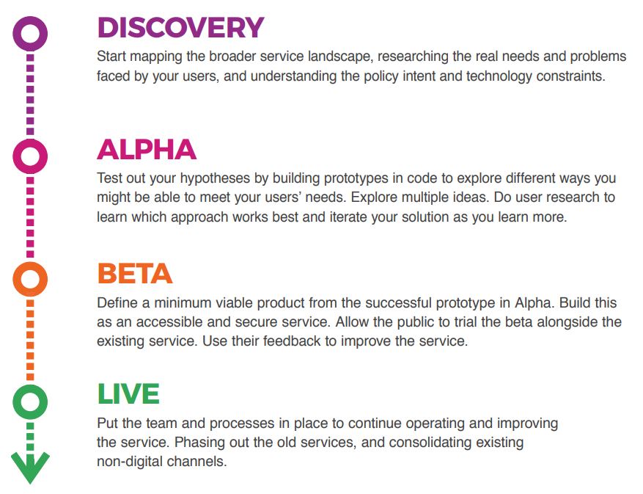
Delivery approach

Slide 26
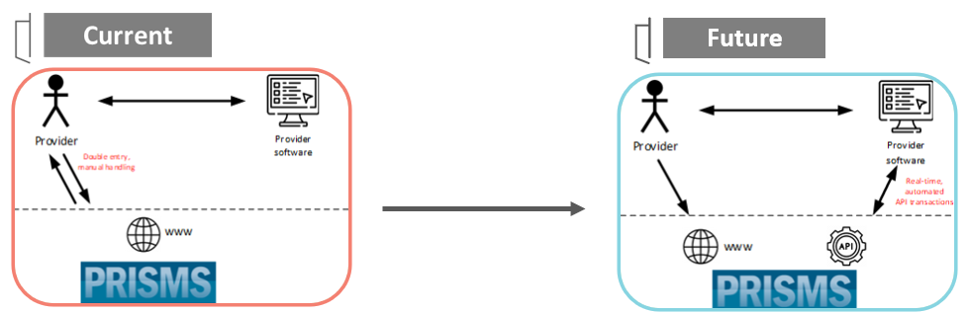
What’s the problem we’re trying to solve?

Slide 27
PRISMS Stakeholders

Slide 28
Assumptions and challenges
The existing PRISMS UI would remain in place after API implementation​
Redevelopment of the existing PRISMS platform and capabilities was not in scope for the initial phase of discovery and development​
No change to existing legislative requirements or reporting
Aligning with whole of government guidance as part of design and development
Initial focus will be on API capabilities to support CoE creation
​

Slide 29
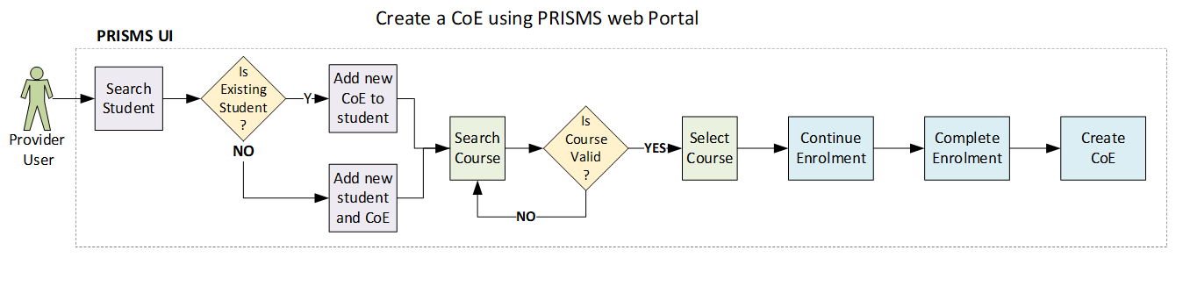
Initial focus – CoE Create

Slide 30
Initial focus – Approved CoE Create
Focus of current work
Defining the data flows and validations that underpin the UI process
Defining the data entities
Developing API specifications based on the CoE Create service flow

Slide 31
Authentication and Authorisation
Authentication and authorisation approach based around some key concepts
Alignment with Whole of Government approach​ and guidance
Analysis of existing authentication models in place in the department with a focus on opportunities for alignment and re-use
Leverage modern OpenID/Connect and OAuth2.0 flows.

Slide 32
Questions?
Contact prismsAPI@education.gov.au

