Slide 1
Draft 2023 TPS Levy - International
September/October 2022
Melinda Hatton, TPS Director

Slide 2
Purpose of the Tuition Protection Service (TPS)
TPS Director and the TPS Advisory Board
Levy settings – legislation and guiding principles
Levy components
Key changes for 2023
Levy collection process and timeframe
Quick recap – income declaration
Agenda

Slide 3
Purpose of the Tuition Protection Service (TPS)
Australian Government initiative, supported by federal Department of Education
Student tuition fee protection scheme
Developed for international student fee protection in 2012 and expanded to specified domestic students since 2020
Safeguards Australia’s reputation as an education destination
Supports registered education providers to understand and meet student obligations
Supports students with refunds/loan re-credits or facilitates new education course placements.
Manages levy collections from registered education providers and maintains special accounts

Slide 4
Legislative Authority for the collection of the TPS Levy – The Tuition Protection International levy
Education Services for Overseas Students (ESOS) Act 2000 https://www.legislation.gov.au/Details/C2022C00066

Slide 5
TPS Director role and function
Statutory Office Holder appointed by the Australian Government
Operational oversight - The TPS Director oversees the operation of the TPS. This includes the operation of the student placement system, payments to alternative education providers for accepting students affected by an education provider default, and refunds to students where appropriate.
TPS Levies - The TPS Director is responsible for the TPS annual levy collections from eligible International and Domestic VET and Higher Education providers.
TPS Levy Special Accounts - the TPS Director is responsible under the law to manage collected TPS Levies in Special accounts. The TPS Director needs to ensure that these accounts are able to meet any drawdowns required as a result of an education provider default.

Slide 6
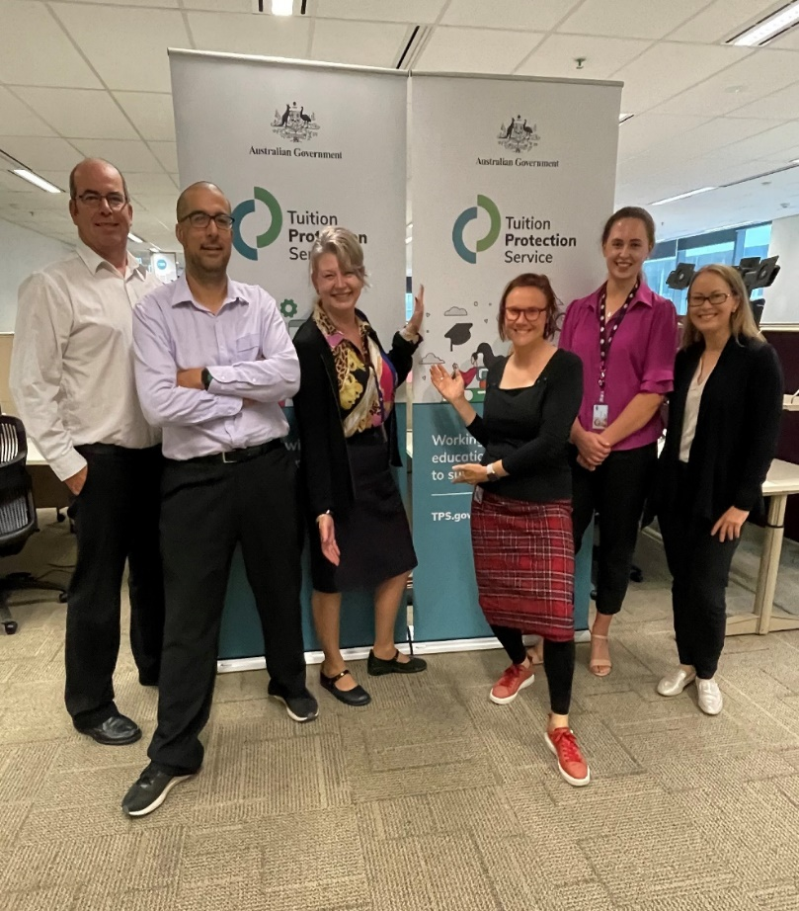
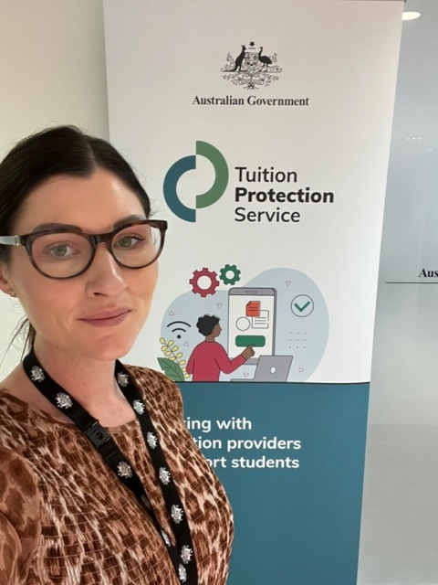
TPS Operations team
We are a small team of about 14 dedicated professionals located in Canberra in the DESE building– most are camera shy but all are always ready to assist!

Slide 7
TPS Advisory Board
Chair – Ms Helen Zimmerman (international education consultant)
Deputy Chair – Dr Kevin Donnelly AM (education academic)
Ms Jenny Lambert (education industry policy specialist and advocate)
Mr Phil Honeywood CEO, International Education Association of Australia
Dr Elizabeth Deane (academic and higher education consultant)
Prof Warren Bebbington AM (academic)
Mr Stephen Moir Group CEO, Motor Trade Association of Western Australia
Mr Guy Thorburn Australian Government Actuary
Mr Peter Kohlhagen General Manager, Australian Prudential Regulation Authority
Mr Libor Pelecky First Assistant Secretary, Commonwealth Department of Finance
Ms Anne Vickers Commonwealth Department of Home Affairs
Ms Karen Sandercock First Assistant Secretary, Commonwealth Department of Education
View board member profiles at
www.tps.gov.au

Slide 8
TPS [International] Levy Drafting and Instruments
Education Providers pay annual levies commensurate with their size and risk.
TPS Levy Instruments - The TPS Levy is determined in legislative instruments which are made under the power delegated by the Parliament. The levy instruments state the methodology used to calculate the levy component amounts that education providers will be required to pay and also describes any changes in the methodology.
Levy drafting - Following advice from the TPS Advisory Board the TPS Director will set the risk rated premium and special tuition protection components of the levy. The responsible Minister sets the administrative and base fee component of each levy.
Authorising the TPS Levy Instruments – The TPS Director and Department of Education manages the drafting of the TPS Levy instruments and ensures that they are made into law in accordance with the relevant TPS Levy legislation.
Links to the TPS Levy Instruments are available on www.TPS.gov.au.

Slide 9
The TPS Advisory Board offered its draft advice to the TPS Director on the 2023 TPS International Levy on 24 August 2022.
The draft advice can be viewed under Resources on the TPS website.
Now open for sector feedback on 2023 TPS [International] Levy settings until 7 October.
The TPS Advisory Board will consider the sector feedback before offering its final advice to the TPS Director at its 26 October meeting.
Draft 2023 TPS International Levy

Slide 10
TPS Advisory Board Levy Setting Guiding Principles
Advice should reflect the overall risk environment and ensure that revenue sustains the relevant fund, while also being sustainable for the industry.
The model for each levy should reflect gradual change and assist the industry with business planning by providing a stable regulatory environment.
The model should be as simple and transparent as possible, preferably based on a small number of risk factors.
Risk premiums should provide incentives for providers to adopt positive behaviours.
Additional imposts on industry, such as data collection, should be minimised as far as possible, consistent with the ability to set sound risk-based levies.

Slide 11
The TPS Levy Framework
The Australian Government Actuary (AGA) developed the levy framework.
The AGA provides advice on the levy methodology to ensure the arrangements are financially sound.
The TPS levies for each year have several components which are set in separate legislative instruments - the administration and base, the risk rated premium and the special component.
Providers operating across the Higher Education, VSL and international education sectors pay separate levies for each sector. Independent levy amounts will be calculated based on data for each sector, and levies may be collected at different times during the year.
The levies collected are held in sector-specific quarantined accounts and used to fund ongoing tuition protections for students and providers of each specific sector only.

Slide 12
Risk Rated Premium Component
5 risk factors:
Risk Factor 1 – Base risk factor
Risk Factor 2 – Length of operation
Risk Factor 3 – Volatility in overseas student enrolments
Risk Factor 4 – Maximum overseas source country concentration
Risk Factor 5 – Non-compliance and registration renewal

Slide 13
Risk Rated Premium Component
draft setting recommended for 2023 Risk Rated Premium component
0.04%
Specified percentage for the year
Increase factor for the risk factor for the year
Provider’s overseas student tuition fees for the previous year
X
X

Slide 14
Special Tuition Protection Component
The TPS Advisory Board recommended that the specified percentage for the Special Tuition Protection Component of the 2023 TPS International Levy be set at zero.
This component is to be charged where the funds are below their target size - builds the funds reserve and contributes to TPS operational costs.
The funds are currently at the lower end of the target range advised by the Australian Government Actuary so this component does not need to be charged at this point in time.

Slide 15
Special Tuition Protection Component
draft setting recommended for 2023 Special Tuition Protection component
0%
Specified percentage for the year
Provider’s overseas student tuition fees for the previous year

Slide 16
Setting the 2023 TPS International Levy
The TPS Advisory Board considers a number of issues when formulating its advice, including:
The strategic risk environment
Advice from the Australian Government Actuary (AGA)
Views of the sector regulators and industry peak bodies
Continuing impacts of the COVID-19 pandemic
The waiver of 2022 TPS International Levy
The quantum of funds required for the long-term sustainability of the Overseas Students Tuition Fund (OSTF).

Slide 17
TPS Advisory Board recommendations for 2023 TPS International Levy
The TPS Advisory Board has recommended changes to Risk Factor 3 – Volatility in overseas student enrolments
to reinstate the risk factor for negative student volatility and set the risk scores higher than they were prior to the pandemic
waive the loading for positive student volatility by setting the factor for positive volatility to zero.

Slide 18
TPS International Levy
Components & Authorities

Slide 19
TPS International Levy Components
Settings as recommended by the TPS Advisory Board
Four components | Draft settings | Notes
Administrative fee Source: Australian Government Actuary Report on International Levy to the TPS Advisory Board, Aug 2022 | $92.74 per provider plus; and $0.48 per 2022 student enrolments | Rates are set by the Minister under the TPS Levy Act, indexed in line with the CPI. 2021 TPS Levy Determination Explanatory Statement: The Minister is making a determination to set the fixed fee and per enrolment components of the administrative and base fee components to zero. It is anticipated that this reduction will be a one-off reduction to the Fund and the Minister will reconsider the fee settings for the 2023 TPS levy collection next year.
Base fee Source: Australian Government Actuary Report on International Levy to the TPS Advisory Board, Aug 2022 | $186.30 per provider plus $1.18 per 2022 student enrolments | Determined annually by responsible Minister
Risk rated premium | 0.04% | Determined annually by the TPS Director Paid by non-government (private) providers
Special tuition protection | 0% | Imposed at the discretion of the TPS Director. Intended to be applied countercyclically to build up a buffer in the OSTF.
Notes:
These are the recommended settings as advised by the Australian Government Actuary in his report to the TPS Advisory Board.

Slide 20
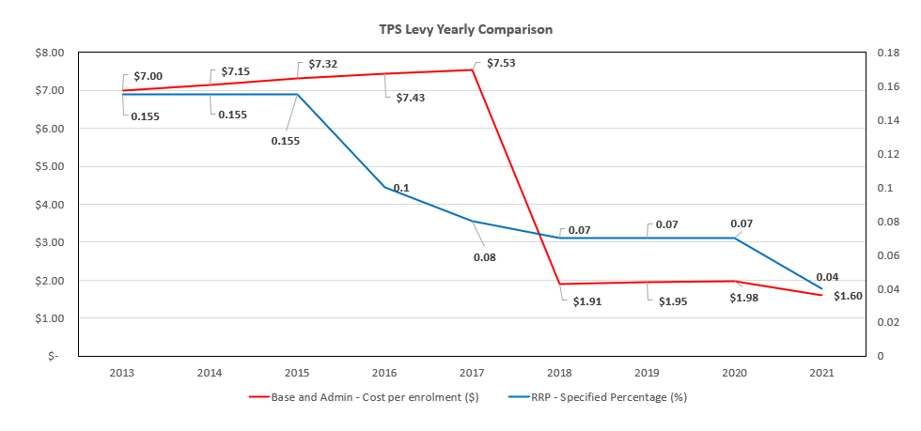
TPS International Levy Rates (up to 2021)

Slide 21
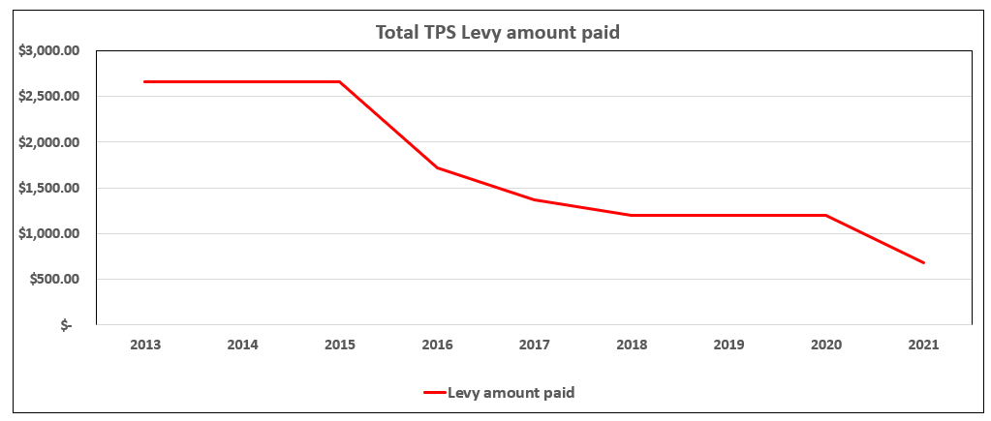
Risk Rated Premium – Provider Average Payment

Slide 22
2023 International TPS Levy – Key Dates
2022 2023
August
September
October
November
Dec/Jan
Feb/Mar/Apr
24 Aug: Draft advice on International Levy confirmed at TPS Advisory Board meeting
Early Sept: draft advice posted on TPS website and feedback opens
Info sessions in Sydney Perth, Melbourne, Brisbane, and Adelaide
Meetings with peaks and industry reps in each state around info sessions.
5 Oct: Online information session for providers
7 Oct: Feedback on TPS International Levy closes
26 Oct: Advisory Board finalises TPS International Levy settings
Late Oct: PRISMS reporting and data update request
11 Nov: Final levy advice published on TPS website
30 Nov: Legislative instrument drafted and sent to Treasurer
Dec: Reminder
to finalise PRISMS data
31 Dec: Legislative instrument must be made
Early Jan: Published on TPS website
Feb: Providers supply Income declaration
April: Invoices sent
May: Levy collected

Slide 23
Overseas Student
Tuition Fee
Income Declaration
Must be declared by the Principal Executive Officer (PEO) or their nominated representative.
Income declaration due date: March 2023

Slide 24
Overseas Student Tuition Fee Income Declaration
Overseas student tuition fees for a registered provider for a year is the amount of tuition fees received by the provider during the year in respect of an overseas student or intending overseas student (section 4 - Education Services for Overseas Students (TPS Levies) Act 2012).
Only declare overseas student tuition fee income received from overseas or intending overseas students on a student visa for the 2022 calendar year.
Ensure your PEO and E-Business contacts and student enrolment data in PRISMS are up-to-date
Notes:
intending overseas student means a person (whether within or outside Australia) who intends to become, or who has taken any steps towards becoming, an overseas student – this could be by either paying a provider tuition fees, receiving a CoE or commenced the process of obtaining a student visa.

Slide 25
Overseas Student Tuition Fee Income Declaration
Please do not include income from:
Students on other visa types
Books or equipment sold to the student
Health insurance
Administration fees
Accommodation
Assisting the student to apply for a hold or a student visa.
All refunds paid to students during the 2022 calendar year should be deducted from the overseas student tuition fees prior to declaration.
A detailed description of what should and should not be included in tuition fees can be found in section 7 of the Education Services For Overseas Students Regulations 2019.

Slide 26
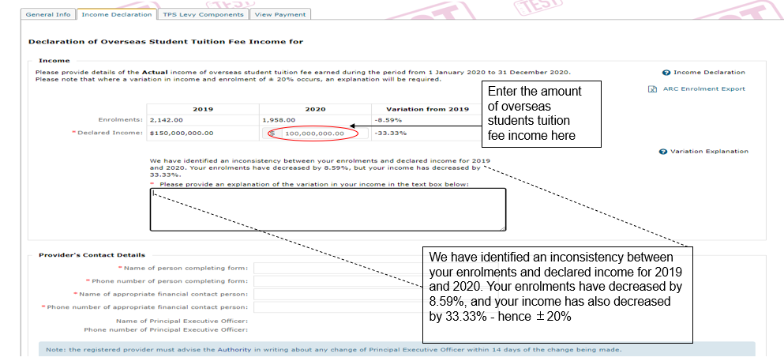
Income Declaration Screens – 1 (2021 example)

Slide 27
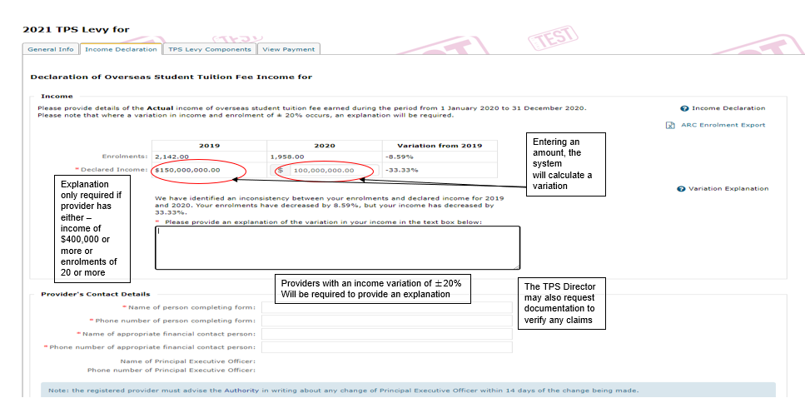
Income Declaration Screens – 2 (2021 example)

Slide 28
Resources
Education Services for Overseas Students Act 2000 (ESOS Act) Section 26 outlines the disclosure obligations requirement on providers regarding the TPS Levy.
Education Services for Overseas Students (TPS Levies) Act 2012 & Education Services for Overseas Students (TPS Levies) (Administrative and Base Fees) Determination 2021 outlines how the base and administrative fees are calculated.
Education Services for Overseas Students (TPS Levies) (Risk Rated Premium and Special Tuition Protection Components) Instrument 2021 sets out the method of calculating the risk rated premium component of the TPS Levy.

Slide 29
W: tps.gov.au
E: operations@tps.gov.au
Contact Information

